Slide 1


CORPORATE SOCIAL RESPONSIBILITY REPORT SELECTA
2023

Slide 2

SELECTA
JUNE 2024
CORPORATE SOCIAL RESPONSIBILITY REPORT 2023
INTRODUCTION
Dear reader,
As I reflect on the past year, I am filled with pride and optimism for the future of Selecta. Our journey has been one of continuous growth and innovation, always driven by our commitment to sustainability and creating moments of joy for our clients and consumers. At Selecta, we are not just participants in the industry; we are leaders, setting new standards and inspiring positive change.
Our mission is simple yet profound: to make people feel great millions of times a day by offering delicious food and drinks, whether at the workplace or on the go. This mission is at the heart of everything we do, guiding our actions and decisions. Our vision is to be the world-class distributor for world-class brands, a goal we strive for with passion and dedication.
In 2023, we have made significant strides in our Corporate Social Responsibility (CSR) strategy, focusing on three core pillars: People, Planet, and Product. These pillars represent our commitment to enhancing the well-being of our associates, clients, consumers, and the communities we operate in. Through initiatives such as fair trade practices, community development projects, and inclusive workplace policies, we aim to improve lives and foster a culture of respect and equality.
Environmental stewardship is at the heart of our CSR strategy.
We are committed to reducing our carbon footprint, conserving natural resources, and promoting biodiversity. Our initiatives include reducing single-use plastics, improving energy efficiency, and supporting reforestation projects. By implementing sustainable practices, we protect the planet for future generations.
We also ensure that our products are sourced and produced sustainably. From ethically sourced coffee beans to eco-friendly packaging, we prioritize quality and sustainability. Our partnerships with certified suppliers and adherence to rigorous standards guarantee that our products not only taste good but also do good.
Our journey towards sustainability is a collaborative effort. We believe that everyone involved in our journey has the power to make a difference. Whether it's our associates, suppliers, clients, consumers, or guests, each plays a crucial role in driving sustainable change. Together, we can create a ripple effect of positive impact, one sip, one coffee at a time.
As we navigate the evolving regulatory landscape, with new directives such as the Corporate Sustainability Reporting Directive (CSRD) and the European Union Deforestation Regulation (EUDR), we remain dedicated to staying ahead. We ensure our practices and reporting are robust, transparent, and aligned with these standards. This commitment helps our clients navigate new regulatory landscapes, ensuring compliance and enhancing their sustainability performance.
Looking ahead, we are excited about the opportunities that lie before us. We will continue to leverage our ESG performance in communication, maintaining full accountability and transparency. By sharing our progress, we build trust and highlight our commitment to leading by example in the journey toward a sustainable future.
In 2024, our commitment to the Science Based Targets initiative will align with our vision of joining forces with our partners in the food tech sector to combat climate change, positioning Selecta as a forward-thinking leader in sustainability. Through this cooperative effort, we will set and achieve ambitious targets that drive innovation, reduce operational risks, and build trust with our stakeholders and clients. By working together, we aim to strengthen our industry and contribute to a more resilient society.
In closing, I want to express my heartfelt gratitude to all our stakeholders for their unwavering support and commitment. Together, we will continue to pioneer progress, drive positive change, and create a sustainable future for all.
Thank you for being a part of our journey.
Warm regards,
Christian Schmitz
CEO, Selecta Group

Slide 3

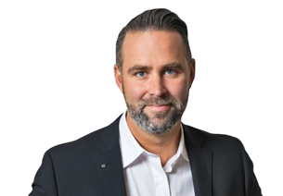

SELECTA
JUNE 2024
CORPORATE SOCIAL RESPONSIBILITY REPORT 2023
INTRODUCTION
In my role as Selecta’s Environmental Specialist, I am dedicated to a philosophy of environmental stewardship, recognizing the Planet as our main stakeholder and envision sustainability as a service to both others and Selecta, acknowledging the interconnectedness within the ecosystem we inhabit. This broader perspective drives our work, centred on understanding and collaboration.
At Selecta, we navigate our sustainability efforts by blending eco-conscious practices with a profound understanding of our operational processes and the technical feasibility of innovation. This synergy leads us to solutions that align Selecta and its stakeholders toward a shared goal: creating mutual value while preserving the ecosystem we inhabit. And, as genuine sustainability truly begins with accountability, we are committed to complete transparency regarding our progress every step of the journey.
Each day, our sustainability team is driven by a vision we collectively envisioned and are actively building today. Through our dedication to understanding the needs of our clients, transparency with our stakeholders, and innovation in the solutions we offer, we continue to daily lay the very foundation of meaningful contributions that benefit our Planet and Communities.
Adrian Mourarach
Environmental Specialist Selecta Group
As the Commercial Value Director at Selecta Group, my primary responsibility is to identify what is truly valuable for our business, and more importantly, what brings value to our clients and consumers. By gaining this understanding, we can forge sustainable partnerships and cultivate long-term relationships, which are essential to us at Selecta.
Joining forces with the sustainability team and the commercial team ensures that we not only adhere to our internal strategies related to ESG targets, regulations, and commitments but also deeply understand our clients' needs. This collaboration allows us to become the partner of choice for our clients, supporting their goals with straightforward and effective sustainability initiatives.
Sustainability should not be confined to a distant reporting framework; it should be a concept that everyone can grasp and contribute to. By working closely with our clients, we can achieve clear and measurable impacts, making sustainability a joint effort with tangible benefits for all.
Andreas Fetscher
Commercial Value Director Selecta Group
Sustainability is a vital part of our company's journey and responsibility. The essence of sustainability can best be illustrated through the four elements: water, sun, wind, and fire.
Water represents life and purity. Just as water is essential for life, our commitment to sustainability is essential for the longevity and health of our planet. We aim to minimize waste and ensure that our operations are as clean and efficient as possible. The sun symbolizes energy and growth. By harnessing renewable energy sources and optimizing our energy use, we can power our future without depleting the Earth's resources. This is crucial for fostering growth that is both robust and responsible. Wind signifies change and innovation. Embracing sustainable practices means continuously innovating and adapting to new technologies and methods that reduce our environmental footprint. It is about staying ahead of the curve and leading by example in our industry. Fire embodies passion and transformation. Our passion for sustainability drives us to transform our business practices and inspire others. We are committed to making bold changes that will have a lasting positive impact on our environment.
"We are all in this together and we can only save the planet together¹" By embracing sustainability, we are not only protecting our planet but also building a resilient and responsible business that future generations can be proud of. With a team of 6,500 strong, each one of us has a role to play in this journey.
Tanya Joustra
Group Marketing Director Selecta Group

Slide 4



SELECTA
JUNE 2024
CORPORATE SOCIAL RESPONSIBILITY REPORT 2023
SUSTAINABILITY METRICS
 |  |  | TOPICS | PROOF OF COMMITMENT |  | ACHIEVEMENTS 2023 | OUR JOURNEY AHEAD
PLANET | Pioneering the fight against climate change: Achieving CO₂ neutrality for our service |  | Reduced fleet emissions | To substantiate our efforts, we have focused on fleet electrification and implementing efficiency improvements. Our achievements in 2023 are a testament to our commitment and progress in this area. |  | 402 Electric vehicles rolled out | Electric benefit cars: We plan to further expand our fleet by incorporating electric benefit cars. Telemetry for route optimization: Implementing advanced telemetry systems will enable us to optimize our routes, thereby reducing fuel consumption and minimizing emissions. This technology will play a crucial role in improving the efficiency of our logistics operations. Driver training programs: We will further introduce efficient driving programs aimed at training our drivers in eco-friendly driving techniques. 24% Of drivers have an outstanding telematics score to fuel economy and reducing carbon impact of provided service.
 |  |  | Green Energy | To demonstrate our commitment, we have focused on increasing the share of renewable energy in our operations. Our achievements in 2023 highlight our progress and dedication to this initiative. |  | 23% Renewable Energy – saving over 335 tons of CO2e | Energy needs assessments: We will conduct thorough assessments of our energy needs and the potential for integrating renewable energy sources. Green energy sourcing through PPAs: We plan to increase our green energy sourcing through Power Purchase Agreements (PPAs).
 |  |  | Smart operations | Our investment in IoT technology has already shown promising results, as evidenced by our achievements in 2023. |  | Telematics in 87% of operational vehicles Telemetry in 78% of machines | Maximizing fleet efficiency: We will ensure that our fleet operates with maximum efficiency by minimizing travel distances and optimizing routes, thereby reducing fuel consumption and emissions. Reducing resource consumption: Continued investment in IoT technology will help us further reduce resource consumption across our operations, enhancing our overall sustainability.
 |  |  | Carbon neutral future | To substantiate our efforts, we have invested in various carbon offset and removal projects within the coffee industry. These projects are crucial for balancing our emissions and contributing to global climate action. Additionally, we have incorporated renewable energy sources into our operations and enhanced energy efficiency measures. |  | 43% Decrease from 2019 base year | Monitor implementation and effectiveness: We will closely monitor the implementation and effectiveness of our carbon compensation programs to ensure they align with recognized sustainability standards. Alignment with sustainability standards: Ensuring our carbon offset and removal projects meet high standards of sustainability is critical. We will continue to work with recognized organizations to validate our efforts and maintain transparency. Targeted energy efficiency measures: We will implement targeted measures to improve energy efficiency, ensuring a more sustainable and resource-conscious approach to energy consumption.
 |  |  | Waste reduction | Our commitment to waste reduction is demonstrated by our ongoing efforts to consolidate waste management practices. |  | Pelican Rouge Coffee Roasters: 0% waste to landfill. | Scaling sustainability initiatives: In 2023, we initiated several pilot projects aimed at finding innovative ways to tackle the growing complexity of waste streams due to advancements in food technology. Our goal is to scale these initiatives in 2024 to achieve significant environmental benefits.
PRODUCTS | Through a sustainable assortment and innovative circularity projects we cover the needs of today considering the impact on tomorrow |  | Certified Coffee | For Selecta, certified coffee signifies a commitment to sustainable sourcing and growing practices. It involves reducing emissions in sourcing regions and compensating for what cannot be reduced. Ensuring that the coffee is fully certified, and farmers are paid a fair price is integral to this process. |  | 2396 tCO2e purchased | Track implementation and effectiveness: We will closely track the implementation and effectiveness of our offsetting and insetting programs, measuring the reduction in CO2 emissions from the farm to the roasted bean.
 |  |  | Recyclable packaging | Our packaging redesign initiatives, like our mono material coffee bags, are aimed at replacing non-recyclable components with sustainable alternatives. |  | 20% Packaging redesign | Increasing the proportion of mono-material packaging: By the end of 2025, we are committed to increasing the proportion of mono-material packaging in our assortment to 50%. These efforts are projected to result in a 24% reduction in CO2 emissions by 2025 compared to 2023 levels, equating to approximately 2,460 tons of CO2 saved.
 |  |  | Circular machines | Our refurbishment initiatives focus on giving a second life to our machines, thus avoiding emissions associated with manufacturing new ones. |  | 22,241 circular machines | Continue refurbishing machines: We will continue refurbishing machines at our facilities across Europe, further integrating circularity into our operations.
 |  |  | Certified Products | We are actively developing partnerships with suppliers who are committed to certified and sustainable practices. |  | Not quantified, so no metric available | Further develop partnerships: We will continue to develop partnerships with suppliers who are committed to providing certified and sustainable products, ensuring our offerings meet the highest standards.
 |  |  | Zero waste offer | Our commitment to zero waste involves detailed analysis and the implementation of pilot projects to achieve our goals. |  | Explored potential collaborations to integrate advanced recycling solutions into our operations. | Detailed reviews: We will conduct detailed reviews of client waste streams, identify opportunities for reduction and diversion, and implement pilot zero-waste initiatives to move closer to our zero-waste commitment.
PEOPLE | We are committed to the health & safety of our associates and a fair relationships with our partners and ensuring a positive social impact on the community |  | Social Impact coffee | Our efforts are focused on ensuring that 100% of Change Please‘ profits are directed towards supporting homeless individuals. |  | Partnership with Change Please | Every bag count: We aim to support individuals experiencing homelessness by ensuring that every bag and every cup of Change Please coffee contributes to providing them with opportunities for a better future.
 |  |  | Selecta Coffee Fund | Our investments aim to support farmers, improve biodiversity, and contribute to climate adaptation and mitigation. |  | 2.000+ Farmers supported 3.000 tCO2 Carbon removal potential 11.000 Shade trees planted | Comprehensive impact measurement: We will measure the comprehensive impact on farmer families, biodiversity, climate adaptation, and mitigation, ensuring our programs deliver meaningful benefits. We will also extend our carbon insetting programs, allowing more Selecta clients to embark on this opportunity.
 |  |  | Supply Chain fairness | We conduct systematic ESG risk evaluations to ensure compliance and ethical behaviour throughout our supply chain. |  | 509 Critical Suppliers Assessed | Systematic ESG Risk Assessment: We will implement systematic ESG risk assessments for all new suppliers, ensuring ongoing compliance and ethical practices.
 |  |  | Employer of Choice | Our policies and programs aim to ensure zero preventable accidents and foster a diverse and inclusive workplace. |  | 23% Women in Country Leadership roles. 43% Women in OPCO. Each enrolled employee spent, on average, 10 hours engaged in training. | Selecta D&I program: We will continue to expand our Diversity & Inclusion program. Fairness in recruiting, promotion, and compensation: We will implement and enhance policies around fairness in recruiting, promotion, and compensation to ensure an equitable workplace.

Slide 5
SELECTA
JUNE 2024
CORPORATE SOCIAL RESPONSIBILITY REPORT 2023
SUSTAINABILITY METRICS
 |  |  | TOPICS | PROOF OF COMMITMENT |  | ACHIEVEMENTS 2023 | OUR JOURNEY AHEAD
PLANET | Pioneering the fight against climate change: Achieving CO₂ neutrality for our service |  | Reduced fleet emissions | To substantiate our efforts, we have focused on fleet electrification and implementing efficiency improvements. Our achievements in 2023 are a testament to our commitment and progress in this area. |  | 402 Electric vehicles rolled out | Electric benefit cars: We plan to further expand our fleet by incorporating electric benefit cars. Telemetry for route optimization: Implementing advanced telemetry systems will enable us to optimize our routes, thereby reducing fuel consumption and minimizing emissions. This technology will play a crucial role in improving the efficiency of our logistics operations. Driver training programs: We will further introduce efficient driving programs aimed at training our drivers in eco-friendly driving techniques. 24% Of drivers have an outstanding telematics score to fuel economy and reducing carbon impact of provided service.
 |  |  | Green Energy | To demonstrate our commitment, we have focused on increasing the share of renewable energy in our operations. Our achievements in 2023 highlight our progress and dedication to this initiative. |  | 23% Renewable Energy – saving over 335 tons of CO2e | Energy needs assessments: We will conduct thorough assessments of our energy needs and the potential for integrating renewable energy sources. Green energy sourcing through PPAs: We plan to increase our green energy sourcing through Power Purchase Agreements (PPAs).
 |  |  | Smart operations | Our investment in IoT technology has already shown promising results, as evidenced by our achievements in 2023. |  | Telematics in 87% of operational vehicles Telemetry in 78% of machines | Maximizing fleet efficiency: We will ensure that our fleet operates with maximum efficiency by minimizing travel distances and optimizing routes, thereby reducing fuel consumption and emissions. Reducing resource consumption: Continued investment in IoT technology will help us further reduce resource consumption across our operations, enhancing our overall sustainability.
 |  |  | Carbon neutral future | To substantiate our efforts, we have invested in various carbon offset and removal projects within the coffee industry. These projects are crucial for balancing our emissions and contributing to global climate action. Additionally, we have incorporated renewable energy sources into our operations and enhanced energy efficiency measures. |  | 43% Decrease from 2019 base year | Monitor implementation and effectiveness: We will closely monitor the implementation and effectiveness of our carbon compensation programs to ensure they align with recognized sustainability standards. Alignment with sustainability standards: Ensuring our carbon offset and removal projects meet high standards of sustainability is critical. We will continue to work with recognized organizations to validate our efforts and maintain transparency. Targeted energy efficiency measures: We will implement targeted measures to improve energy efficiency, ensuring a more sustainable and resource-conscious approach to energy consumption.
 |  |  | Waste reduction | Our commitment to waste reduction is demonstrated by our ongoing efforts to consolidate waste management practices. |  | Pelican Rouge Coffee Roasters: 0% waste to landfill. | Scaling sustainability initiatives: In 2023, we initiated several pilot projects aimed at finding innovative ways to tackle the growing complexity of waste streams due to advancements in food technology. Our goal is to scale these initiatives in 2024 to achieve significant environmental benefits.
PRODUCTS | Through a sustainable assortment and innovative circularity projects we cover the needs of today considering the impact on tomorrow |  | Certified Coffee | For Selecta, certified coffee signifies a commitment to sustainable sourcing and growing practices. It involves reducing emissions in sourcing regions and compensating for what cannot be reduced. Ensuring that the coffee is fully certified, and farmers are paid a fair price is integral to this process. |  | 2396 tCO2e purchased | Track implementation and effectiveness: We will closely track the implementation and effectiveness of our offsetting and insetting programs, measuring the reduction in CO2 emissions from the farm to the roasted bean.
 |  |  | Recyclable packaging | Our packaging redesign initiatives, like our mono material coffee bags, are aimed at replacing non-recyclable components with sustainable alternatives. |  | 20% Packaging redesign | Increasing the proportion of mono-material packaging: By the end of 2025, we are committed to increasing the proportion of mono-material packaging in our assortment to 50%. These efforts are projected to result in a 24% reduction in CO2 emissions by 2025 compared to 2023 levels, equating to approximately 2,460 tons of CO2 saved.
 |  |  | Circular machines | Our refurbishment initiatives focus on giving a second life to our machines, thus avoiding emissions associated with manufacturing new ones. |  | 22,241 circular machines | Continue refurbishing machines: We will continue refurbishing machines at our facilities across Europe, further integrating circularity into our operations.
 |  |  | Certified Products | We are actively developing partnerships with suppliers who are committed to certified and sustainable practices. |  | Not quantified, so no metric available | Further develop partnerships: We will continue to develop partnerships with suppliers who are committed to providing certified and sustainable products, ensuring our offerings meet the highest standards.
 |  |  | Zero waste offer | Our commitment to zero waste involves detailed analysis and the implementation of pilot projects to achieve our goals. |  | Explored potential collaborations to integrate advanced recycling solutions into our operations. | Detailed reviews: We will conduct detailed reviews of client waste streams, identify opportunities for reduction and diversion, and implement pilot zero-waste initiatives to move closer to our zero-waste commitment.
PEOPLE | We are committed to the health & safety of our associates and a fair relationships with our partners and ensuring a positive social impact on the community |  | Social Impact coffee | Our efforts are focused on ensuring that 100% of Change Please‘ profits are directed towards supporting homeless individuals. |  | Partnership with Change Please | Every bag count: We aim to support individuals experiencing homelessness by ensuring that every bag and every cup of Change Please coffee contributes to providing them with opportunities for a better future.
 |  |  | Selecta Coffee Fund | Our investments aim to support farmers, improve biodiversity, and contribute to climate adaptation and mitigation. |  | 2.000+ Farmers supported 3.000 tCO2 Carbon removal potential 11.000 Shade trees planted | Comprehensive impact measurement: We will measure the comprehensive impact on farmer families, biodiversity, climate adaptation, and mitigation, ensuring our programs deliver meaningful benefits. We will also extend our carbon insetting programs, allowing more Selecta clients to embark on this opportunity.
 |  |  | Supply Chain fairness | We conduct systematic ESG risk evaluations to ensure compliance and ethical behaviour throughout our supply chain. |  | 509 Critical Suppliers Assessed | Systematic ESG Risk Assessment: We will implement systematic ESG risk assessments for all new suppliers, ensuring ongoing compliance and ethical practices.
 |  |  | Employer of Choice | Our policies and programs aim to ensure zero preventable accidents and foster a diverse and inclusive workplace. |  | 23% Women in Country Leadership roles. Gender parity in our Group OPCO. Each enrolled employee spent, on average, 10 hours engaged in training. | Selecta D&I program: We will continue to expand our Diversity & Inclusion program. Fairness in recruiting, promotion, and compensation: We will implement and enhance policies around fairness in recruiting, promotion, and compensation to ensure an equitable workplace.

Slide 6
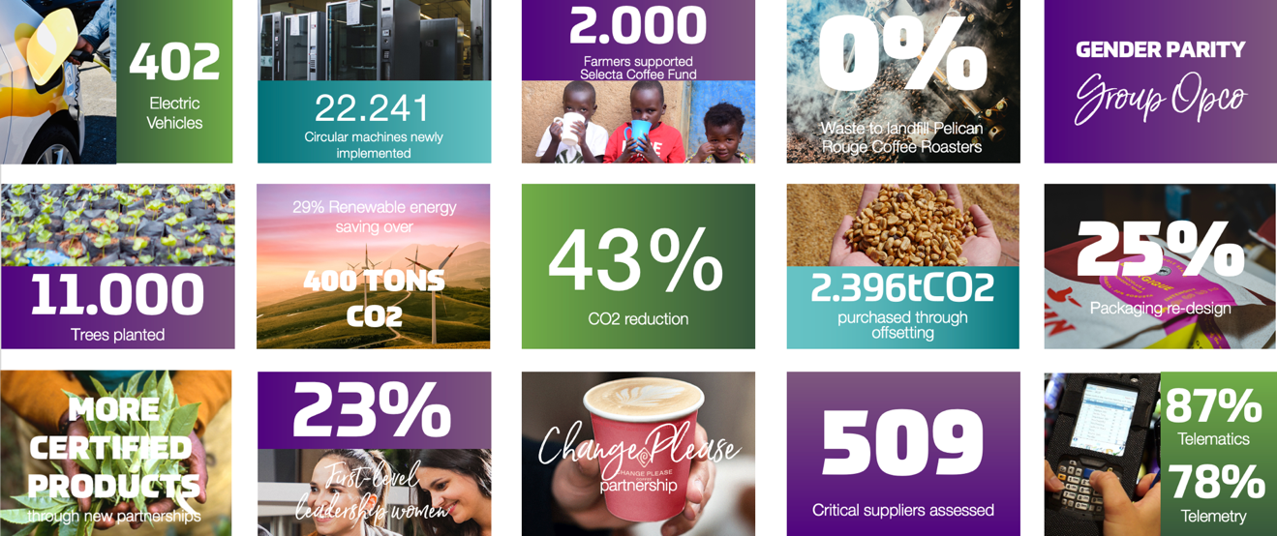
SUSTAINABILITY HIGHLIGHTS
SELECTA
JUNE 2024
CORPORATE SOCIAL RESPONSIBILITY REPORT 2023
2023 SUSTAINABILITY HIGHLIGHTS
2023

Slide 7
CONTENT
SELECTA
JUNE 2024
CORPORATE SOCIAL RESPONSIBILITY REPORT 2023
TABLE OF CONTENT
Table of
01 COMPANY PROFILE 01
Value creation 03
Vision, mission, CSR-strategy 03
Company values 05
Value creation model 06
Timeline 07
Ethics at Selecta 10
Organization and activities 11
Products and services 11
Governance 32
Associates 33
Value chain 37
Stakeholder engagement 39
Materiality matrix 42
02 PLANET 43
Reduce fleet emissions 49
Transitioning to green energy sources 50
Net-zero carbon emissions 51
Efficient operations through IoT 61
Waste reduction 65
03 PRODUCT 71
Pelican Rouge certified coffee 74
Recyclable packaging 81
Circular machines 83
Certified products 86
Zero waste offer 88
04 PEOPLE 91
Social impact coffee 94
Selecta Coffee Fund 97
Ethics in the supply chain 105
Employer of choice 107
05 QUALITY & INNOVATION 111
Panama 117
Aquablu 119
EcoJoy 120
Zero Waste 121
Made Blue 123
06 ACHIEVEMENTS, AWARDS & 125 CERTIFICATIONS
Ecovadis 126
Local certifications 127
07ABOUT THIS REPORT 129
08 ATTACHMENTS 131
GRI-table 132
Planet 132
People 133
Product 133
Sustainable initiatives timeline 134
Planet 134
People 135
Product 136

Slide 8

SELECTA
JUNE 2024
CORPORATE SOCIAL RESPONSIBILITY REPORT 2023
CHAPTER ONE
COMPANY PROFILE
PAGE 01
01
COMPANY PROFILE

Slide 9

SELECTA
JUNE 2024
CORPORATE SOCIAL RESPONSIBILITY REPORT 2023
CHAPTER ONE
COMPANY PROFILE
PAGE 02

Slide 10

VISION, MISSION, CSR STRATEGY
SELECTA
JUNE 2024
CORPORATE SOCIAL RESPONSIBILITY REPORT 2023
CHAPTER ONE
COMPANY PROFILE
PAGE 03
Value creation
About Selecta Group
Selecta is the FoodTech leader in Europe, dedicated to bringing millions of moments of joy to consumers every day. Our commitment to excellence is reflected in our innovative solutions, world-class brands, and best-in-class service across the 16 European markets we serve. We take pride in delivering joy with every coffee, bite, and smile.
Our purpose
Our mission is simple; making people feel great millions of times a day by offering delicious food and drinks anytime, whether at the workplace or on the go.
Our vision
Selecta aims to be the world-class distributor for world-class brands.
Our CSR-Strategy
Leading by example and inspiring sustainability
At Selecta, we believe that true leadership in sustainability means setting a standard that inspires others. By integrating sustainability into every aspect of our business, we aim to improve our operations and motivate collective action across different sectors and communities. Together, we can create a sustainable future that resonates with all our stakeholders and sets a new standard for environmental stewardship.

Slide 11
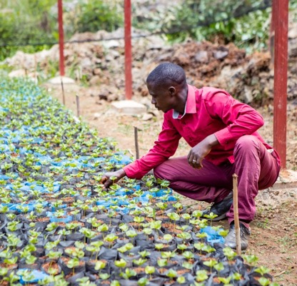
SELECTA
JUNE 2024
CORPORATE SOCIAL RESPONSIBILITY REPORT 2023
CHAPTER ONE
COMPANY PROFILE
PAGE 04
Driving positive change
As a leader in our industry, we have a unique opportunity to drive positive change. We are committed to providing innovative solutions and services that exceed environmental and social standards. Our goal is to support our clients in their sustainability journeys by offering comprehensive strategies and tools that lead to meaningful progress.
In today's world, with evolving regulations and increased transparency demands like the Corporate Sustainability Reporting Directive (CSRD), European Union Deforestation Regulation (EUDR), and the upcoming Corporate Sustainability Due Diligence Directive (CSDDD), we are dedicated to staying ahead. We ensure our practices and reporting are robust, transparent, and aligned with these standards. This commitment helps our clients navigate new regulatory landscapes, ensuring compliance and enhancing their sustainability performance. We believe global change requires a holistic approach, and we are here to facilitate this transformation.
Leveraging ESG performance in communication
Effective communication with our stakeholders is crucial. We use our ESG achievements to maintain full accountability and transparency. Sharing our progress not only builds trust but also highlights our commitment to leading by example in the journey toward a sustainable future.
Our CSR vision
Our vision is to be a leader in sustainability, inspiring positive change in the communities we serve and the world at large. We strive to create a lasting impact by integrating sustainability into our core operations, from the coffee beans we source to the products we deliver. Our commitment is to ensure that every step of our supply chain is responsible and ethical, making a difference one sip, one coffee at a time.
Our pillars of impact
Planet - environmental stewardship is at the heart of our CSR strategy. We are committed to reducing our carbon footprint, conserving natural resources, and promoting biodiversity. Our initiatives include reducing single-use plastics, improving energy efficiency, and supporting reforestation projects. By implementing sustainable practices, we protect the planet for future generations.
People - we are dedicated to enhancing the well-being of our associates, clients and consumers, and the communities we operate in. Through initiatives such as fair trade practices, community development projects, and inclusive workplace policies, we aim to improve lives and foster a culture of respect and equality.
Product - we ensure that our products are sourced and produced sustainably. From ethically sourced coffee beans to eco-friendly packaging, we prioritize quality and sustainability. Our partnerships with certified suppliers and adherence to rigorous standards guarantee that our products not only taste good but also do good.
Sustainable purchasing
Our commitment to buying sustainably means that we carefully select our suppliers based on their environmental and social practices. We ensure that every product we offer is aligned with our sustainability goals, supporting ethical production and fair trade.
Making a difference
We believe that everyone involved in our journey has the power to make a difference. Whether it's our associates, suppliers, clients, consumer or guests, each plays a crucial role in driving sustainable change. Together, we can create a ripple effect of positive impact, one sip, one coffee at a time.
Image: Selecta Coffee Fund Coffee Farmer inspecting young coffee plants
WE BELIEVE THAT TRUE LEADERSHIP IN SUSTAINABILITY MEANS SETTING A STANDARD THAT INSPIRES OTHERS

Slide 12

SELECTA
JUNE 2024
CORPORATE SOCIAL RESPONSIBILITY REPORT 2023
CHAPTER ONE
COMPANY PROFILE
PAGE 05
Value creation
COMPANY VALUES
Our values and identity
At Selecta, we are driven by a passion to bring joy to our clients and their consumers every single day. Founded on the principles of reliability, innovation, and exceptional service, we strive to create memorable experiences through our food and drink solutions, always aiming to exceed expectations.
Our purpose and commitment
Selecta's core purpose is encapsulated in our brand positioning, "Joy to Go." Reflecting our commitment to being present where and when people need us, delivering not just products, but delightful experiences one coffee, one bite, and one smile at a time. We are dedicated to ensuring that our clients and their consumers feel the difference in quality and service that we provide.
We are Selecta
We are Selecta, a company built on strong values and a clear mission. We believe in:
Upbeat and dynamic service: our tone and actions are energetic, optimistic, and future-focused. We aim to inject positivity into every interaction, ensuring that our services are both lively and reliable.
Human touch: despite being a large, international organization, we prioritize a personal and heartfelt approach. Our communications and services are designed to be personable, addressing individual needs with a warm and friendly demeanour.
Our Brand attributes
Our brand attributes guide the tone and style of all our communications:
Upbeat: energetic, optimistic, and joyful.
Dynamic: entrepreneurial, innovative, and future-focused.
Human: service-led, heartfelt, individual, and personal.
Client and consumer focus
We understand that our clients' success depends on the satisfaction of their consumers. Therefore, we emphasize a deep understanding of consumer needs and preferences, ensuring that our solutions not only meet but exceed expectations. The world-class brands and our services are designed to fuel success and enhance the daily rhythms of our clients' consumers.
Sustainability and innovation
As pioneers in sustainability, we are committed to reducing our environmental impact and supporting our clients in achieving their sustainability goals. Programs like the Zero Waste Concept and Eco Joy are testament to our dedication to creating a more sustainable future through innovative solutions.
We blend reliability, innovation, and a human touch to deliver exceptional food and drink experiences. We are here to bring joy to go, ensuring that every interaction is infused with positivity and excellence. Join us on our journey to make every day a little brighter, one cup and one smile at a time.

Slide 13

















SELECTA
JUNE 2024
CORPORATE SOCIAL RESPONSIBILITY REPORT 2023
CHAPTER ONE
COMPANY PROFILE
PAGE 06
Value creation
VALUE CREATION MODEL
Pioneering progress across all 17 sustainable development goals
At Selecta, we are not just participants in the industry; we are trailblazers. Our unwavering commitment to sustainability and innovation sets us apart, driving us to achieve what no other company in our field has accomplished. Our value creation model boldly addresses all 17 United Nations Sustainable Development Goals (SDGs), ensuring that every aspect of our operations contributes to a healthier planet and a brighter future for all.
PLANET
Joyful earth, flourishing futures
Every drop of water we save, every seed we nurture, brings us closer to a world where no one must suffer from thirst or hunger. Our actions in Burundi, Rwanda, and beyond aren't just about conservation; they're a promise to future generations that we'll leave them a planet where every life flourishes, every community thrives, and every landscape is a testament to our shared commitment to preserving the earth's precious resources.
  Clean water and sanitation - In Burundi, efforts are dedicated to rehabilitating water sources and ensuring access to clean drinking water for communities.
  Affordable and clean energy - Selecta optimizes energy usage with LED lighting, insulation improvements, and sustainable machine practices, enhancing energy efficiency and eco-friendly operations. Plus, we actively pursue the transition to green energy sources within our contracts whenever feasible.
  Climate action - Selecta's commitment includes transitioning to electric vehicles, optimizing routes, and investing in CO2 neutrality, alongside promoting plant-based products and sustainable farming to mitigate climate change.
  Life below water - Selecta's cold-water machines and recycling initiatives reduce plastic waste, indirectly aiding marine life and minimizing ocean pollution.
  Life on land - The shift to eco-friendly materials like wood, bamboo, and fibre, alongside recycling coffee waste, supports sustainable land use and biodiversity conservation.
PEOPLE
Cultivating smiles, nurturing dreams
In the heart of every farmer, in the smile of every child nourished by our efforts, lies the true impact of our work. Through our initiatives in gender equality, health, and education, we're not just changing lives; we're weaving a tapestry of hope, empowerment, and dignity that stretches from the rolling hills of Rwanda to the bustling streets of our cities. Our mission transcends beyond feeding bodies; it's about nourishing souls, uplifting spirits, and building a world where equality, health, and education are not privileges, but rights for all.
  No poverty - The Selecta Coffee Fund enhances farmer incomes in Rwanda, Burundi, Honduras, and Colombia through training and diversified income sources, focusing on living incomes and regenerative agriculture for poverty alleviation.
  Zero hunger - Selecta focuses on sustainable tea and coffee production and innovative fresh food solutions, enhancing food security and nutrition, while minimizing food waste through strategic partnerships and diversification in farming.
  Good health and Well-being - Healthier options like plant-based toppings, mental health discussions, and emphasis on health and safety in the workplace and supplier networks contribute to improved well-being.
  Quality education - The Employer of Choice Graduate Program and learning initiatives provide practical experiences and skill development for young professionals, fostering quality education.
  Gender equality - Initiatives in Rwanda and Burundi prioritize gender balance in agriculture, with training and empowerment programs for female farmers, and corporate efforts ensure a 40% female workforce.
  Decent work and economic growth - Training and agricultural improvements in Rwanda, Burundi, and Honduras enhance livelihoods and working conditions, while internal policies promote a safe and ethical work environment.
  Reduced inequalities
  Equal access for male and female farmers in Rwanda and Burundi, as well as support for the homeless through our partnership with Change Please, alongside internal diversity and inclusion programs, aim to reduce inequalities within the company and communities.
  Peace, Justice, and strong institutions - Collaborations with sustainable suppliers and the internal Speak Up program foster transparent and accountable institutions, promoting integrity and ethical conduct.
PRODUCT
Innovations for a happier planet
Each innovation, each sustainable choice we make in our products and infrastructure, is a step towards a future where harmony between humanity and nature is not just a dream, but a reality. Our commitment to responsible consumption and production is more than a corporate responsibility; it's a testament to our belief that every action, no matter how small, can spark a revolution in how we live, work, and care for our planet. In every eco-friendly package, in every energy-efficient machine, lies our pledge to a world where sustainability is the norm, not the exception.
  Industry, innovation, and infrastructure - Integrating telemetry systems, sustainable solutions like LED lighting, and innovative training modules optimize resource use and contribute to a dynamic workforce.
  Sustainable cities and communities - The Lighthouse Projects in Amsterdam and Oslo, along with route optimization and sustainable driving behaviours, support the creation of eco-friendly urban infrastructures.
  Responsible Consumption and Production - Initiatives like pre-kitting technology, shift towards eco-friendly products, recyclable packaging, and machine optimization promote responsible consumption and production practices.
  Partnerships for the goals - Collaborations with entities like Green Waste and Caffee Inc., along with partnerships in community initiatives and disaster relief, demonstrate a commitment to cooperative and sustainable solutions.

Slide 14




SELECTA
JUNE 2024
CORPORATE SOCIAL RESPONSIBILITY REPORT 2023
CHAPTER ONE
COMPANY PROFILE
PAGE 07
Sustainability initiatives
TIMELINE
EMBRACING CIRCULAR ECONOMY & SMART TECHNOLOGY
2020
2018
PIONEERING SUSTAINABILITY & INNOVATION
Plastic Reduction: reduced plastic cups from 49% to 33%, initiated the CIRCUP project
Smart technology: installed 9,300 additional smart vending machines
Machine refurbishment: 47% of vending machines refurbished
Electric fleet: renewed policy aiming for a fully electric fleet by 2030
Community support: partnered with OLIO and AUARA to support communities
Sustainable coffee: increased sustainably certified green coffee to 57%
Food solutions: operated the first Foodies Micro Markets
Ethical sourcing: renewed the Supplier Code of Conduct
Sustainability approach: launched a group-wide sustainability strategy with stakeholder collaboration.
Eco-Friendly Initiatives: ensured all cups were recyclable and PEFC certified
Energy efficiency: transformed 873 tons of biowaste into electricity, introduced telemetry and pre-kitting, and started a green mobility project
Technological advancements: 60% of machines equipped with energy-saving options, 135,000 machines switched to LED lighting
Community support: supported Juegaterapia Foundation, Jack O’Donnell Foundation, and launched the ‘Vägen In’ program in Sweden
Workforce diversity: 30% of workforce were women, 90% associates held permanent contracts.
Ethical sourcing: 45% of coffee ethically sourced, 40% of Miofino Rwanda beans from Bufcoffee.
Refurbishment: 44% of 450,000 machines refurbished
2018
ADVANCING SUSTAINABILITY & COMMUNITY ENGAGEMENT
Machine refurbishment: installed 23,000 refurbished vending machines, making up 43% of new installations.
Waste reduction: launched a cup reuse pilot in Switzerland
Smart technology expansion: expanded the network of smart vending machines to 94,000
Green mobility: operated a fleet of 6,900 vehicles, initiating green mobility projects in Sweden, the Netherlands, and Spain
Employee engagement: conducted the first group-level survey with a 73% response rate
Ethical reporting: launched Selecta AlertLine and established a Code of Conduct
Community support: supported ‘Knæk Cancer’ in Denmark and other community initiatives
Sustainable sourcing: roasted 15,000 tonnes of coffee, 52% certified
Human rights: conducted a human rights impact assessment
2019

Slide 15




SELECTA
JUNE 2024
CORPORATE SOCIAL RESPONSIBILITY REPORT 2023
CHAPTER ONE
COMPANY PROFILE
PAGE 08
2021
REDUCING CARBON FOOTPRINT & ENHANCING SUSTAINABILITY
Carbon reduction: set targets and reduced Scope 1 & 2 emissions from 49,142 to 37,270 metric tons CO₂-e
Route optimization: saved 206 metric tons of CO₂ through route optimization
Electric fleet transition: committed to fully electric fleet by 2030 for new orders
Awards: received the Swisscom IoT Climate Award
Biogas production: developed biogas from coffee grounds in Italy
Ethical reporting: launched Speak Up Program
Training initiatives: implemented Needs-Based Solutions training
Reusable cups: launched the ‘Use me again’ campaign
Supplier assessment: deployed a supplier assessment tool in Sweden
Certified coffee: 58% of coffee certified by Fairtrade or UTZ/Rainforest Alliance
2022
ACCELERATING SUSTAINABILITY & COMMUNITY SUPPORT
CO2 emissions reduction: achieved 75% reduction in Scope 1 and 2 CO2 emissions from 2019 levels
Fleet efficiency: reduced fleet from 5,071 to 4,785 vehicles.
Energy investment: invested €150,000 in energy-efficient LED lighting.
Machine refurbishment: refurbished 13,961 machines across Europe.
Belief System: integrated a Belief System with daily commitments.
Diversity & inclusion: launched a Diversity & Inclusion Program, increasing women in leadership roles.
Health & safety: implemented a new Group-wide health and safety policy.
Training: introduced EdApp for training, with 8,524 hours completed.
Community support: donated during humanitarian crises and supported local communities.
Sustainable coffee: relaunched Pelican Rouge brand as a sustainable coffee solution.
Plastic waste reduction: expanded cold-water machines to reduce plastic waste.
Plant-based products: offered plant-based products with confirmed lower CO2 impact.
Local sourcing: prioritized fresh, regional products with 70% sourced locally in Switzerland.

Slide 16

SELECTA
JUNE 2024
CORPORATE SOCIAL RESPONSIBILITY REPORT 2023
CHAPTER ONE
COMPANY PROFILE
PAGE 09

Slide 17
SELECTA
JUNE 2024
CORPORATE SOCIAL RESPONSIBILITY REPORT 2023
CHAPTER ONE
COMPANY PROFILE
PAGE 10
Value creation
ETHICS AT SELECTA
Speak Up and Anti-Corruption policy
At Selecta, we are committed to conducting business with the highest standards of integrity and ethics. Our comprehensive policies on anti-bribery and anti-corruption and our Speak Up program are designed to foster a transparent, fair, and accountable workplace.
Speak Up Program
Selecta’s Speak Up program encourages associates and external parties to report any conduct that may violate our Code of Conduct, policies, or applicable laws. This program is a crucial component of our commitment to ethical business practices and helps us address potential issues proactively.
The Speak Up program provides a safe and confidential way for individuals to report concerns about potential misconduct. By speaking up, you help us maintain our reputation and uphold our commitment to ethical practices.
How to report?
Concerns can be raised through various channels.
Leadership and HR involvement - Concerns about suspected misconduct can be raised with a leader, HR representative, or market leader. These representatives may escalate the concern to the Group General Counsel and the Group Risk & Compliance Leader, based on the preferred level of investigation—either locally or at the Group level. If no specific preference is indicated, the Legal department will assess the report and take appropriate action in coordination with the market.
SpeakUp Line - An externally hosted SpeakUp Line is available for confidential reporting in multiple languages, managed by an independent third party. This service operates 24/7, 365 days a year, accessible online or via phone (free of charge) through the EthicsPoint - Selecta AG webpage: https://secure.ethicspoint.eu/domain/media/en/gui/105612/report.html.
The SpeakUp Line provides unique report keys (PIN) and passwords to reporters for secure follow-up on submitted concerns. All reports are reviewed by Selecta Group for further handling, with access limited to the Group General Counsel and the Group Risk & Compliance Leader.
Non-retaliation policy
We protect individuals who raise concerns in good faith from any form of retaliation. It is essential to create an environment where associates feel safe to report issues without fear of negative consequences.
Anti-bribery and anti-corruption policy
Selecta has a zero-tolerance policy towards bribery and corruption. Our anti-bribery and anti-corruption policy
outlines our commitment to complying with all relevant anti-bribery laws globally and ensures that our business partners do the same.
Zero tolerance for bribery - Selecta strictly prohibits offering, giving, receiving, or authorizing bribes or anything of value to improperly influence business decisions or secure an unfair advantage.
Applicability - this policy applies to all Selecta associates worldwide, including directors, associates, and third parties acting on our behalf, such as agents, suppliers, and distributors.
Due diligence and monitoring - we conduct thorough due diligence before engaging with business partners and include anti-corruption clauses in contracts. We also monitor and review our internal controls to ensure they effectively prevent bribery and corruption.
By adhering to these policies, Selecta aims to create a culture of integrity and accountability, ensuring that our business practices reflect our commitment to ethical conduct.

Slide 18

PRODUCTS & SERVICES
SELECTA
JUNE 2024
CORPORATE SOCIAL RESPONSIBILITY REPORT 2023
CHAPTER ONE
COMPANY PROFILE
PAGE 11
Organization & activities
OUR BELIEF SYSTEM
At Selecta, we pride ourselves on being the leading provider of food tech and distribution services across Europe. We offer a diverse range of products and services designed to meet the needs of businesses of all sizes and sectors, ensuring a delightful and efficient experience for our clients, consumers, and guests.
Our business
Selecta Group, headquartered in Switzerland since 1957, boasts a leading route-based, self-service distribution network in Europe. We specialize in innovative food solutions and top-tier coffee brands for workplaces and public spaces. With an annual turnover of €1.4 billion, our success is driven by our 6,500 dedicated associates who bring joy to our clients and their consumers daily.
Since 2020, we have embraced the 'ONE Selecta' approach, unifying our operations across 16 markets. A cornerstone of this approach is our 'glocal' model, combining global strategies with local execution. This has enabled us to offer a consistent range of solutions, strengthen relationships with suppliers and partners, and implement critical sustainability initiatives like telemetry expansion and comprehensive training programs. While we focus on these benefits, we also recognize the importance of local needs and relationships. For instance, we source fresh food for our Foodies solutions from local and regional suppliers to maintain a fresh and reliable supply chain.
Central to our transformation is the Selecta Belief System, which underscores our business operations. By delivering millions of moments of joy every day, our belief system emphasizes the importance of understanding our clients' and consumers' needs. We strive to offer tailored solutions that exceed expectations. Our commitment is to address inquiries within 24 hours and provide solutions within 48 hours. With this approach, we aim to retain 100% of our clients, attract new ones, and consistently deliver exceptional service.

Slide 19

SELECTA
JUNE 2024
CORPORATE SOCIAL RESPONSIBILITY REPORT 2023
CHAPTER ONE
COMPANY PROFILE
PAGE 12
Products & services
OUR SOLUTIONS
Coffee in the workplace – and beyond - is not just a refreshment; it’s a tool for engagement, symbol of a company's culture, and contributor to consumer satisfaction and productivity. The availability of complimentary high-quality coffee - and tea – is not considered as a luxury but as an essential element of a supportive and stimulating work environment. It's a vital part of the work culture and daily routine for many employees.
Cultural significance
Coffee is deeply ingrained in workplace culture. It's a universal sign of hospitality and warmth, often associated with taking a break, sharing ideas, or simply starting the day off strong. In the modern workplace, coffee acts as a communal bond, bringing people together and fostering a sense of belonging and togetherness.
Performance and productivity
Caffeine is a well-known stimulant that can enhance mental alertness and concentration. By offering coffee in the workplace, employers provide a resource that helps many people feel more focused and ready to tackle their tasks. Good quality coffee can be especially effective, as it is more enjoyable and can be a small, yet significant, morale booster.
Expectation and value
In today's job market, the standard for office perks has risen. Employees often expect not just coffee but high-quality coffee to be available for free. This expectation stems from a wider trend of workplaces offering more benefits to attract and retain top talent. High-quality coffee and tea options can be seen as a reflection of a company's regard for its employees' comfort and satisfaction.
Health and well-being
Good quality coffee and tea often come with health benefits. Coffee is a source of antioxidants, and certain teas are known for their calming effects and additional healthful properties. Providing these options promotes a workplace that cares about the well-being of its employees.
Diversity and inclusion
With a diverse workforce, offering a variety of good quality teas and coffees can cater to different preferences and dietary needs. This inclusivity can show a company's commitment to accommodating all its employees, which is important for building a positive workplace culture.
Brand image and reputation
The quality of coffee and tea an organization offers can reflect its brand image. Offering premium beverages can enhance a company's reputation, signaling to both employees and visitors that the company values quality in all aspects of its operations.
COFFEE … A TOOL FOR ENGAGEMENT, SYMBOL OF THE COMPANY CULTURE & CONTRIBUTOR TO CONSUME SATISFACTION

Slide 20


SELECTA
JUNE 2024
CORPORATE SOCIAL RESPONSIBILITY REPORT 2023
CHAPTER ONE
COMPANY PROFILE
PAGE 13
Products & services
PELICAN ROUGE COFFEE ROASTERS
Not just a point of pride; a strategic asset
Selecta stands distinct in the marketplace with its very own Pelican Rouge Coffee Roasters, a hallmark of heritage and quality in the coffee industry. This ownership is not just a point of pride; it's a strategic asset that allows us to deliver an exceptional level of service to our clients.
Image: Pelican Rouge Coffee Roaster – Coffee Roasting

Slide 21
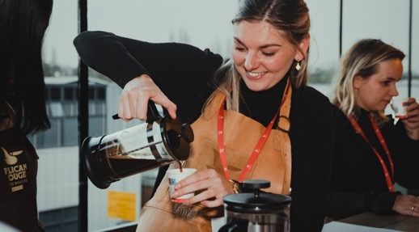
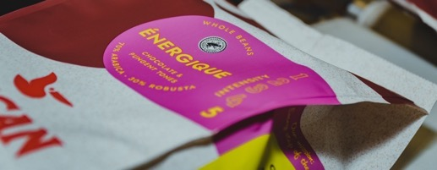
SELECTA
JUNE 2024
CORPORATE SOCIAL RESPONSIBILITY REPORT 2023
CHAPTER ONE
COMPANY PROFILE
PAGE 14
With Pelican Rouge Coffee Roasters, we are uniquely positioned to offer private label coffee solutions, enabling businesses to elevate their brand with bespoke blends that are tailored to their specific tastes and preferences. This vertical integration ensures that every bean we roast and every cup we serve meets the highest standards of quality and consistency. For our clients, this means access to a premium product line, expertly crafted by a team dedicated to the art of coffee. It's more than just coffee; it's a sensory journey that starts at our roastery and culminates in the unforgettable coffee experiences we create for each consumer. With Pelican Rouge Coffee Roasters, we don't just serve coffee—we craft a signature experience that sets our clients apart.
Pelican Rouge, the brand
The Pelican Rouge brand dates to the nineteenth century, where its coffee journey began in Belgium. Since 1863, Pelican Rouge has always explored new grounds and developed new ways, to finetune our great coffees. On this great journey we continue to innovate and expand our knowledge, creating the high-quality coffee experiences our clients and guests are looking for. At Pelican Rouge we look back on years of experience only to keep moving forward to deliver the best tasting coffee.
We offer different products, like Pelican Rouge coffee, ICS Instant products, Plant-based products, NOIR Coffee and Private label coffees.
Image: Top – Pelican Rouge Coffee Roasters coffee tasting. Bottom – Pelican Rouge mono material packaging

Slide 22



CELEBRATING EXCELLENCE
SELECTA
JUNE 2024
CORPORATE SOCIAL RESPONSIBILITY REPORT 2023
CHAPTER ONE
COMPANY PROFILE
PAGE 15
Pelican Rouge Coffee Roasters prestigious certifications
We are immensely proud of our Pelican Rouge Coffee Roasters for achieving multiple prestigious certifications, highlighting our commitment to excellence in quality, environmental responsibility, and sustainable practices. These certifications reflect our dedication to delivering outstanding products while ensuring the well-being of people and the planet. Pelican Rouge Coffee Roasters is now fully up to standard with the following certifications: ISO 14001, ISO 22000, and CO2 Performance Ladder Level 5.
ISO 14001 - Environmental management
ISO 14001 is an internationally recognized standard for effective environmental management systems. It provides a framework for organizations to protect the environment, respond to changing environmental conditions, and continuously improve their environmental performance.
Benefits:
Creates a healthier workplace by minimizing environmental hazards
Reduces the environmental impact of our operations through efficient resource use and waste reduction
ISO 22000 - Food safety management
ISO 22000 is a globally recognized standard for food safety management systems. It ensures that organizations in the food chain manage food safety hazards and provide safe products that meet both customer and regulatory requirements.
Benefits
Guarantees the highest standards of food safety, protecting consumer health
Promotes sustainable sourcing and production practices, reducing waste and improving efficiency
Assures clients and consumers of the highest quality and safety standards

Slide 23
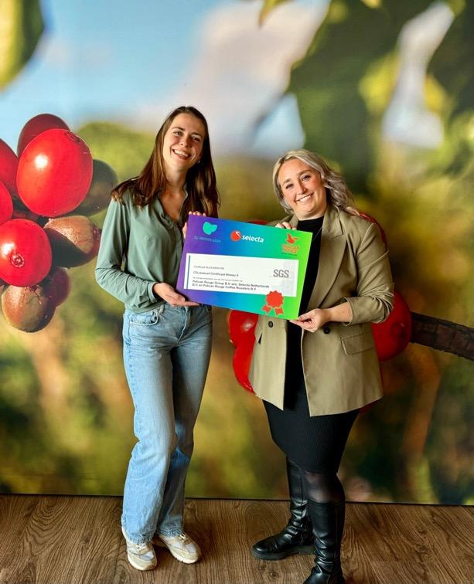

SELECTA
JUNE 2024
CORPORATE SOCIAL RESPONSIBILITY REPORT 2023
CHAPTER ONE
COMPANY PROFILE
PAGE 16
CO2 Performance ladder level 5: Carbon management
The CO2 Performance Ladder is a certification scheme that helps organizations reduce their carbon emissions. Level 5 is the highest certification level, indicating significant achievements in managing and reducing CO2 emissions across operations.
Benefits
Contributes to the fight against climate change, benefiting communities by promoting a healthier environment.
Demonstrates the Roasters ànd Selecta Netherlands’ commitment to reducing greenhouse gas emissions and promoting sustainable practices.
Positions our products as environmentally friendly, appealing to consumers who value sustainability.
Our certifications ensure that we prioritize the health and safety of our associates and consumers. By adhering to strict environmental and food safety standards, we create a safer workplace and deliver products that our consumers can trust.
Through these certifications, Pelican Rouge Coffee Roasters demonstrates a strong commitment to environmental stewardship. By reducing our carbon footprint, managing resources efficiently, and minimizing waste, we contribute to a more sustainable future for our planet.
These achievements underscore the superior quality and sustainability of our products. Consumers can enjoy our coffee knowing it meets the highest standards of safety, environmental responsibility, and sustainability.
Achieving ISO 14001, ISO 22000, and CO2 Performance Ladder Level 5 certifications is a testament to Pelican Rouge Coffee Roasters' unwavering commitment to excellence. These certifications reflect our dedication to protecting the environment, ensuring food safety, and reducing our carbon footprint, benefiting people, the planet, and our products. We are proud of this achievement and remain committed to continuous improvement and sustainable practices.
“WE ARE COMMITTED TO MAINTAINING A LEADING ROLE IN CO2 REDUCTION. WITH CONCRETE DATA AND MEASURABLE RESULTS, WE STRIVE FOR A GREEN AND SUSTAINABLE FUTURE, WITHOUT GREENWASHING”

Slide 24
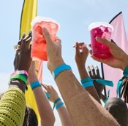

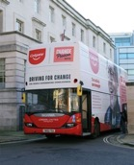


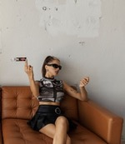
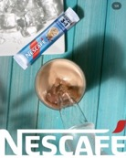




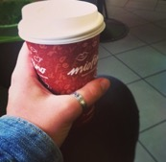




SELECTA
JUNE 2024
CORPORATE SOCIAL RESPONSIBILITY REPORT 2023
CHAPTER ONE
COMPANY PROFILE
PAGE 17
Products & services
WORLD-RENOWNED BRANDS
Selecta provides an extensive selection of coffee and hot beverage solutions. Our partnerships with world-renowned brands like Starbucks, Nescafé, Change Please and Segafredo, allow us to offer barista-quality coffee in workplaces and public spaces. Our coffee machines range from compact models to high-capacity machines, ensuring that we have the right solution for any environment.
Images: Instagram; starbucks, starbucksfrance, colgateuk, demontfortunifood, darnadude en nescafe3in1.Bulgaria, nescafebih, beachclubgorsje, segafredo_Zanetti_greecesegafredozanettialbania, fioredimaggio15, gabriella_kcs

Slide 25

SELECTA
JUNE 2024
CORPORATE SOCIAL RESPONSIBILITY REPORT 2023
CHAPTER ONE
COMPANY PROFILE
PAGE 18
The Selecta Coffee Brand Pyramid
Clients have diverse business issues and needs, and their decision-making process for selecting a specific coffee brand goes beyond just price. Other crucial factors also play significant roles. To effectively meet our clients' needs, we have developed the One Selecta coffee brand pyramid that addresses several critical areas
PRICE
This factor considers the cost of the coffee brand, ensuring it aligns with the client's budget while delivering value.
PERCEIVED BRAND VALUE
This involves the overall perception of the brand's quality, reputation, and the value it brings to the client. A strong brand value can enhance the consumers’ trust and satisfaction.
SUSTAINABILITY
Sustainability practices of the coffee brand are increasingly important to those who prioritize environmental and social responsibility. This includes fair trade practices, eco-friendly production methods, and overall impact on the planet.
EXPERIENCE
The overall experience the coffee brand provides, including taste, aroma, and the enjoyment it brings to consumers, plays a pivotal role. This also encompasses the service and support provided by the brand.
By considering these areas, the One Selecta coffee brand pyramid helps us tailor our offerings to best match the unique needs and priorities of each client. This comprehensive approach ensures that we provide the optimal solution, benefiting the client most effectively.
01
STARBUCKS
Local hero
CHANGE PLEASE
02
03
NESCAFÉ
04
PELICAN ROUGE
05
SEGAFREDO
06
Price fighter
MIOFINO
Image: The Selecta Coffee Brand Pyramid. As you move higher up the brand pyramid, the offerings increase in price, but so does the perceived value of the brand. These premium tiers are characterized by strong sustainability efforts and provide a memorable consumer experience. Conversely, the lower tiers in the brand pyramid offer more affordable options, which may come with a more basic but still valuable consumer experience. Each level of the pyramid caters to different consumer needs and preferences, ensuring a diverse range of choices.

Slide 26
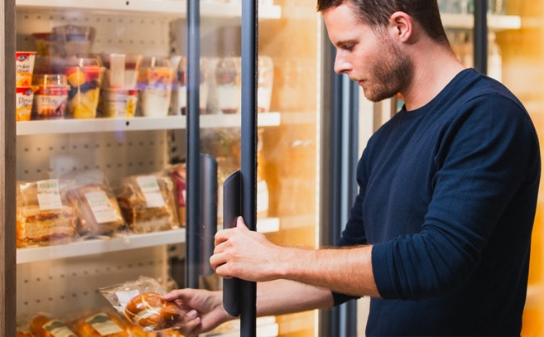
SELECTA
JUNE 2024
CORPORATE SOCIAL RESPONSIBILITY REPORT 2023
CHAPTER ONE
COMPANY PROFILE
PAGE 19
Products & services
FOODIES FROM SELECTA
At Selecta, we are dedicated to promoting healthier eating habits and supporting sustainable practices through our innovative Foodies solutions. Foodies is a modular, self-service food concept that brings fresh, healthy food to the workplace and beyond. The Foodies range includes the Foodies Scan & Go Food Market, Foodies Grab & Go Smart Fridge, and Foodies Shop and Go, each designed to meet diverse consumer needs while minimizing environmental impact.
For the end-consumers, our Foodies solutions offer unparalleled convenience and access to healthy, fresh food options, catering to various dietary needs, including vegan and gluten-free choices. The easy-to-use interfaces and flexible payment options enhance the user experience, making it simple to enjoy high-quality meals at any time. By fostering a positive food culture in the workplace, these solutions help improve employee well-being, engagement, and overall productivity.
Foodies’ solutions underscore our commitment to sustainability. By working closely with local suppliers, we reduce the carbon footprint associated with long-distance transportation. Our focus on eco-friendly packaging and waste reduction aligns with broader environmental goals, contributing to a more sustainable food ecosystem. These initiatives not only support environmental stewardship but also resonate with consumers who value responsible and sustainable practices.
Image: Foodies Food Market

Slide 27
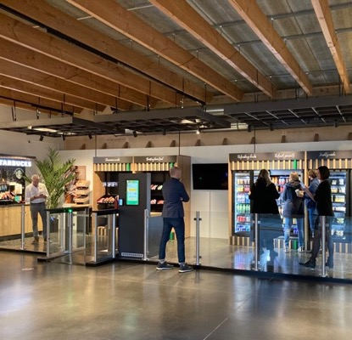
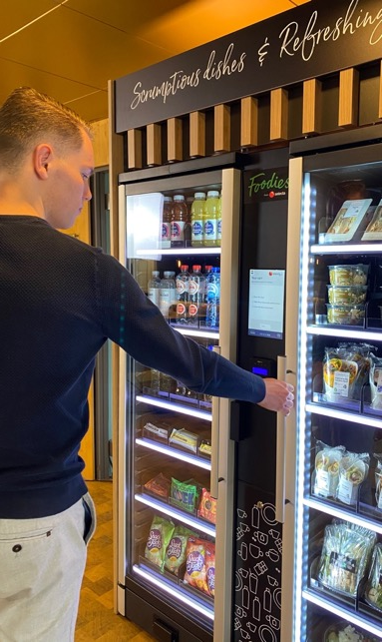
SELECTA
JUNE 2024
CORPORATE SOCIAL RESPONSIBILITY REPORT 2023
CHAPTER ONE
COMPANY PROFILE
PAGE 20
Foodies Scan & Go Food Market
The Foodies Scan & Go Food Market provides a flexible, 24/7 self-service solution that caters to the evolving needs of modern workplaces. This micro-market setup offers a wide variety of fresh, nutritious food options, including salads, fruits, and plant-based dishes. By conducting extensive market research, we've tailored our assortment to align with consumer preferences, ensuring a selection that promotes healthy eating habits. The open, modular design of the Food Market fosters a communal atmosphere where employees can connect and enjoy their meals, contributing to increased workplace satisfaction and productivity. Foodies can be scaled to fit any size business, from small offices to large enterprises, making them a versatile and cost-effective catering solution.
Foodies Grab & Go Smart Fridge
The Foodies Grab & Go Smart Fridge is an ideal solution for spaces with limited room, offering a compact yet comprehensive food service. These smart fridges are designed to store a variety of fresh food, drinks, and snacks. The technology behind these fridges ensures seamless transactions and theft prevention, providing a hassle-free experience like using a home refrigerator. This solution is perfect for hybrid working environments, offering fresh and healthy food options around the clock, and significantly reducing the need for traditional, space-consuming canteens.
Foodies Shop and Go
Foodies Shop and Go represents the pinnacle of convenience and innovation in self-service food solutions. This fully automated, self-serve shop offers a vast array of products without the need for staffing, making it a cost-effective and efficient alternative to traditional retail setups. It supports flexible working patterns or visitor frequency by providing 24/7 access to a wide range of food and beverages, ensuring that employees and guests have continuous access to nutritious options whenever they need them.
A MODULAR, SELF-SERVICE FOOD CONCEPT THAT BRINGS FRESH, HEALTHY FOOD TO THE WORKPLACE & BEYOND.
Images: Left – Foodies Grab & Go Smart fridge. Right – Foodies Shop & Go

Slide 28
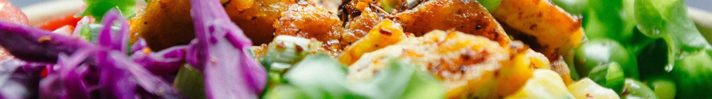
SELECTA
JUNE 2024
CORPORATE SOCIAL RESPONSIBILITY REPORT 2023
CHAPTER ONE
COMPANY PROFILE
PAGE 21
Products & services
FRESH & HEALTHY FOOD CHOICES
At Selecta, we are committed to promoting healthy eating habits. While we rely on our suppliers to provide fresh and healthy food options, we leverage our influence to encourage conscious consumption and support healthier lifestyles.
Recent market research shows a significant increase in demand for healthy food options. According to a 2022 Nielsen report, 64% of global consumers are trying to reduce their sugar intake, and 56% are looking for products with all-natural ingredients. The plant-based food market is also booming, with the Good Food Institute reporting a 27% increase in sales of plant-based foods in 2021 compared to the previous year. Furthermore, a study by Food Navigator found that 45% of consumers are looking for gluten-free options.
We continuously adapt to consumer needs by conducting thorough research and analysing our product assortment. This approach keeps us aligned with consumer preferences and ensures that we offer products that meet their needs and tastes. As the end consumer being a key stakeholder, we acknowledge, that consumers’ preferences significantly influence our impact.
LOCAL SUPPLIERS
EMPOWERING CONSUMERS
CONSUMER NEEDS
HEALTHY LIFESTYLE
We prioritize working with local suppliers who offer high-quality, fresh, and healthy products, including vegan and gluten-free options. This not only ensures that our offerings meet the diverse dietary needs of our consumers but also helps reduce our carbon footprint by minimizing transportation distances.
We use the power of influence to its fullest. We engage consumers through promotional point-of-sale (POS) materials that highlight the benefits of healthy eating. By providing clear and informative content, we help consumers make better food choices and become more conscious of what they eat.
Conscious of the of choices of the consumer, we conduct market studies which influence and enrichen our fresh food assortment on a continuous basis.
We believe that by promoting fresh and nutritious foods, we can contribute to the well-being of our consumers and create a positive impact on the environment. This is in line with the growing trend towards holistic health, where consumers seek not only nutritional benefits but also ethical and environmental assurances from their food choices.

Slide 29

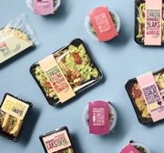
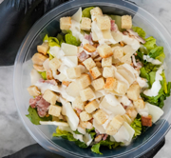

SELECTA
JUNE 2024
CORPORATE SOCIAL RESPONSIBILITY REPORT 2023
CHAPTER ONE
COMPANY PROFILE
PAGE 22
Our champions of healthy and sustainable food
At Selecta, we pride ourselves on collaborating with local suppliers who share our commitment to offering healthy and sustainable food options.
These partnerships allow us to offer a diverse and nutritious assortment, meeting the growing demand for health-conscious and eco-friendly food choices. By working closely with these local heroes, we support regional economies and reduce our carbon footprint, making a positive impact on both people and the planet.
Here are a few examples of these outstanding partners.
SONIGIRI
BY KAVSMAN
GOOD2EAT
L'ATELIER DES LILAS
SONiGiRi, stands for authentic Japanese onigiri snacks, perfectly adapted for French tastes. The delicious, triangular rice snacks come in a variety of exciting flavours, offering a nutritious and convenient option for any meal. Made with premium ingredients sourced from trusted suppliers, including high-quality Japonica rice, SONiGiRi delivers a unique and satisfying eating experience.
By Kavsman specializes in developing, manufacturing, and packaging delicious meals and accompaniments. Rooted in agility, innovation, and quality consciousness, they constantly adapt to market changes and push the boundaries of culinary creativity. Their commitment to using high-quality raw materials and fostering collaborative work environments ensures that every product meets the highest standards.
Good2Eat is one of Sweden's largest brands for fresh, ready-to-eat meals. Its hand-crafted salads, hearty baguettes, and creamy wraps are made with love in Sweden, ensuring the highest quality and freshness. Good2Eat offers delicious and convenient food options that you can enjoy anywhere, anytime. They are committed to providing you with tasty classics that fit seamlessly into your busy lifestyle. Good2Eat blends taste and convenience, handcrafted just for you.
Through our partnership with L'Atelier des Lilas, we offer an exquisite range of 100% gluten-free products crafted with natural ingredients. Based in Champigny Sur Marne, L'Atelier des Lilas is renowned for its high-quality, handmade quiches, salads, soups, pastries, and desserts. These delicious and healthy options are perfect for any client seeking to provide their employees or guests with top-notch, gluten-free delights.

Slide 30

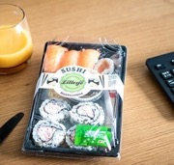
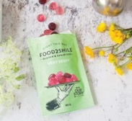
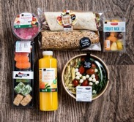
SELECTA
JUNE 2024
CORPORATE SOCIAL RESPONSIBILITY REPORT 2023
CHAPTER ONE
COMPANY PROFILE
PAGE 23
Experience new tastes with Selecta's 'Food Days'
At Selecta, we believe in the power of experiencing and tasting products firsthand. That's why we organize 'Food Days' for our clients, providing them with the opportunity to sample and enjoy our latest offerings. These events are highly appreciated as they allow clients to explore new products and flavours, giving us valuable feedback for future innovations. 'Food Days' serve as a perfect platform to introduce and test new items, ensuring we meet our clients' evolving tastes and preferences.
GOOH
LILLESJÖ
FOOD2SMILE
COOP TO GO
Gooh offers a unique culinary experience with high-quality, ready-made meals inspired by traditional Swedish and Italian cuisine. Crafted by expert chefs using the finest Swedish ingredients, all meals are prepared using the innovative Micvac method, which preserves the natural flavours and nutritional value while ensuring a long shelf life without unnecessary additives. Gooh's commitment to sustainability is evident through its use of locally sourced, fresh produce and meats, ensuring both exceptional taste and minimal environmental impact.
With a long history of producing hand-made mixes, dips, sandwiches, cakes and other delicacies, Lillesjö is Sweden’s leading manufacturers of fresh-ready made meals.
Food2Smile, revolutionizes the way you enjoy snacks and treats. Founded by nutritionist Miriam Bouwens, Food2Smile offers a delightful range of sugar-free candies, healthier chips, and guilt-free chocolates that fit perfectly into a healthy lifestyle. All products are crafted to bring joy without the added sugar, supporting both personal wellness goals and environmental sustainability.
Through our exclusive partnership with Coop to Go, we can offer an impressive range of Bio certified products to our clients in all Foodies solutions. The assortment includes fresh salads, wholesome sandwiches, nutritious snacks, and refreshing beverages, all made with high-quality, organic ingredients. Committed to sustainability and health, Coop to Go ensures that every product meets strict organic standards, providing the consumer with delicious and environmentally friendly choices.

Slide 31
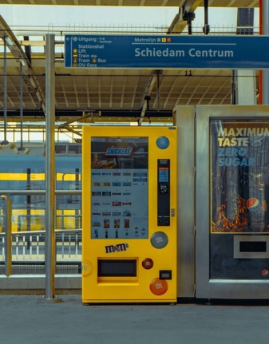
SELECTA
JUNE 2024
CORPORATE SOCIAL RESPONSIBILITY REPORT 2023
CHAPTER ONE
COMPANY PROFILE
PAGE 24
Products & services
VENDING
Selecta's innovative vending solutions - transforming refreshment services
We are committed to enhancing the refreshment experience through our cutting-edge vending solutions. Our wide range of (digital) vending machines and services cater to various needs, ensuring convenience, quality, and sustainability. Our machines offer a wide variety of snacks and drinks, ensuring your employees and guests have access to their favourites at any time. Features like contactless payment options and real-time inventory monitoring make our vending machines a modern and efficient solution.
Smart vending technology
Our smart vending machines incorporate advanced technologies such as contactless payments and telemetry. These features not only enhance the user experience but also provide real-time data to ensure machines are always stocked with popular items. This reduces downtime and improves efficiency, making it easier for businesses to provide high-quality refreshment options.
Our vending machines support eco-friendly practices by offering products with minimal packaging and working with local suppliers to reduce carbon footprints. Additionally, refurbished vending machines are available, which help reduce waste and promote a circular economy by extending the lifecycle of equipment.
The machines offer a seamless and enjoyable experience. With a variety of payment options, including cash, contactless, and mobile payments, consumers can easily purchase their favourite snacks and beverages. The machines are designed to keep food fresh for longer periods, ensuring high-quality products are always available.
Our vending solutions are versatile and can be customized to fit different locations and branding needs. Whether for indoor or outdoor use, we have options that cater to various environments and requirements. This flexibility ensures that businesses can provide tailored refreshment solutions that meet their specific needs.
Image: Smart Vending Machine Public Sector

Slide 32
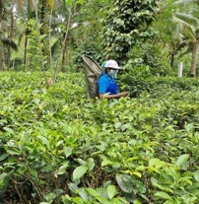
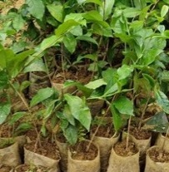
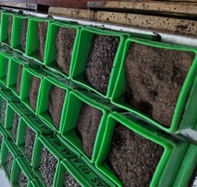
SELECTA
JUNE 2024
CORPORATE SOCIAL RESPONSIBILITY REPORT 2023
CHAPTER ONE
COMPANY PROFILE
PAGE 25
Products & services
OUR EXQUISITE TEA PORTFOLIO
Our diverse and high-quality tea portfolio caters to a wide range of tastes and preferences. Understanding that tea is the second most popular drink in the world, we aim to enhance our offerings with the finest selections available.
All our tea brands prioritize sustainability and ethical sourcing, ensuring that the tea you enjoy is produced with respect for both the environment and the people involved in its production. Whether you prefer classic black teas, aromatic green teas, or caffeine-free herbal blends, our portfolio has something for everyone. Each brand within our portfolio is committed to maintaining the highest quality standards, ensuring that every cup of tea delivers a consistently excellent experience. Our tea offerings include unique and innovative flavours that cater to modern consumer preferences, enhancing the overall tea-drinking experience.
FINELEAF TEA
Fineleaf tea represents the pinnacle of our tea offerings. This premium brand is Fairtrade certified, ensuring that the living and working conditions of the tea estate employees are well taken care of. All Fineleaf teas are 100% organic, grown without artificial fertilizers and chemical pesticides, which allows the natural flavours to shine through in every cup.
The production process takes place in Sri Lanka, providing employment in local communities and supporting the local economy. With a commitment to sustainability, Fineleaf uses recyclable materials and maintains a minimal carbon footprint, ensuring an eco-friendly experience from plantation to your cup.
TEA CULTURES
Tea Cultures is not just about enjoying a cup of tea; it's about embracing a sophisticated lifestyle. This exclusive brand offers high-quality, organically grown, and Fairtrade certified teas that are perfect for tea lovers who appreciate the finer things in life.
From the English Blend to the exotic Bali Monkey Fruit, each tea is crafted with care, ensuring an exceptional taste experience.
The brand emphasizes sustainability, with eco-friendly packaging and a commitment to ethical sourcing practices, making it a responsible choice for discerning consumers.
Images: (from left to right) Fineleaf tea farmer. Fresh tea leaves. Young tea plants.

Slide 33
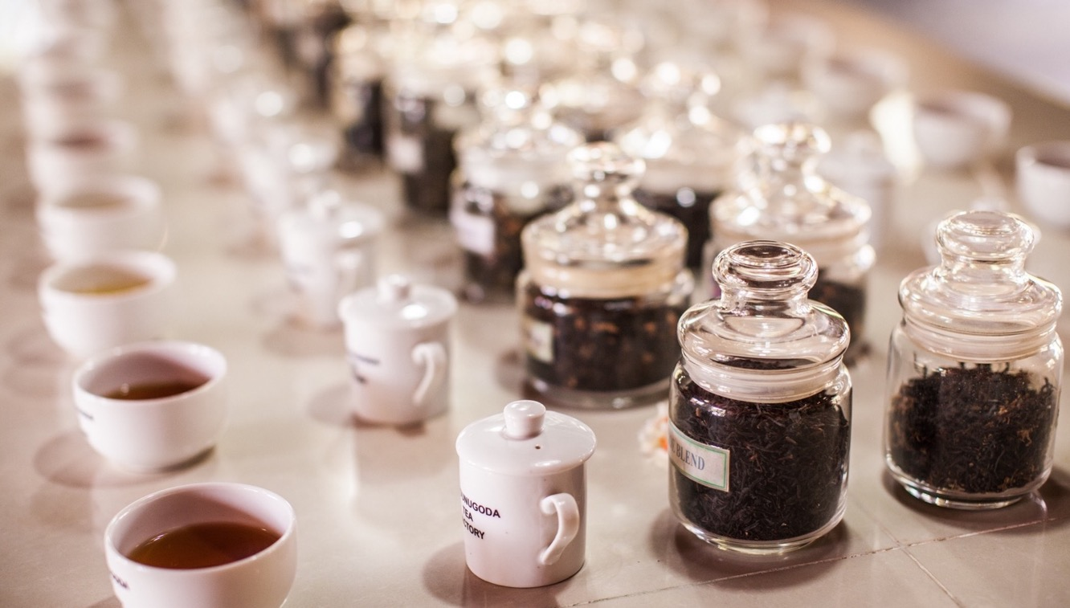
SELECTA
JUNE 2024
CORPORATE SOCIAL RESPONSIBILITY REPORT 2023
CHAPTER ONE
COMPANY PROFILE
PAGE 26
LIFE BY FOLLIS
Life by Follis brings you fresh, single estate teas from the highlands of India, combined with the finest spices and herbs. Double certified as EU-organic and Fairtrade, this brand ensures that every step of the production process adheres to the highest sustainability standards.
The innovative flavour combinations and minimal environmental impact make Life by Follis a standout choice for those seeking both quality and sustainability. The brand supports extensive ethical and environmental initiatives, providing full traceability from plant to cup.
FLAVOURS OF TEA
Axxent Masters in Tea is dedicated to creating surprising and innovative tea concepts. With over 25 years of experience, Axxent produces Fairtrade and Rainforest Alliance certified teas, ensuring social responsibility and environmental sustainability.
Their Flavours of Tea range offers a delightful selection, from classic English Breakfast to the refreshing Moroccan Mint, all crafted to provide a mindful and enjoyable tea experience.

Slide 34

SELECTA
JUNE 2024
CORPORATE SOCIAL RESPONSIBILITY REPORT 2023
CHAPTER ONE
COMPANY PROFILE
PAGE 27
Products & services
PLNT
PLNT - Quality vegan products with a caring touch
At Selecta, we are proud to offer PLNT, our own range of high-quality vegan products designed with a caring touch.
With the increasing demand for health-conscious options, PLNT offers a wide selection of delicious vegan and gluten-free products, perfect for those with dairy allergies or lactose intolerance.
Our product line includes
Vegan Topping (gluten-free)
Vegan Oat Topping (gluten-free)
Vegan Oat Cappuccino (gluten-free)
Vegan Oat Choco Drink
Sustainable Packaging
In line with our commitment to sustainability, all PLNT packaging is fully recyclable and free from aluminium, making it easier to make eco-friendly choices.
Image: Pelican Rouge PLNT Crockery

Slide 35







1 TON OF CO2E REPRESENTS ...
SELECTA
JUNE 2024
CORPORATE SOCIAL RESPONSIBILITY REPORT 2023
CHAPTER ONE
COMPANY PROFILE
PAGE 28
Did you know?
1,961
192
By switching to PLNT-based milk powder, we’ve made a significant impact on reducing emissions in our production process. In 2023 alone, we avoided 355 tons of CO2.
Additionally, our commitment to sustainability led to a remarkable 259% increase in the use of PLNT-based toppings compared to 2022. These achievements reflect our dedication to creating a greener, more sustainable future for everyone.
cotton T-shirts
vegetarian meals
Scope of emissions plant-based toppings PLNT
CO₂/KG Product Level
250
138
Big Macs (eating)
meat-based meals
3x
1-WAY TRIP
Driving around the world on an electric bike
from Paris to New York by plane

Slide 36

SELECTA
JUNE 2024
CORPORATE SOCIAL RESPONSIBILITY REPORT 2023
CHAPTER ONE
COMPANY PROFILE
PAGE 29
Products & services
ENHANCING HYDRATION
Enhancing hydration with our innovative water solutions
Access to fresh, clean water is a necessity for all. Selecta continuously prioritizes providing top-notch hydration solutions through our advanced water dispensers and systems. Our water portfolio is designed to meet the diverse needs of modern workplaces and public spaces, offering a range of options that ensure convenience, quality, and sustainability for both end-consumers and the planet.
Our water solutions significantly contribute to sustainability efforts. By providing alternatives to plastic-bottled water, we help reduce plastic waste and the associated environmental impact. Using these dispensers supports the trend towards sustainable hydration solutions, aligning with the increasing consumer preference for eco-friendly options. Moreover, ensuring easy access to clean, filtered water always boosts workplace productivity, as hydration has been shown to improve cognitive function and overall employee well-being. Our water portfolio offers versatile, high-quality hydration solutions that promote health and sustainability.

Slide 37

SELECTA
JUNE 2024
CORPORATE SOCIAL RESPONSIBILITY REPORT 2023
CHAPTER ONE
COMPANY PROFILE
PAGE 30
Enhancing client experience with wholesale & webshop offerings
At Selecta, we strive to provide our clients with a seamless and comprehensive service experience. In several markets, our clients have the convenience of ordering a wide range of products—such as coffee beans, condiments, tea, snacks, water, and both disposables and reusables—directly through our webshops. This integrated platform not only simplifies the ordering process but also ensures that our clients have access to high-quality products that meet their specific needs.
Added value for our clients
Convenience - our webshops offer a one-stop solution for all beverage and snack needs, streamlining the ordering process and saving time for our clients.
Quality assurance - by providing products that are perfectly suited for our machines, we guarantee world-class service and optimal machine performance. When the right coffee beans are used, the machine settings are calibrated to ensure a perfect brew every time.
Wide selection - clients can choose from a diverse range of products, ensuring that they can cater to various tastes and preferences within their organization.
Wholesale division
Our wholesale division is a crucial component of this ecosystem. Wholesale refers to the sale of goods in large quantities at discounted prices, typically to be retailed by others. At Selecta, our wholesale division supplies products to various clients, including those who purchase through our webshops.
This division manages large-scale procurement and distribution, ensuring that we can offer competitive prices and maintain a steady supply of high-quality products.
How it works
Procurement - our wholesale team sources products in bulk, leveraging relationships with suppliers to secure the best quality at competitive prices.
Distribution - these products are then made available through our webshops, where clients can easily browse and order the items they need.
Integration with webshops - the wholesale division ensures that our webshops are well-stocked and that orders are fulfilled promptly, providing clients with a reliable and efficient service.
We are committed to reducing our carbon footprint by sourcing products in bulk and optimizing our distribution routes, thereby minimizing transportation emissions.
We prioritize offering eco-friendly disposables and reusables, which support our clients in reducing their environmental impact.
Additionally, our preference for local suppliers not only bolsters local economies but also lessens the environmental consequences associated with long-distance transportation.
By providing high-quality, calibrated products for our machines, we ensure optimal use, thereby reducing waste generated from product spoilage and machine malfunctions.
Together, these efforts significantly contribute to a more sustainable and environmentally friendly operation.
ACCESS TO HIGH-QUALITY PRODUCTS THAT MEET YOUR NEEDS AT ANY GIVEN TIME

Slide 38

CLIENTS & INDUSTRIES WE SERVE
SELECTA
JUNE 2024
CORPORATE SOCIAL RESPONSIBILITY REPORT 2023
CHAPTER ONE
COMPANY PROFILE
PAGE 31
Products & services
WIDE RANGE
Our client base is diverse, encompassing small and medium-sized enterprises as well as large corporations across various sectors. This wide range ensures that we are well-versed in addressing a variety of business challenges and delivering customized services. The sectors we serve include:
Healthcare - providing essential services to hospitals, clinics, and other healthcare facilities.
Education - catering to schools, colleges, and universities, ensuring students and staff have access to nutritious and convenient food and beverages.
Retail - serving both retail staff and customers, enhancing their shopping experience.
Public transport - offering convenient solutions to commuters and staff in the transportation sector.
Petrol stations - delivering refreshments to travellers and station employees.
Hotels and leisure - enhancing guest experiences in hotels, resorts, and leisure facilities.
Restaurants and cafés - supporting foodservice establishments with premium offerings.
Office spaces - creating comfortable and productive environments for office workers.
Manufacturing - providing solutions to factories and production facilities.
Logistics - serving the needs of logistics companies and their employees.
Our extensive network ensures that we can meet the needs of clients across various locations. From bustling urban centres to more remote areas, Selecta is there to deliver. Additionally, we have a strong presence in public sectors, addressing the specific requirements of public institutions and services.

Slide 39

SELECTA
JUNE 2024
CORPORATE SOCIAL RESPONSIBILITY REPORT 2023
CHAPTER ONE
COMPANY PROFILE
PAGE 32
Organization & activities
GOVERNANCE
The Selecta Group is a private limited company governed by a Board, an Operating Committee (OpCo), and group-wide Leadership Forums critical for executing our strategy. The Board approves the Group's strategy, business, and financial plans. It oversees senior executive appointments and reviews critical strategic initiatives.
The OpCo consists of functional leaders reporting to our CEO and Chairman, who ensure our strategy and purpose are executed. Our Group-level leaders oversee areas such as Finance, Human Resources, Technology, Service, Commercial, Marketing Procurement, Strategy, Sustainability, and Legal.
Selecta's Leadership Council, comprising OpCo members and market leaders, meets regularly to discuss key topics and ensure the One Selecta strategy is executed across all markets. The Leadership Circle includes leadership teams and representatives across functions responsible for executing key strategic initiatives.
Sustainability topics are discussed at all levels, driven by the Sustainability Team. Regular updates and calls to action are discussed in broader leadership groups. Cross-functional committees focus on embedding sustainability, including the Sustainability Network, Diversity & Inclusion Working Group, and Health & Safety Committee.
The sustainability network includes representatives from key functions, providing feedback on initiatives and supporting local execution. Regular reviews track progress and execute larger initiatives market-by-market.
Another critical group within Selecta is our 170 owner associates who hold equity stakes. These individuals drive the One Selecta transformation, with the unique structure offering further responsibility and benefits from the company's success. Monthly meetings highlight key initiatives and progress.
ANOTHER CRITICAL GROUP WITHIN SLECTA IS OUR 170 OWNER ASSOCIATES WHO HOLD EQUITY STAKES

Slide 40
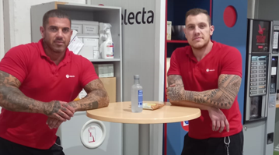
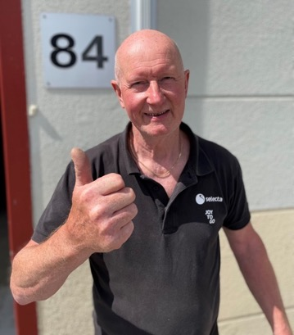
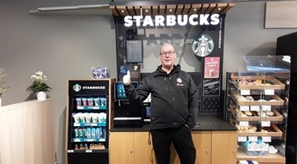
SELECTA
JUNE 2024
CORPORATE SOCIAL RESPONSIBILITY REPORT 2023
CHAPTER ONE
COMPANY PROFILE
PAGE 33
Organization & activities
OUR ASSOCIATES
At Selecta, our strength lies in our community, our diversity, and our commitment to creating an engaging and supportive work environment. Our story is one of family, commitment, and passion, as showcased through the remarkable journeys of our team members across Europe.
From the sunny shores of Spain to the bustling cities of Sweden, our team members bring life and joy to every interaction. For instance, the story of Daniel and Alejandro Peña, brothers and Joy Ambassadors in Spain, underscores the familial ties that make our workplace unique. Their shared journey at Selecta not only strengthens their bond but also enhances the team spirit, proving that Selecta is more than just a place to work; it’s a place to grow together.
In Sweden, the heartwarming tale of Mikael and Ove, who have been with Selecta for decades, competing playfully for the title of the longest-serving associate, highlights our deep respect for loyalty and dedication. Their story reflects the fun, competitive spirit and the camaraderie that Selecta fosters among its associates.
Images: Top left – Daniel and Alejandro Peña, Joy Ambassadors. Bottom left – Ove Rönnblom, Brand advisor/OKQ8 auditor. Right – Mikael Hane, Technical Joy Ambassador

Slide 41
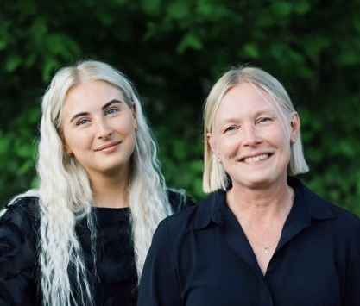
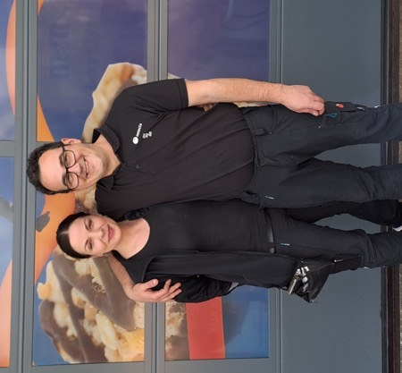
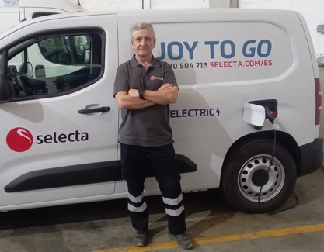
SELECTA
JUNE 2024
CORPORATE SOCIAL RESPONSIBILITY REPORT 2023
CHAPTER ONE
COMPANY PROFILE
PAGE 34
Further exemplifying our commitment to nurturing relationships, Elin and Anna Bengtsson in Sweden represent a touching mother-daughter duo who share more than just familial bonds—they share a workplace that respects and advances their individual careers while celebrating their connection.
The story of Tanja Kalas and Irvin Zunic from Austria, engaged to be married, also emphasizes how Selecta is a backdrop to personal milestones. Our supportive environment respects and cherishes the personal happiness of our associates, understanding that joy at work translates to joy in life.
Lastly, the enduring loyalty of Manuel García Nájera, who has dedicated 37 years to our team in Spain, exemplifies the deep sense of belonging and appreciation we foster within our community. Manuel’s long service is celebrated as not just a personal achievement but as a testament to the nurturing and rewarding environment that Selecta offers.
These stories, from family ties and lifelong friendships to love and laughter, illustrate that Selecta isn’t just about providing excellent client service—it’s about creating a workplace where every employee feels valued, supported, and inspired. We understand that our success as a company is built on the happiness and well-being of our people. That’s why we are dedicated to ensuring that everyone in our team, no matter where they are in the world, feels like they are part of something bigger—a family, a community, a place where every day at work is an opportunity to connect, grow, and smile.
JOY AT WORK RELATES TO JOY IN LIFE
Images: Top left – Elin and Anna Bengtsson, Contract Administrator Clients Solutions and Joy Ambassador. Bottom left – Manuel García Nájera, warehouse. Right – Tanja Kalas and Irvin Zunic, Joy Ambassador and Joy Ambassador Refurbishment.

Slide 42
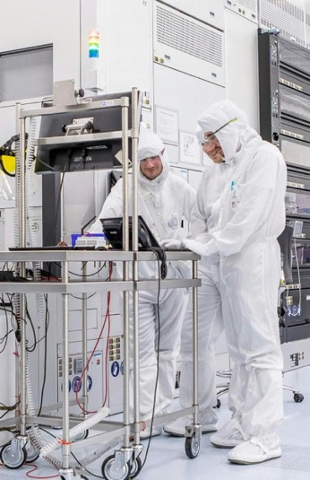
SELECTA
JUNE 2024
CORPORATE SOCIAL RESPONSIBILITY REPORT 2023
CHAPTER ONE
COMPANY PROFILE
PAGE 35
Sylvia’s story
AMBASSADOR OF JOY & CONNECTIVITY
Within the vibrant tapestry of Selecta's community, each thread adds strength and colour, weaving a story of dedication and service. One such inspiring story is that of Sylvia, a Coffee Joy Ambassador who brings warmth and energy to every cup she serves at IMEC, a spinoff from Leuven University and one of Selecta Belgium's largest clients.
Sylvia’s role at IMEC goes beyond just ensuring that over 5,000 collaborators start their day with a smile; she crafts 140,000 moments of joy every month. Her commitment illuminates her extraordinary ability to manage such a significant responsibility on her own. Every cup of coffee she serves is a testament to Selecta's dedication to enhancing workplace culture and fuelling innovation through quality and care.
Imagine the bustling environment of IMEC, where breakthroughs and innovations are a daily pursuit. Here, Sylvia ensures that the fuel that powers these minds—coffee—is always up to the mark, maintaining high standards and a ready supply. Her presence is a comforting constant in the fast-paced routine of the researchers and staff, making her an integral part of their daily interactions and successes.
Her story is not just about the coffee she serves but about the relationships she nurtures through her service. Each interaction with Sylvia is personalized, memorable, and filled with warmth, making her role pivotal in not just meeting but exceeding the expectations of one of Selecta’s biggest clients.
Sylvia's dedication and the joy she spreads underscore Selecta’s core values of passion, partnership, and excellence. Her story beautifully illustrates how our team members are not just associates but ambassadors of joy and connectivity, deeply embedded in the fabric of the organizations they serve. Her unwavering commitment exemplifies how Selecta is truly a remarkable place to work—one that respects, recognizes, and rewards its people for the pivotal roles they play.
Images: IMEC Leuven Research. Next page: Sylvia Franssens, Coffee Joy Ambassador and her daughter.

Slide 43
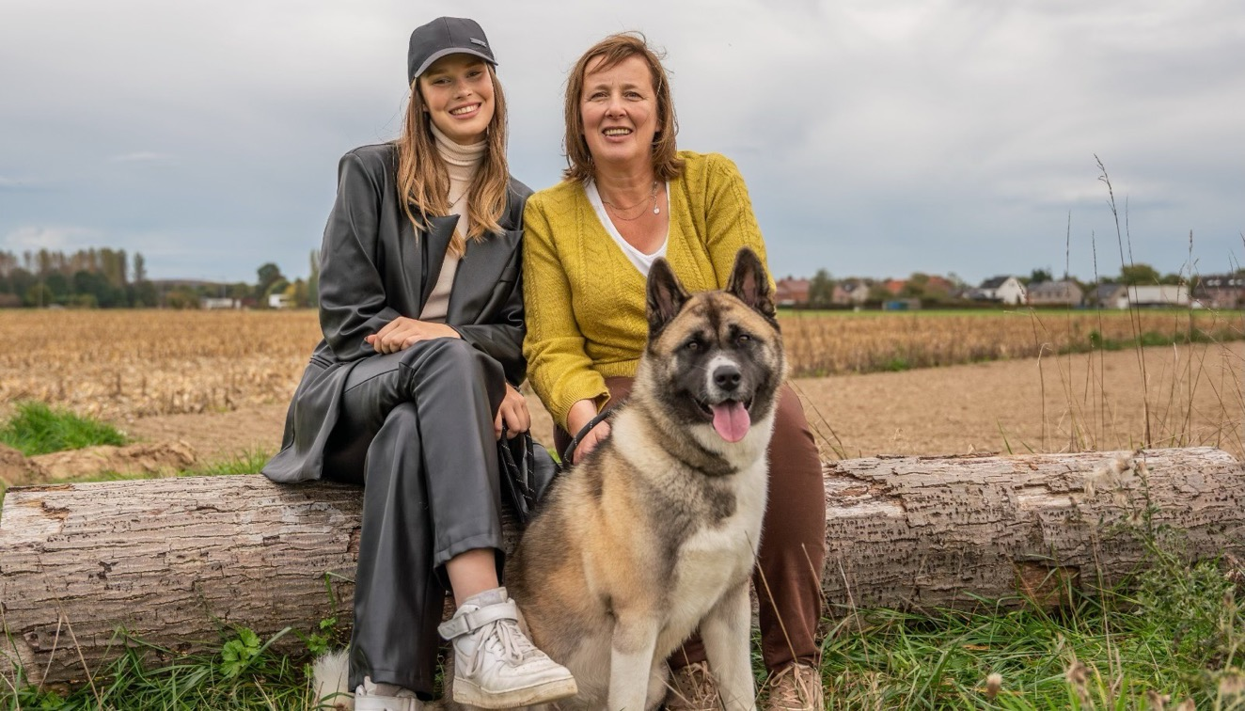
SELECTA
JUNE 2024
CORPORATE SOCIAL RESPONSIBILITY REPORT 2023
CHAPTER ONE
COMPANY PROFILE
PAGE 36

Slide 44
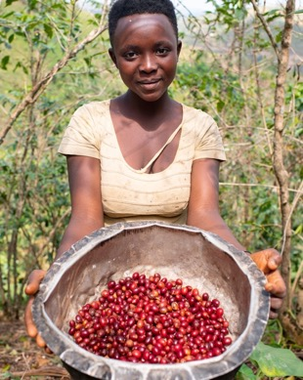
SELECTA
JUNE 2024
CORPORATE SOCIAL RESPONSIBILITY REPORT 2023
CHAPTER ONE
COMPANY PROFILE
PAGE 37
Organisation & activities
VALUE CHAIN
BRINGING JOY SUSTAINABLY - UNDERSTANDING SELECTA'S VALUE CHAIN
At Selecta, our mission is to bring moments of joy to our clients and consumers every day, and we believe in doing so responsibly and sustainably. Let’s take a journey through how we make this happen, and how we’re striving to leave a positive mark on the world.
FROM FARM TO CUP
Our coffee journey begins with the heart and soul of our business: our passionate coffee farmers. Through the Selecta Coffee Fund, we go beyond merely purchasing coffee beans – we forge deep, meaningful relationships and commit to fair practices.
The story continues in our own roasting facilities, where we lovingly roast our coffee, including cherished brands like Pelican Rouge and Miofino. This meticulous, hands-on approach ensures every single cup of coffee is crafted with unparalleled care, embodying our high sustainability standards.
The impact of our commitment is truly remarkable. In 2023, we proudly achieved 100% certification for our Pelican Rouge coffee. Additionally, 73% of all coffee imported by Pelican Rouge Coffee Roasters is certified, along with 46% of all instant powders. These numbers reflect our unwavering dedication to sustainability and quality, transforming every sip into a testament to our journey from farm to cup.
Image: Selecta Coffee Fund Fresh coffee beans
IN 2023, WE PROUDLY ACHIEVED 100% CERTIFICATION FOR OUR PELICAN ROUGE COFFEE. ADDITIONALLY, 73% OF ALL COFFEE IMPORTED BY PELICAN ROUGE COFFEE ROASTERS IS CERTIFIED, ALONG WITH 46% OF ALL INSTANT POWDERS.

Slide 45
SELECTA
JUNE 2024
CORPORATE SOCIAL RESPONSIBILITY REPORT 2023
CHAPTER ONE
COMPANY PROFILE
PAGE 38
MAKING A BIGGER IMPACT WITH INSET CREDITS
We’re not stopping at just reducing our emissions. Through innovative practices like using inset credits, we’re making a deeper impact. Insetting means investing in projects within our own supply chain to offset carbon emissions. It’s about supporting the very farmers who grow our coffee and enhancing their livelihoods while also tackling climate change.
EFFICIENT AND SUSTAINABLE DELIVERY
Once the coffee is ready, it’s time to deliver it to you. We have over 5,000 vehicles that crisscross Europe, ensuring our products reach their destinations efficiently. We’ve made significant strides in greening our fleet; in 2023 alone, we introduced 402 electric vehicles (EVs). This move helped us prevent 1,805 tons of CO2 emissions – a win for both us and the planet!
But it’s not just about vehicles. Our advanced telemetry technology and dedicated call centres keep us informed about what products and services are needed, ensuring timely deliveries. We pre-kit stocks whenever possible to reduce waste and speed up our delivery process. It’s all about getting you what you need, when you need it, with minimal environmental impact.
MEETING YOU WHERE YOU ARE
We have nearly 450,000 points of sale across Europe – from vending machines to Micro Markets offering drinks, snacks, and fresh food. Whether you’re at work, on the go, or shopping, we aim to provide you with convenient and delightful options. Our team of over 4,800 merchandisers and 1,400 technicians ensures these points of sale are always stocked, clean, and well-maintained.
SPREADING THE JOY GLOBALLY
We believe in the power of scaling up good practices. That’s why we’re committed to replicating our successes in EV adoption and insetting across all the markets we operate in. By doing so, we’re amplifying our positive impact and ensuring we bring joy to more people in more sustainable ways.
OUR COMMITMENT TO YOU AND THE PLANET
At Selecta, every decision we make is guided by our commitment to sustainability and our dedication to bringing you the best possible products and services. From the coffee farms to your cup, from our distribution centres to your office or local vending machine, we are constantly looking for ways to improve and innovate.
We are proud of the journey we’re on and excited about the future. By choosing Selecta, you’re not just enjoying great products; you’re also supporting a company that cares deeply about making a positive difference in the world.

Slide 46

SELECTA
JUNE 2024
CORPORATE SOCIAL RESPONSIBILITY REPORT 2023
CHAPTER ONE
COMPANY PROFILE
PAGE 39
Company profile
STAKEHOLDER ENGAGEMENT
In 2023, Selecta launched an extensive stakeholder engagement process to assess the environmental, social, and governance (ESG) impacts of critical issues affecting our business's financial sustainability. Building on the materiality matrix from 2018, this evaluation incorporated both internal and external research.
By actively engaging with our stakeholders, we identified issues that are crucial both financially and for our ESG footprint. This dual-focus approach ensures that we prioritize areas impacting our financial performance and sustainability commitments. Today, our approach to sustainability is holistic, involving key stakeholders across various sectors to ensure all material topics are addressed comprehensively.

Slide 47
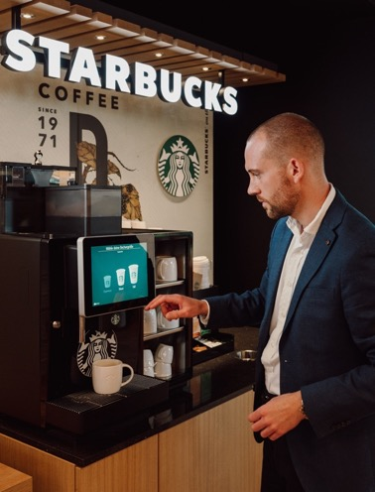
SELECTA
JUNE 2024
CORPORATE SOCIAL RESPONSIBILITY REPORT 2023
CHAPTER ONE
COMPANY PROFILE
PAGE 40
At Selecta, we engage with our stakeholders through various channels to ensure open, honest, and continuous communication.
Associates
We are committed to creating a work environment that prioritizes sustainability, diversity, and inclusion. Through regular meetings, emails, internal communication platforms, performance reviews, training sessions, and company events, we ensure our associates are informed, engaged, and empowered to contribute to our sustainability goals.
Clients
We measure and share our impact through the Joy Score, a metric that reflects our dedication to client satisfaction and sustainability. This score allows us to communicate our progress and align our services with our clients' sustainability objectives.
Business partners (Suppliers)
We foster collaborative relationships that emphasize ethical practices and mutual growth. Supplier evaluations and feedback sessions ensure that our partners understand and meet our ethical and market standards.
Shareholders/Investors
We maintain transparency with our shareholders and investors through noteholder calls, quarterly results, and an annual ESG questionnaire. These communications provide insights into our sustainability performance and strategic direction.
Government bodies
We prioritize transparency and verified data in our interactions with government bodies, ensuring compliance and fostering trust in our sustainability initiatives.
Certification bodies
We undergo formal audits and provide detailed reports to certification bodies, demonstrating our adherence to high sustainability standards.
NGOs
We engage in collaborative projects and consultations with NGOs to address social and environmental challenges, leveraging their expertise and insights to enhance our impact.
Academic and Research Institutions
We develop research programs with academic and research institutions to enhance our sustainability impact across all 17 SDGs, fostering innovation and thought leadership.
Selecta Coffee Fund
We drive social and environmental projects through the Selecta Coffee Fund, providing resources and support to coffee-growing communities. This initiative helps improve the livelihoods of farmers and promotes sustainable agricultural practices.
Consumers
We prioritize consumer health and safety by providing detailed information about our products and sustainability efforts. Through social media, our website, and customer service channels, we engage with consumers to build trust and ensure transparency.
Image: We Proudly Serve Starbucks™ Coffee Corner at the workplace

Slide 48






















SELECTA
JUNE 2024
CORPORATE SOCIAL RESPONSIBILITY REPORT 2023
CHAPTER ONE
COMPANY PROFILE
PAGE 41
Nature sustains us by providing the raw materials and ecosystem services essential for life and prosperity, balancing delicate ecosystems that support all living beings.
We recognize that nature is our home and the foundation of our existence. We strive to minimize our environmental impact, conserve biodiversity, and promote sustainability to maintain a healthy and resilient environment for future generations.
ASSOCIATES
associates are the backbone of Selecta, driving innovation, productivity, and client and consumer satisfaction. Their skills, dedication, and well-being are essential for the company's success. Selecta provides a supportive and dynamic work environment, opportunities for professional growth, and a platform to make a meaningful impact.
CLIENTS
Clients are at the heart of Selecta's business, providing the revenue that fuels growth and development. Their feedback helps shape products and services to better meet market needs. Selecta delivers high-quality products and services tailored to client needs, fostering strong relationships and ensuring satisfaction and loyalty.
BUSINESS PARTNERS (SUPPLIERS)
Suppliers ensure the supply chain's efficiency and reliability, providing high-quality materials and services necessary for Selecta's operations. Selecta offers long-term partnerships, fair business practices, and opportunities for growth within a stable and ethical supply chain network.
SHAREHOLDERS/INVESTORS
Shareholders and investors provide the capital necessary for expansion, innovation, and long-term sustainability, while also holding the company accountable for financial performance. Selecta offers transparency, consistent returns on investment, and a commitment to sustainable and ethical business practices
GOVERNMENT BODIES
Regulatory compliance ensures that Selecta operates within legal frameworks, maintaining its license to operate and protecting its reputation. Selecta supports regulatory goals by adhering to laws, contributing to economic stability, and promoting public health and safety.
CERTIFICATION BODIES
Certification bodies provide third-party validation of Selecta's compliance with industry standards, enhancing credibility and consumer trust. Selecta upholds the standards and requirements set by certification bodies, promoting industry best practices and continuous improvement.
NGOS
NGOs collaborate with Selecta on sustainability and social responsibility initiatives, helping to enhance the company's positive impact on society and the environment. Selecta supports NGO missions by providing resources, expertise, and a platform to address key social and environmental challenges.
ACADEMIC & RESEARCH INSTITUTIONS
Collaboration with academic and research institutions drives innovation, research, and development, keeping Selecta at the forefront of industry advancements. Selecta offers practical applications for research, funding opportunities, and a collaborative environment for academic growth.
SELECTA COFFEE FUND
The Selecta Coffee Fund drives social and environmental projects, enhancing the company's corporate social responsibility profile and community impact. Selecta provides financial support, strategic direction, and a platform for impactful projects that benefit communities and the environment.
CONSUMERS
Consumers are the end-users of Selecta's products and services, driving demand and providing essential feedback for continuous improvement. Selecta ensures consumer health and safety, transparency in product information, and a commitment to quality and innovation, enhancing consumer trust and satisfaction.

Slide 49












SELECTA
JUNE 2024
CORPORATE SOCIAL RESPONSIBILITY REPORT 2023
CHAPTER ONE
COMPANY PROFILE
PAGE 42
Stakeholder engagement
MATERIALITY MATRIX
The Materiality Matrix is a strategic tool used by Selecta to identify and prioritize the most important sustainability topics that impact both the company and its stakeholders, including people, products, and the planet. The matrix helps us focus our efforts on areas that are crucial for achieving long-term sustainability and business success.
CARBON EMISSIONS AND COMMITMENTS
Net Zero by 2040
Achieve carbon neutrality in Scopes 1 and 2 by 2030
OPERATIONAL EFFICIENCY
Efficient operations through IoT
PACKAGING & PRODUCT LIFECYCLE
Recyclable packaging
Circular machines
RENEWABLE ENERGY
Reduce fleet emissions
Transitioning to green energy sources
WASTE MANAGEMENT
Waste reduction
Zero waste offer
ETHICS IN THE SUPPLY CHAIN
Human Rights
Ethical approach with partners
PRODUCT RESPONSIBILITY
Pelican Rouge Certified Coffee
Certified Products
Importance for People Product Planet
COMMUNITY DEVELOPMENT & ENGAGEMENT
Selecta Coffee Fund
Social Charity
FOOD SAFETY & QUALITY
Food safety
WORKPLACE ENVIRONMENT
Safe and healthy environment
Employer of Choice
Diversity and Inclusion
CLIENT RELATIONS
Client satisfaction
Importance for Selecta Group

Slide 50

SELECTA
JUNE 2024
CORPORATE SOCIAL RESPONSIBILITY REPORT 2023
CHAPTER TWO
PLANET
PAGE 43
02
PLANET

Slide 51

SELECTA
JUNE 2024
CORPORATE SOCIAL RESPONSIBILITY REPORT 2023
CHAPTER TWO
PLANET
PAGE 44

Slide 52

SELECTA
JUNE 2024
CORPORATE SOCIAL RESPONSIBILITY REPORT 2023
CHAPTER TWO
PLANET
PAGE 45
Trailblazing the path to carbon neutrality
LEADING THE FIGHT AGAINST CLIMATE CHANGE BY ACHIEVING CO2 NEUTRALITY ACROSS OUR SERVICES
At Selecta, we are committed to mitigating our carbon impact as part of our broader sustainability goals. Our comprehensive carbon impact mitigation strategy is structured into five key steps, each designed to systematically reduce our carbon footprint and contribute to a more sustainable future.
Selecta's carbon impact mitigation strategy is a structured and systematic approach to achieving our sustainability goals. Through careful planning, precise measurement, targeted actions, and transparent communication, we are committed to reducing our carbon footprint and contributing to a more sustainable future for all. This is supported by five key initiatives, each designed to reduce our environmental impact and lead the industry towards a greener future. By focusing on these initiatives, we are not only mitigating our carbon footprint but also pioneering innovative solutions to combat climate change.

Slide 53



SELECTA
JUNE 2024
CORPORATE SOCIAL RESPONSIBILITY REPORT 2023
CHAPTER TWO
PLANET
PAGE 46
2023
TOTAL CO₂ EMISSIONS
SCOPE 1
SCOPE 2
SCOPE 3
Stationary combustion 6,7% - 1.687 tCO2e
Fleet (owned & rented vehicles) 93,3% - 23.562 tCO2e
.
District heating 7,3% - 179 tCO2e
Electricity 92,7% - 2.273 tCO2e
.
Purchased goods and services 55% - 358.573 tCO2e
Capital goods 18% - 117.082 tCO2e
Downstream Leased Assets 14% - 89.510 tCO2e
Upstream transportation and distribution 9% - 57.058 tCO2e
Downstream transportation and distribution 3% - 22.823 tCO2e
Additionally: Employee commuting 5.643 tCO2e, Fuel- and Energy-related activities 2.551 tCO2e, Waste generated in operations 1.299 tCO2e, Business travel 635 tCO2e

Slide 54
SELECTA
JUNE 2024
CORPORATE SOCIAL RESPONSIBILITY REPORT 2023
CHAPTER TWO
PLANET
PAGE 47
Sum of Impact
Scope 1 and 2 from 2019 base year.
Scope 1
Scope 2
50%
2019
2020
2021
2022
2023
tCo2e
Scope 1 46.095
Scope 2 2.859
Total 48.954
tCo2e
Scope 1 36.435
Scope 2 2.676
Total 39.111
tCo2e
Scope 1 34.265
Scope 2 2.766
Total 37.031
tCo2e
Scope 1 33.511
Scope 2 2.239
Total 35.750
tCo2e
Scope 1 25.249
Scope 2 2.451
Total 27.700

Slide 55





SELECTA
JUNE 2024
CORPORATE SOCIAL RESPONSIBILITY REPORT 2023
CHAPTER TWO
PLANET
PAGE 48
STEP 3: SET TARGETS
With a clear understanding of our emissions, we then set specific targets to reduce these emissions across different activities and markets. These targets are essential for driving progress and ensuring accountability within our organization. By setting measurable and time-bound targets, we can track our progress and make necessary adjustments to stay on course.
STEP 2: MEASURE OUR IMPACT
03
Next, we provide a complete and accurate account of our Scope 1, 2, and 3 emissions. This measurement phase is crucial as it gives us a detailed understanding of our current carbon footprint. Accurate data collection allows us to identify key areas where emissions are highest and prioritize our reduction efforts accordingly.
02
04
STEP 4: IMPLEMENT AND REDUCE
Selecta's carbon impact mitigation strategy
In this phase, we take actions to reduce our emissions and document the results. This involves a variety of activities such as improving energy efficiency, optimizing logistics, adopting renewable energy sources, and promoting sustainable practices throughout our operations. By taking these concrete steps, we can achieve significant reductions in our carbon footprint.
STEP 1: DEFINE OUR OBJECTIVES
01
05
The first step is to establish a clear definition of Selecta’s carbon ambition. This involves setting precise and achievable goals that align with our overall sustainability vision. By defining our objectives, we lay the foundation for all subsequent actions and ensure that our efforts are focused and effective.
STEP 5: COMMUNICATE OUR PROGRESS
Finally, we provide accurate and verified updates on Selecta’s climate journey through mainstream platforms such as Carbon Disclosure Project¹ and EcoVadis². Transparent communication is vital for maintaining trust with our stakeholders and demonstrating our commitment to sustainability. By regularly sharing our progress, we ensure that our efforts are recognized and supported by the broader community.
¹Carbon Disclosure Project is an international non-profit organization that runs a global disclosure system for investors, companies, cities, states, and regions to manage their environmental impacts. CDP is widely recognized for its comprehensive and transparent reporting on climate change, water security, and deforestation issues, providing valuable insights and data to help drive sustainable economic development.
²EcoVadis is a global provider of business sustainability ratings, intelligence, and collaborative performance improvement tools for global supply chains. It assesses companies across various industries on their environmental, social, and ethical performance. EcoVadis' methodology is based on international sustainability standards such as the Global Reporting Initiative (GRI), the United Nations Global Compact (UNGC), and the ISO 26000 standard. The platform helps businesses enhance transparency, manage risk, and foster improvement in sustainability practices throughout their supply chain.

Slide 56

SELECTA
JUNE 2024
CORPORATE SOCIAL RESPONSIBILITY REPORT 2023
CHAPTER TWO
PLANET
PAGE 49
Planet
REDUCED FLEET EMISSIONS
Our fleet is a significant component of our operations and major contributor to scope 1 presenting a major opportunity for reducing our carbon footprint. We have taken proactive steps to transform our fleet into a more sustainable one, emphasizing electrification and operational efficiency. This transition is crucial to our broader goal of achieving CO2 neutrality and setting a standard for others in the industry.
PROOF OF COMMITMENT
2023 MILESTONES
OUR JOURNEY AHEAD 2024-2026
To substantiate our efforts, we have focused on fleet electrification and implementing efficiency improvements. Our achievements in 2023 are a testament to our commitment and progress in this area.
402 Electric vehicles rolled out
In 2023, we made significant strides in reducing the carbon footprint of our fleet by deploying 402 electric vehicles (EVs). This initiative prevented the release of 1,805 tons of CO2 equivalent. By transitioning to EVs, we have effectively lowered both Selecta’s direct emissions and our clients' indirect emissions, thereby reducing the overall carbon footprint of our services.
Leading the charge in EV adoption are markets like Norway and the Netherlands. In Norway, 45% of our fleet comprises EVs, avoiding over 240 tons of CO2 annually. In the Netherlands, 35% of our fleet is electric, with 140 vehicles preventing more than 600 tons of CO2 emissions each year. The success in these markets highlights the significant environmental benefits and the feasibility of large-scale EV integration.
Electric benefit cars - we plan to further expand our fleet by incorporating electric benefit cars. This initiative not only supports our sustainability goals but also provides our associates with environmentally friendly transportation options.
Telemetry for route optimization - implementing advanced telemetry systems will enable us to optimize our routes, thereby reducing fuel consumption and minimizing emissions. This technology will play a crucial role in improving the efficiency of our logistics operations.
Driver training programs - we will introduce efficient driving programs aimed at training our drivers in eco-friendly driving techniques. These programs are designed to enhance fuel efficiency and further reduce emissions from our fleet.

Slide 57

SELECTA
JUNE 2024
CORPORATE SOCIAL RESPONSIBILITY REPORT 2023
CHAPTER TWO
PLANET
PAGE 50
Planet
TRANSITIONING TO GREEN ENERGY SOURCES
A crucial aspect of our sustainability strategy is transitioning to renewable energy sources. Increasing our reliance on green energy is an important lever for reducing our dependence on fossil fuels and significantly lowering our carbon emissions for scope 2. This initiative not only supports our goal of CO2 neutrality but also promotes a cleaner and more sustainable energy landscape.
PROOF OF COMMITMENT
2023 MILESTONES
OUR JOURNEY AHEAD 2024-2026
To demonstrate our commitment, we have focused on increasing the share of renewable energy in our operations. Our achievements in 2023 highlight our progress and dedication to this initiative.
23% Renewable Energy – saving over 335 tons of CO2e
In 2023, Selecta reached an exciting milestone: 23% of our energy now comes from renewable sources, including PPAs and on-site solar energy generation! This achievement highlights our dedication to sustainability. By choosing energy suppliers that provide wind, solar, and hydropower, we're making a big difference. These renewable sources create little to no air pollution, use less water, and leave a smaller carbon footprint compared to fossil fuels.
The benefits are clear: cleaner air and water, healthier wildlife habitats, reduced climate change impacts, and more jobs in the renewable energy sector. This progress is a crucial step toward our goal of reaching Net Zero emissions for Scopes 1 and 2 by 2030.
Energy needs assessments - we will conduct thorough assessments of our energy needs and the potential for integrating renewable energy sources. This will help us identify opportunities for further reducing our carbon footprint.
Green energy sourcing through PPAs - we plan to increase our green energy sourcing through Power Purchase Agreements (PPAs). These agreements will enable us to secure a steady supply of renewable energy, further reducing our reliance on non-renewable sources.

Slide 58
SELECTA
JUNE 2024
CORPORATE SOCIAL RESPONSIBILITY REPORT 2023
CHAPTER TWO
PLANET
PAGE 51
Planet
ACHIEVE NET-ZERO CARBON EMISSIONS THROUGHOUT THE ENTIRE SUPPLY CHAIN BY 2040
Our supply chain represents a significant portion of our overall carbon footprint. To address this, we are committed to achieving net-zero carbon emissions across our entire supply chain by 2040, while also aiming for carbon neutrality in scopes 1 and 2 by 2030. This initiative is focused on addressing emissions within our own operations by utilizing optimization strategies and implementing environmentally friendly practices. Additionally, we are committed to investing in carbon removal projects to counterbalance the emissions that are currently inevitable.
PROOF OF COMMITMENT
2023 MILESTONES
OUR JOURNEY AHEAD 2024-2026
To substantiate our efforts, we have invested in various carbon offset and removal projects within the coffee industry. These projects are crucial for balancing our emissions and contributing to global climate action. Additionally, we have incorporated renewable energy sources into our operations and enhanced energy efficiency measures.
43% Decrease in scope 1 and 2 from 2019 base year
Since our 2019 base year, we have achieved a remarkable 43% reduction in carbon emissions. This accomplishment is largely due to our efficient fleet management. By utilizing telemetry, we enable intelligent route planning, which optimizes efficiency for each visit and significantly reduces our carbon footprint.
Monitor implementation and effectiveness - we will closely monitor the implementation and effectiveness of our carbon compensation programs to ensure they align with recognized sustainability standards. This ongoing evaluation will help us make necessary adjustments and improvements.
Alignment with sustainability standards - ensuring our carbon offset and removal projects meet high standards of sustainability is critical. We will continue to work with recognized organizations to validate our efforts and maintain transparency.
Targeted energy efficiency measures - we will implement targeted measures to improve energy efficiency, ensuring a more sustainable and resource-conscious approach to energy consumption.

Slide 59

PROMOTING SUSTAINABLE CHOICES
SELECTA
JUNE 2024
CORPORATE SOCIAL RESPONSIBILITY REPORT 2023
CHAPTER ONE
COMPANY PROFILE
PAGE 52
Leading the way towards a greener future
Empowering clients and consumers with informed decisions for a healthier planet
Our main environmental impact comes from the goods and services we purchase, particularly the coffee and items we stock in our machines. This impact falls under Scope 3 emissions, which include all indirect emissions that occur in our value chain.
While we can’t directly control what products people choose, we recognize our vital role in guiding them towards healthier and more eco-friendly options. This approach not only helps lessen the impact on our shared environment but also sparks a new trend among conscious consumers in the market, aligning with goals to reduce carbon emissions.
Collaboration is crucial to this strategy. We are committed to providing detailed information about the carbon footprint of the products we purchase, enabling consumers to make more sustainable choices. By sharing this information, we aim to encourage a culture of informed decision-making, promoting choices that benefit both the individual and the environment.
By fostering transparency and collaboration, we empower the consumer to make decisions that support a sustainable future. This initiative reflects our dedication to reducing carbon emissions and promoting a cleaner, healthier planet for all.
Image: Top –vegan product labelling. Right page - variety of plant-based meat,

Slide 60
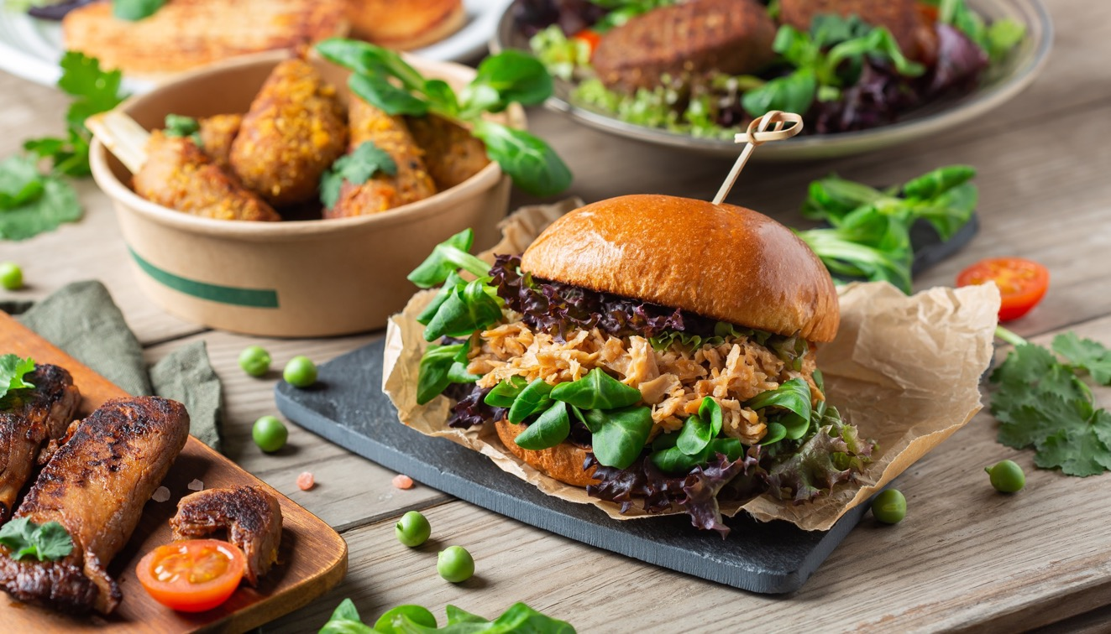
SELECTA
JUNE 2024
CORPORATE SOCIAL RESPONSIBILITY REPORT 2023
CHAPTER TWO
PLANET
PAGE 53
SWITCHING TO PLANT-BASED MEATS AND FOODS CAN DRAMATICALLY CUT YOUR CARBON FOOTPRINT, MAKING EVERY MEAL A STEP TOWARDS A GREENER PLANET.

Slide 61
SELECTA
JUNE 2024
CORPORATE SOCIAL RESPONSIBILITY REPORT 2023
CHAPTER TWO
PLANET
PAGE 54
Scope 1, 2, and 3 emissions explained…
At Selecta, we are committed to understanding and managing our greenhouse gas (GHG) emissions comprehensively. To achieve this, we categorize our emissions into three scopes: Scope 1, Scope 2, and Scope 3. Here's how we break down these categories:
Scope 1 Emissions - direct emissions
Scope 1 emissions are the direct emissions from sources that we, Selecta, own or control. These emissions come from activities that we directly engage in and can manage.
Examples
Fuel Combustion - emissions from burning fossil fuels in our company-owned vehicles and heating (gas and oil).
Scope 2 Emissions - indirect emissions from energy
Scope 2 emissions are the indirect emissions from the consumption of purchased energy. These emissions occur at the site where the energy is generated, but we are responsible for them because we use the energy in our operations.
Examples
Purchased electricity - emissions from the electricity we buy from the grid to power our operations and EVs.
Purchased steam or heating - emissions from steam or heating that we buy from an external provider to heat our facilities.
Scope 3 Emissions - other indirect emissions
Scope 3 emissions are all other indirect emissions that occur in our value chain. These emissions are a consequence of our activities but occur from sources not owned or directly controlled by us. Scope 3 is often the largest category and includes a wide range of activities.
Examples
Upstream activities
Purchased goods and services - the emissions produced during the creation of goods and services that we buy.
Capital goods - long-term assets like equipment and machinery that we buy for production, which are used over several years.
Fuel and energy-related activities - the process of making energy sources usable at Selecta and the losses during energy transmission and distribution to our locations.
Upstream transportation and distribution - the emissions from transportation companies we pay to deliver our goods by truck, rail, sea, or air.
Waste generated in operations - the emissions linked to creating, recycling, and composting our solid waste.
Business travel - the emissions from our associates traveling for work, including flights and car rentals.
Employee commuting - the emissions from our associates traveling to and from work.
Upstream leased assets: The impact of leasing equipment or buildings for our use.
Downstream activities
Use of sold products - this includes the emissions from the use of products sold by Selecta. In our case, it includes the indirect emissions from clients using the coffee sold by Pelican Rouge Coffee Roaster.
End-of-life treatment of sold products - this includes the emissions from the disposal of sold coffee by Selecta.

Slide 62

SELECTA
JUNE 2024
CORPORATE SOCIAL RESPONSIBILITY REPORT 2023
CHAPTER TWO
PLANET
PAGE 55
Inset credits
A SUSTAINABLE PATH TO CARBON NEUTRALITY
At Selecta, we are committed to reducing our carbon footprint while supporting the farmers within our value chain. One innovative way we are achieving this is using inset credits, specifically Acorn Carbon Removal Units (CRUs).
What are inset credits?
Inset credits are a unique mechanism that allows companies to offset their carbon emissions by investing in projects within their own supply chain. Unlike traditional carbon offsets, which often involve external projects, insetting integrates carbon reduction efforts directly into the company’s value chain. This approach not only helps in achieving carbon neutrality but also delivers direct benefits to the communities and environments where the company operates.
How inset credits work for Selecta
1. Measurement and verification - Acorn, owned by Rabobank¹, plays a crucial role in this process. Using sophisticated radar technology, Acorn measures and verifies the avoided CO2 emissions from farm-level projects. Each ton of CO2 avoided is converted into a carbon insetting credit, known as a Carbon Removal Unit (CRU).
2. Creating inset credits - the Selecta Coffee Fund runs agricultural programs aimed at reducing CO2 emissions on farms in countries like Colombia and Burundi. These programs focus on sustainable farming practices that lower emissions and enhance the productivity and livelihoods of farmers.
3. Purchasing and using Carbon Removal Units: Selecta, through its Pelican Rouge brand, buys back the credits generated from these projects. These CRUs can then be used in two main ways:
Company-wide emissions - to offset the overall emissions from Selecta/Pelican Rouge, moving towards the goal of complete carbon neutrality.
Product-specific emissions - to offset emissions specifically from the coffee supply chain. This involves calculating the emissions from coffee production and using CRUs to neutralize these emissions.
4. Flexibility in usage - the way Selecta chooses to use these CRUs can be decided at a later stage. After purchasing, the CRUs are retired in Selecta's name, ensuring the payment goes directly to the farmers. This flexibility allows Selecta to adapt the use of CRUs based on evolving company needs and priorities.
Current availability and first right of refusal
Selecta has an agreement to identify available CRUs within its supply chains, particularly focusing on Colombia through partnerships with Sucden and Global Cafes. In 2023 the number of CRUs transferred from the Colombia project was 108 (mt CO₂).
Insetting with Acorn Carbon Removal Units presents a unique and effective strategy to achieve our carbon neutrality goals while supporting the farmers who are integral to our coffee supply chain. This innovative approach not only addresses environmental challenges but also creates a sustainable future for our partners and communities.
¹Rabobank: is a Dutch multinational banking and financial services company known for its cooperative structure and focus on agriculture and sustainability.

Slide 63
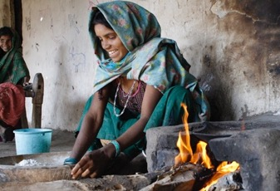
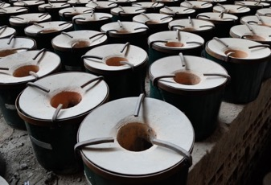
SELECTA
JUNE 2024
CORPORATE SOCIAL RESPONSIBILITY REPORT 2023
CHAPTER TWO
PLANET
PAGE 56
Inset credits
SELECTA’S OFFSET PROJECTS
Our efforts for a sustainable future. At Selecta, we are committed to creating a more sustainable world by offsetting our CO2 emissions through impactful projects worldwide. Here are some of our key initiatives.
IMPROVED COOKSTOVES FOR WOMEN IN INDIA
EFFICIENT COOKSTOVES IN RWANDA
Empowering women and protecting forests in the Raichur region of India.
In Raichur, India, Selecta, together with local partner Samuha, has provided over 18,000 households with cleaner cookstoves (Chulikas) since 2011. These cookstoves reduce wood use by two-thirds, lower CO2 emissions, and protect local forests. They also improve living conditions by reducing indoor smoke and the time women spend gathering wood.
Benefits
66% reduction in wood use
Reduced indoor smoke
Improved living conditions for women
Reducing wood consumption and improving air quality in Rwanda.
In Rwanda, where 98% of households cook with wood, distributing efficient cookstoves significantly reduces wood use, smoke, and CO2 emissions. These locally produced stoves, made from materials like clay and scrap metal, help preserve biodiversity by reducing deforestation.
Benefits
58,315 tons of CO2 emissions reduced annually
Positive impact on 22,000 families
Reduced time spent collecting wood, allowing more time for education and work

Slide 64
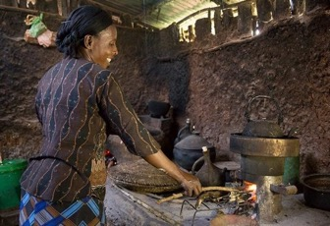
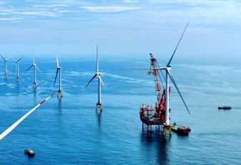

SELECTA
JUNE 2024
CORPORATE SOCIAL RESPONSIBILITY REPORT 2023
CHAPTER TWO
PLANET
PAGE 57
CLEANER COOKSTOVES FOR COFFEE FARMERS IN ETHIOPIA
WIND ENERGY IN TAIWAN
SAFE WATER FOR SCHOOLS IN KENYA
Promoting sustainability and improving living conditions for coffee farmers in Ethiopia.
In Ethiopia, where the coffee sector is threatened by deforestation and climate change, Selecta, in collaboration with the Oromia Coffee Farmers Cooperative Union, has distributed 40,000 cleaner cookstoves. These cookstoves reduce wood consumption and CO2 emissions by 40%, lowering environmental impact and enhancing the quality of life for the farmers.
Benefits
40% reduction in wood consumption
Improved air quality due to less smoke
Support for local communities
Promoting renewable energy and environmental awareness in Taiwan.
Despite strong coastal winds, Taiwan relies on fossil fuels for 75% of its electricity. This project involves four bundled wind farms with a total of 42 wind turbines, generating 250,000 MWh of energy annually. These wind farms reduce fossil fuel dependence, create jobs, and support reforestation efforts to enhance local biodiversity.
Benefits
250,000 MWh of renewable energy annually
Reduction of 200,000 tons of CO2 emissions per year
Improved local infrastructure and job creation
Providing access to safe drinking water for students in Kenya.
This project delivers reliable and affordable water purification technologies to public and private schools in developing countries, funded by the reduction of carbon emissions from eliminating the need to boil water. To date, the project has reached over 10,000 schools and improved the health and well-being of more than 3 million students.
Benefits
Improved student health and well-being
Reduced school absenteeism
Economic savings from reduced firewood use

Slide 65




SELECTA
JUNE 2024
CORPORATE SOCIAL RESPONSIBILITY REPORT 2023
CHAPTER TWO
PLANET
PAGE 58
Offset credits
HOW IT WORKS
REQUESTING CO2 CREDITS
Once we have all the data and the CO2 emissions have been calculated, we request the necessary carbon credits. These credits come from certified projects (Gold Standard or VERRA) and are obtained in collaboration with specialized external partners.
02
CALCULATING CO2 EMISSIONS FOR COFFEE
01
First, we determine the CO2 emissions for our client’s coffee based on the following factors:
Type of coffee: Arabica or Robusta
Country of origin
Amount of coffee: in kg
Certifications
Transport method
Roasting process
Packaging
If we expand the scope to include the journey from production to the store shelf, we also consider:
Client's location
Type of distribution
All this information is entered into our coffee calculator, which then calculates the CO2 emissions per kilogram of coffee and determines how many carbon credits are needed to offset these emissions.
CERTIFICATION
Finally, the client receives a certificate confirming the carbon compensation for their coffee.
03
Notes:
© Copyright PresentationGO.com – Free Templates & Infographics for PowerPoint and Google Slides

Slide 66

SELECTA
JUNE 2024
CORPORATE SOCIAL RESPONSIBILITY REPORT 2023
CHAPTER TWO
PLANET
PAGE 59
Did you know?
In a recent study by Selecta Sweden, we explored the impact of using telemetry and pre-kitting on our carbon footprint. We carefully tracked the same delivery routes for the same clients, both before and after implementing these technologies.
The results were impressive! In just one quarter, we reduced our carbon emissions by 10.5 tons of CO2 equivalent (tCO2e). Projecting these results over an entire year, we could potentially cut our emissions by 42 tCO2e.
10.5 tons of CO2 is equivalent to
Burning 3.350 liters of diesel
Driving an average car approximately 60.900 km
Flying to Paris 73 times
Traveling 168,000 km by train
Traveling 73,500 km by bus
Cycling around the earth 31,5 times on an electric bike
Breathing for 5.250 days
Eating 2.625 Big Macs
To Offset 10.5 Ton of CO2 Emissions
525 trees need to grow for a year
A 2.3MW wind turbine needs to run for 26 hours
95 to 105 solar panels are needed to generate electricity for a year
This study highlights the powerful role of innovative solutions like telemetry and pre-kitting in promoting sustainability and reducing our carbon footprint, particularly in Scope 3 emissions. It's a significant step forward in our commitment to a greener future.
What is prekitting?
Prekitting is a process where all necessary items for restocking (vending) machines are pre-packaged and organized before being dispatched. This preparation involves compiling all products, tools, and materials needed for a service visit into a single, ready-to-go kit. The kits are prepared in advance at a central location, ensuring that our Joy Ambassadors have everything they need when they arrive at the site.

Slide 67









SELECTA
JUNE 2024
CORPORATE SOCIAL RESPONSIBILITY REPORT 2023
CHAPTER TWO
PLANET
PAGE 60
Did you know?
PREKITTING
MINIMIZED WASTE & IMPROVED INVENTORY MANAGEMENT
ENHANCED OPERATIONAL COORDINATION
OPTIMIZED ROUTE PLANNING
REDUCE VEHICLE LOAD
INCREASED SERVICE EFFICIENCY
By preassembling kits, we streamline the restocking process, reducing the time spent at each location.
Telemetry data from our vending machines allows us to plan the most efficient routes, minimizing travel distances and fuel consumption.
Prekitting ensures that only the necessary items are carried, reducing the overall weight of the service vehicles.
Lighter vehicle loads contribute to lower fuel consumption and decreased emissions.
With pre-packaged kits, service technicians can complete their tasks more quickly and efficiently.
This efficiency reduces the number of trips needed, further cutting down on fuel usage and emissions.
Prekitting helps in precise inventory management, ensuring that only required quantities are transported.
This reduces overstocking and waste, contributing to overall sustainability efforts.
Centralized preparation of kits allows for better coordination and planning, ensuring optimal use of resources and minimizing unnecessary trips.

Slide 68

SELECTA
JUNE 2024
CORPORATE SOCIAL RESPONSIBILITY REPORT 2023
CHAPTER TWO
PLANET
PAGE 61
Planet
EFFICIENT OPERATIONS THROUGH INTERNET OF THINGS
Leveraging the power of the Internet of Things (IoT) is a key component of our strategy to optimize operations and reduce emissions. By utilizing IoT technology, we can enhance the efficiency of our fleet and machinery, leading to significant reductions in resource consumption and emissions.
PROOF OF COMMITMENT
2023 MILESTONES
OUR JOURNEY AHEAD 2024-2026
Our investment in IoT technology has already shown promising results, as evidenced by our achievements in 2023.
Telematics in 87% of operational vehicles
We equipped 87% of our operational vehicles with telematics, allowing us to monitor and optimize their performance. This percentage represents the maximum achievable as we have equipped all vehicles with telematics wherever technically feasible.
Telemetry in 78% of machines
78% of our machines are now equipped with telemetry. This percentage represents the maximum achievable as we have equipped all compatible machinery with telemetry wherever technically feasible.
Maximizing fleet efficiency - we will ensure that our fleet operates with maximum efficiency by minimizing travel distances and optimizing routes, thereby reducing fuel consumption and emissions.
Reducing resource consumption - continued investment in IoT technology will help us further reduce resource consumption across our operations, enhancing our overall sustainability.
Picture: Telemetry handheld

Slide 69






SELECTA
JUNE 2024
CORPORATE SOCIAL RESPONSIBILITY REPORT 2023
CHAPTER TWO
PLANET
PAGE 62
Telematics is an essential tool for optimizing fleet operations and enhancing service efficiency. By providing real-time data on vehicle location, driver behaviour, fuel consumption, and vehicle health, telematics helps us reduce costs, improve safety, and deliver superior service to our clients. This technology not only supports operational excellence but also aligns with our commitment to sustainability and client satisfaction.
Telematics explained…
ROUTE OPTIMISATION
By analyzing anonymized vehicle location data, telematics helps us plan the most efficient routes for restocking and servicing. This reduces travel time and fuel consumption.
01
DRIVER SAFETY MONITORING
Safety and efficiency: our telematics systems monitor the safe driver behavior, including speed, acceleration, braking, and idling. This data helps us identify and address unsafe or inefficient driving practices, promoting safer and more fuel -efficient driving.
Driver training: insights gathered from telematics data are then used to develop targeted driver training programs, enhancing overall driver performance, and reducing the risk of accidents.
02
03
FUEL MANAGEMENT
Fuel efficiency improvements: by optimizing routes and monitoring driver behavior, we use telematics to help us improve the overall fuel efficiency of our fleet and reduce the carbon footprint of our service.
04
Resource allocation: with real -time anonymized data on vehicle location and status, we can allocate resources more effectively, ensuring that service personnel are deployed where they are needed most.
Reduced downtime: by optimizing routes and scheduling maintenance proactively, telematics helps minimize vehicle ware and service downtime, ensuring that our fleet is always ready to meet client needs at peek moments.
OPERATIONAL EFFICIENCY
05
Improved responsiveness: real -time GPS tracking enable us to respond quickly to service requests, enhancing client satisfaction.
Reliable service: by ensuring that vehicles are well -maintained, and drivers are well -trained, telematics contributes to the reliability and consistency of our service operations.
CLIENT SERVICE
Important Note: the driver identity is always respected and subject to GDPR guidelines. Therefore, only vehicle identification is used, ensuring that drivers remain anonymous.

Slide 70
SELECTA
JUNE 2024
CORPORATE SOCIAL RESPONSIBILITY REPORT 2023
CHAPTER TWO
PLANET
PAGE 63
Telemetry explained…
01 - INVENTORY MONITORING
1
2
3
4
5
Real-time data collection - Telemetry systems collect data on stock levels in our machines. This real-time data helps us ensure that machines are always well-stocked and ready to meet consumer demand.
Automated alerts - when stock levels fall below a certain threshold, the system sends automated alerts to the central management system, prompting timely restocking and reducing the risk of stockouts.
For Selecta, telemetry is a powerful tool that enhances inventory management and machine performance. By providing real-time data, predictive maintenance capabilities, and operational insights, telemetry helps us ensure that our vending machines, smart fridges, coffee machines and other Food Tech solutions, are always well-stocked, operational, and efficient. This technology not only improves the client and consumer experience but also supports our commitment to sustainability and operational excellence.
02 - PERFORMANCE MONITORING
Machine diagnostics - Telemetry provides detailed information on the performance and health of machines. It monitors key parameters such as temperature, energy consumption, and operational status, ensuring that all equipment is functioning optimally.
Predictive maintenance - by analysing data from sensors, telemetry can predict potential issues before they lead to machine failures. This proactive approach helps minimize downtime and ensures that machines are always available for use.
03 - EFFICIENCY IMPROVEMENTS
05 - DATA-DRIVEN DECISIONS
Route optimization - Telemetry data can be used to optimize restocking routes for service personnel. By knowing which machines need attention and where they are located, we can plan the most efficient routes, saving time and fuel.
Resource allocation - with detailed insights into machine usage patterns, we can allocate resources more effectively, ensuring that high-demand locations receive priority service.
Operational insights - Telemetry provides valuable data that can be analysed to gain insights into usage patterns, consumer preferences, and machine performance. These insights help us make informed decisions about inventory management, machine placement, and service strategies.
Sustainability - by optimizing routes, reducing unnecessary service visits, and ensuring efficient operation of machines, telemetry contributes to our sustainability goals by minimizing the environmental impact of our operations.
04 - CONSUMER EXPERIENCE
Consistent availability - by maintaining optimal stock levels and ensuring that machines are always operational, telemetry enhances the consumer experience. Consumers can rely on our machines to provide their favourite snacks, drinks, and coffee without interruption.
Quality assurance - continuous monitoring of machine performance ensures that products are stored and dispensed under optimal conditions, maintaining product quality and safety.

Slide 71
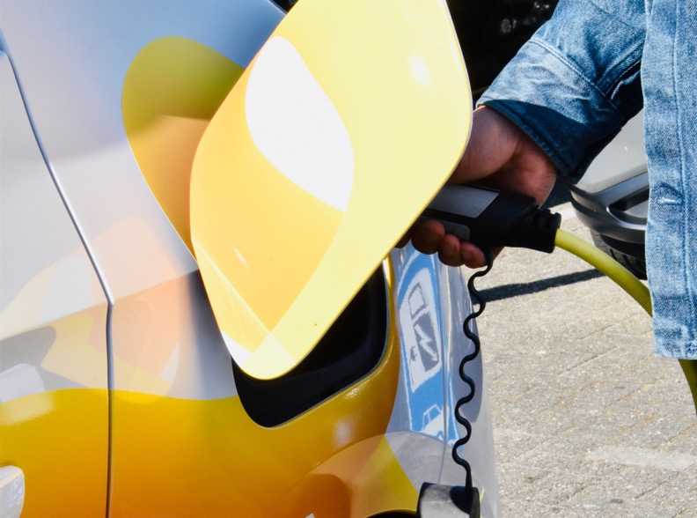
SELECTA
JUNE 2024
CORPORATE SOCIAL RESPONSIBILITY REPORT 2023
CHAPTER TWO
PLANET
PAGE 64
Did you know?
Impact of Telematics on fuel efficiency and carbon reduction
We examined the impact of telematics on fuel efficiency and carbon emissions by comparing two teams: Team A with a high telematics score and Team B with a low telematics score. To ensure a fair comparison, both teams were standardized on key technical factors, including van type, age, model, and route type.
The driver's telematics score was determined based on various driving metrics such as speeding, harsh braking, idling, and overall driving behaviour.
The results were compelling. Team A, which achieved a high telematics score, successfully reduced diesel consumption by over 160 litres over a distance of 20,000 km. This reduction translated to a significant saving of 430 kgCO2e.
The study conclusively demonstrates that telematics is an effective tool for monitoring and improving driver behaviour, leading to substantial reductions in fuel consumption and carbon emissions. The implementation of telematics not only enhances fuel efficiency but also contributes positively to environmental sustainability.
Picture: Selecta electric car

Slide 72
SELECTA
JUNE 2024
CORPORATE SOCIAL RESPONSIBILITY REPORT 2023
CHAPTER TWO
PLANET
PAGE 65
Planet
WASTE REDUCTION
01
Selecta’s waste management strategy focuses on minimizing waste generation right from the start. We achieve this by using smarter packaging and making better choices in packaging design.
REDUCE
02
Next, we extend the life of our products through reuse. We encourage using refurbished machines or parts and repairing items to prolong their usability, reducing the need for manufacturing new ones.
RE-USE
Selecta’s waste management strategy focuses on minimizing waste generation right from the start. We achieve this by using smarter packaging and making better choices in packaging design. Next, we extend the life of our products through reuse. We encourage using refurbished machines or parts and repairing items to prolong their usability, reducing the need for manufacturing new ones. Recycling is another key part of our approach, helping to conserve energy and resources during material manufacturing. By following the “3Rs” – Reduce, Reuse, Recycle – we aim to minimize waste and repurpose materials into new products through recycling and refurbishing, thus saving resources and energy.
When the “3Rs” are not feasible, we focus on transforming waste into something useful, like energy. Landfilling is our last resort, and we strive to avoid it whenever possible. Reducing waste is essential to our sustainability strategy. By minimizing waste and promoting recycling, we reduce our environmental impact and support a circular economy.
PROOF OF COMMITMENT
Our commitment to waste reduction is demonstrated by our ongoing efforts to consolidate waste management practices.
Recycling is another key part of our approach, helping to conserve energy and resources during material manufacturing. By following the “3Rs” – Reduce, Reuse, Recycle – we aim to minimize waste and repurpose materials into new products through recycling and refurbishing, thus saving resources and energy.
RECYCLE
03
ENERGY RECOVERY
04
When the “3Rs” are not feasible, we focus on transforming waste into something useful, like energy.
LANDFILL
05
Landfilling is our last resort, and we strive to avoid it whenever possible.

Slide 73

SELECTA
JUNE 2024
CORPORATE SOCIAL RESPONSIBILITY REPORT 2023
CHAPTER TWO
PLANET
PAGE 66
Championing waste treatment in Italy
TURNING COFFEE GROUNDS INTO ENERGY
We are proud to introduce one of our waste treatment champions: Italy. In 2023, Selecta Italy processed 553 tons of coffee grounds, transforming what was once waste into valuable bio-generated energy. This innovative approach not only reduces waste but also contributes significantly to our sustainability goals.
From coffee grounds to electricity
The coffee grounds collected from our vending machines are processed into biogas, which is then converted into electricity. This process yields an impressive 610 kWh of electricity per ton of coffee grounds. In 2023, this amounted to 337 MWh of electricity, enough to power 34 average EU households for an entire year!
Project steps and process
Collection - our Joy Ambassadors remove the bags of spent coffee grounds from each vending machine during their service visits. These bags are then securely stored in our company vehicles.
Storage - upon returning to our facilities, the coffee grounds are poured into large containers to avoid contamination. These containers are kept in a dry, sheltered environment until they are transported.
Transportation - every 15 to 20 days, the filled containers are collected and taken by our logistics partner to a biogas plant.
Biogas production: At the biogas plant, the coffee grounds are processed to produce methane gas. Each ton of coffee grounds generates approximately 150 to 160 cubic meters of methane, which is then converted into electricity.
Environmental and economic benefits
Sustainable energy - the biogas produced from coffee grounds is a reliable source of energy, available regardless of weather conditions or time of day.
Reduced emissions - this process helps save fossil fuels and reduces carbon dioxide emissions, contributing to a cleaner environment.
Cost savings - by converting waste into energy, we reduce waste disposal costs and receive financial incentives that are reinvested into our sustainability projects.
A brighter, greener future!
Selecta Italy’s innovative use of spent coffee grounds showcases our commitment to sustainability and environmental stewardship. By turning waste into energy, we are making a tangible difference and setting an example for others to follow. Our efforts demonstrate that with creativity and dedication, we can transform challenges into opportunities for a greener future.
553
Picture: Collection of coffee grounds

Slide 74

SELECTA
JUNE 2024
CORPORATE SOCIAL RESPONSIBILITY REPORT 2023
CHAPTER TWO
PLANET
PAGE 67
BRITA & Selecta
RECYCLING PROGRAM
At Selecta, we believe in making a positive impact on our planet through innovative and sustainable practices. One of our key initiatives is the BRITA Recycling Program, a comprehensive approach to recycling that ensures every end is a new beginning.
BRITA is a global leader in water filtration, known for its high-quality products that enhance the taste and safety of drinking water. Founded in 1966, BRITA has been at the forefront of developing sustainable and efficient water filtration solutions for both households and professional use. Their commitment to innovation and sustainability aligns perfectly with Selecta’s values, making BRITA a key partner in our journey towards a greener future.
BRITA filters remove impurities from water, such as chlorine, limescale, and other contaminants. This improves the water quality, reduces the need for bottled water, thereby cutting down on plastic waste and the carbon footprint associated with the production and transportation of bottled water. Filtering out harmful substances ensures that the water consumed is safer, which is particularly important in areas where tap water quality may be compromised. Over time, using a BRITA filter is more economical than buying bottled water, providing long-term savings for both households and businesses.

Slide 75
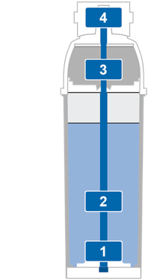

SELECTA
JUNE 2024
CORPORATE SOCIAL RESPONSIBILITY REPORT 2023
CHAPTER TWO
PLANET
PAGE 68
Did you know?
Did you know that the type of water you use can significantly influence the taste and quality of your coffee. Different water compositions can affect not only the flavour but also the longevity and performance of your coffee machines.
Using the right type of water ensures better crema, a more refined aroma, and improved taste. Elements in tap water, though invisible, influence the flavour, consistency, and appearance of coffee, impacting your barista skills and consumer satisfaction. Adjusting water quality to the specific needs of the coffee-making process can prevent issues like bitterness or flatness.
Brita filters ensure the highest water quality through a reliable systematic filtration technology that decarbonizes water in four steps:
Pre-filtration - a pre-filter captures coarse particles.
Reduction of carbonate hardness - the filter medium reduces carbonate hardness to minimize lime scale build-up.
Activated carbon filtration - water, including bypass water, flows through an activated carbon filter to reduce substances that affect taste and odour.
Fine filtration - a membrane captures any remaining fine particles.
By employing these filters, Selecta helps clients avoid substantial carbon emissions. For every 50 machines in use, we save over 380 kg of CO2 equivalent (kgCO2e).
This remarkable achievement is calculated as follows: each filter saves 3.86 kgCO2e at the end of its life. With each machine requiring two filter changes per year, the total savings amount to 386 kgCO2e annually for 50 machines.
Why this matters
Environmental protection - by recycling our products, we significantly reduce waste and the demand for new raw materials, protecting natural resources. This reduces the environmental footprint of both BRITA and Selecta.
Circular economy - this program supports a circular economy where products are reused and recycled rather than discarded.
Resource efficiency - by recycling approximately 80% of the filter’s components, we demonstrate high efficiency in resource utilization and waste reduction. This not only conserves valuable materials but also reduces the volume of waste sent to landfills.
Hard Water
Contains high levels of calcium, magnesium, and bicarbonates.
Gypsum Water
High in calcium, magnesium, and sulfates.
Soft Water
Contains low levels of calcium, magnesium, and gypsum.
Salty Water
High levels of chlorides and sulfates, which can lead to corrosion.

Slide 76


SELECTA
JUNE 2024
CORPORATE SOCIAL RESPONSIBILITY REPORT 2023
CHAPTER TWO
PLANET
PAGE 69
2023 MILESTONES
Champion in avoiding landfill
We are incredibly proud to announce that Selecta's Pelican Rouge Coffee Roaster, certified under ISO 14001, has achieved a significant environmental milestone in 2023: 0% waste to landfill.
Recycling - 78,11% of waste was recycled, highlighting our dedication to resource efficiency and waste reduction.
Reuse - 0,03% of materials were reused, demonstrating our commitment to minimizing waste.
Green energy conversion - 11,08% of waste was converted into green energy, contributing to sustainable energy solutions.
Grey energy conversion - 0,01% of waste was converted into grey energy, ensuring that even non-recyclable materials are utilized efficiently.
This outstanding achievement showcases our unwavering commitment to sustainable practices and positions the Pelican Rouge Coffee Roaster as a true leader in environmental responsibility.
What is ISO 14001?
ISO 14001 is an internationally recognized standard for effective environmental management systems. It provides a framework for organizations to protect the environment, respond to changing environmental conditions, and enhance environmental performance.
Picture: Pelican Rouge Coffee Roasters

Slide 77
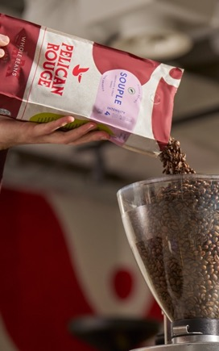
SELECTA
JUNE 2024
CORPORATE SOCIAL RESPONSIBILITY REPORT 2023
CHAPTER TWO
PLANET
PAGE 70
OUR JOURNEY AHEAD 2024-2026
Scaling sustainability initiatives
In 2023, we initiated several pilot projects aimed at finding innovative ways to tackle the growing complexity of waste streams due to advancements in food technology. Our goal is to scale these initiatives in 2024 to achieve significant environmental benefits.
Waste reduction efforts
Single-use items - to combat the environmental impact of single-use items, we have implemented alternatives across our points of sale. Most of this waste stream consists of cups. We currently offer crockery as an alternative to disposable cups, along with multi-use cups that include collection and washing services. In locations where multi-use cups are not viable, we provide plastic-free, recyclable single-use options. In 2024, we plan to introduce the first deposit systems to incentivize consumers to choose multi-use options in our public locations.
Packaging - our Pelican Rouge coffee bags are produced with mono-material plastic, which allows for highly efficient recycling. We have established collection programs with our clients to gather used bags, even in partial service operations. Additionally, mono-material plastic has lower CO2 emissions during production, making it beneficial throughout its lifecycle. In 2024, we will expand our reversed vending programs for PET bottles and increase the use of functional water dispensers to reduce the number of plastic bottles sold, favouring multi-use containers.
Food and organic waste - Selecta has several programs in place to manage coffee waste. Additionally, we are participating in the "From Waste to Watt" research program, where coffee waste is converted into biocarbon for potential use in battery manufacturing. This collaboration with Granola Battery Technology and RISE Research Institute in Sweden aims to scale this process for industrial use, potentially reducing reliance on climate-sensitive lithium from Asia. To reduce food waste, we leverage advanced telemetry for planogram creation. A successful case in Denmark involved collaboration across multiple departments and client involvement, resulting in a 50% reduction in food waste. We have also increased the number of “Eat Now” fridges, which sell food with short shelf life at reduced prices and implemented campaigns at individual sites to prevent food spoilage over closed weekends.
Key projects to be scaled in 2024
Multi-use cups - expansion of collection and washing services, and introduction of deposit systems for consumer incentives.
Packaging collection - enhanced programs for collecting and recycling Pelican Rouge coffee bags and PET bottles.
Functional water dispensers - increase the installation of water dispensers to reduce plastic bottle usage.
Coffee waste upcycling - scale up partnerships like Coffee Inc and explore new applications such as biocarbon for batteries.
Food waste reduction - broader application of telemetry-based planograms and expansion of "Eat Now" fridges.
Picture: Pelican Rouge Monomaterial packaging
OUR “EAT NOW” FRIDGES OFFER FOOD WITH SHORT SHELF LIFE AT REDUCED PRICES TO PREVENT FOOD SPOILAGE OVER CLOSED WEEKEDS

Slide 78

SELECTA
JUNE 2024
CORPORATE SOCIAL RESPONSIBILITY REPORT 2023
CHAPTER THREE
PRODUCT
PAGE 71
03
PRODUCT

Slide 79
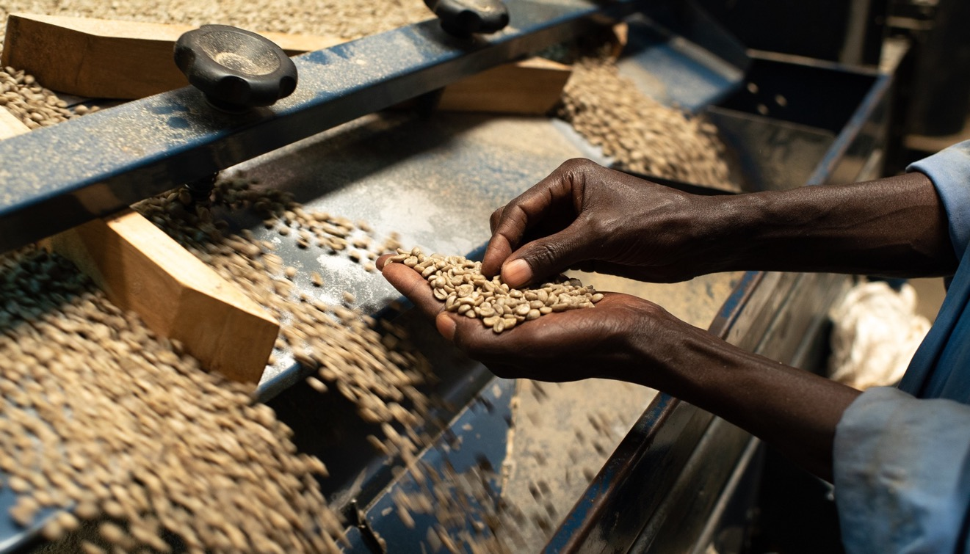
SELECTA
JUNE 2024
CORPORATE SOCIAL RESPONSIBILITY REPORT 2023
CHAPTER THREE
PRODUCT
PAGE 72

Slide 80
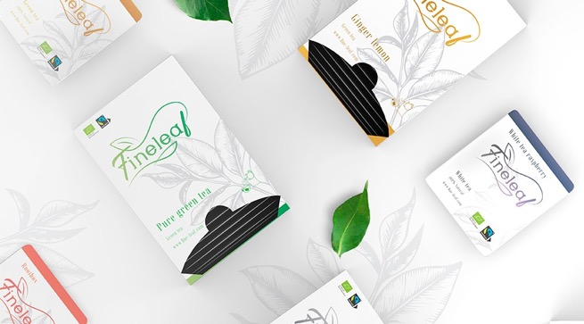
SELECTA
JUNE 2024
CORPORATE SOCIAL RESPONSIBILITY REPORT 2023
CHAPTER THREE
PRODUCT
PAGE 73
Revolutionising sustainability for tomorrow
SUSTAINABLE ASSORTMENT & INNOVATIVE CIRCULARITY PROJECTS
Through a sustainable assortment and innovative circularity projects, we cover the needs of today considering the impact on tomorrow.
At Selecta, our commitment to sustainability extends to the products we offer. We understand that the choices we make today will shape the future, which is why we prioritize sustainable sourcing, innovative circularity projects, and a zero-waste approach. Our bold statement encapsulates our dedication to meeting the current needs of our clients while minimizing our impact on the environment. Here are the five key initiatives that drive our sustainability efforts under the Product pillar.
Picture: Fineleaf tea collection

Slide 81
SELECTA
JUNE 2024
CORPORATE SOCIAL RESPONSIBILITY REPORT 2023
CHAPTER THREE
PRODUCT
PAGE 74
Product
PELICAN ROUGE CERTIFIED COFFEE
Pelican Rouge is at the forefront of our sustainable coffee initiatives. We are dedicated to achieving carbon neutrality for our coffee production, from the farm to the roasted bean. This involves not only offsetting our emissions but also implementing insetting programs to reduce emissions at the source.
PROOF OF COMMITMENT
2023 MILESTONES
OUR JOURNEY AHEAD 2024-2026
At Selecta, we are committed to achieving carbon neutrality and have actively pursued comprehensive carbon offsetting and insetting programs. Our farm-level initiatives in Colombia, Vietnam, and Burundi are central to this effort.
2396 tCO2e purchased
We have focused on reducing emissions at the farm level through various sustainability programs. In 2023, we offset 2,396 tonnes of CO2 equivalent, showcasing our dedication to carbon-neutral coffee production. This achievement corresponds to over 2 million served cups of climate-compensated coffee. With the rapid expansion of our CO2-compensated Change Please program, these numbers are set to grow even further, reinforcing our commitment to sustainability and climate action.
Track implementation and effectiveness
We will closely track the implementation and effectiveness of our offsetting and insetting programs, measuring the reduction in CO2 emissions from the farm to the roasted bean.

Slide 82

SELECTA
JUNE 2024
CORPORATE SOCIAL RESPONSIBILITY REPORT 2023
CHAPTER THREE
PRODUCT
PAGE 75
Empowering sustainable coffee cultivation
OUR CARBON NEUTRALITY COMMITMENT IN VIETNAM
Our Selecta Coffee Fund Project in Vietnam is more than just an initiative—it's a transformative movement aimed at revolutionizing the coffee cultivation sector. Our pioneering efforts focus on lowering the carbon intensity of coffee production while ensuring that farmers achieve incomes above the average benchmark by reducing production costs.
Our project includes a variety of comprehensive activities designed to foster sustainable development and improve farmers' livelihoods:
Household assessment and carbon monitoring - we begin by understanding the needs and current practices of each household. By monitoring carbon emissions, we identify areas for improvement and track progress over time.
Training on responsible sourcing and regenerative agriculture - farmers receive training on sustainable practices that promote soil health, enhance biodiversity, and reduce environmental impact.
Bio-stimulant delivery and tree planting - we provide bio-stimulants to boost crop resilience and productivity. Our efforts have led to the planting of 6,000 shade trees, with a remarkable survival rate of approximately 90%. These trees are projected to sequester an estimated 2,040 metric tons of CO2 over 20 years, translating to an annual carbon reduction of 102 metric tons.
Establishment of demonstration plots - these plots serve as practical examples of best practices, allowing farmers to see first-hand the benefits of sustainable farming techniques.
With 58.6% of households involved in coffee cultivation living below the living income benchmark, our project aims to significantly boost productivity and profitability. This not only improves living standards but also contributes to the broader economic development of the region.
In 2023, the Selecta Coffee Fund achieved a significant milestone. Over 450 farmers were Rainforest Alliance certified. This certification validates the sustainable practices adopted by our farmers, enhancing their marketability and potential income. It signifies our commitment to not just meeting, but exceeding, global standards of sustainability and social responsibility.
Through the Selecta Coffee Fund Project, we are not just growing coffee; we are cultivating a future where farmers thrive, communities prosper, and the environment flourishes. Our commitment to meaningful impact drives us to continue innovating and supporting the coffee cultivation sector in Vietnam, ensuring a brighter, more sustainable future for all.
Picture: Right – Selecta Coffee Fund shade tress, avocado. Next page – Coffee flowering

Slide 83
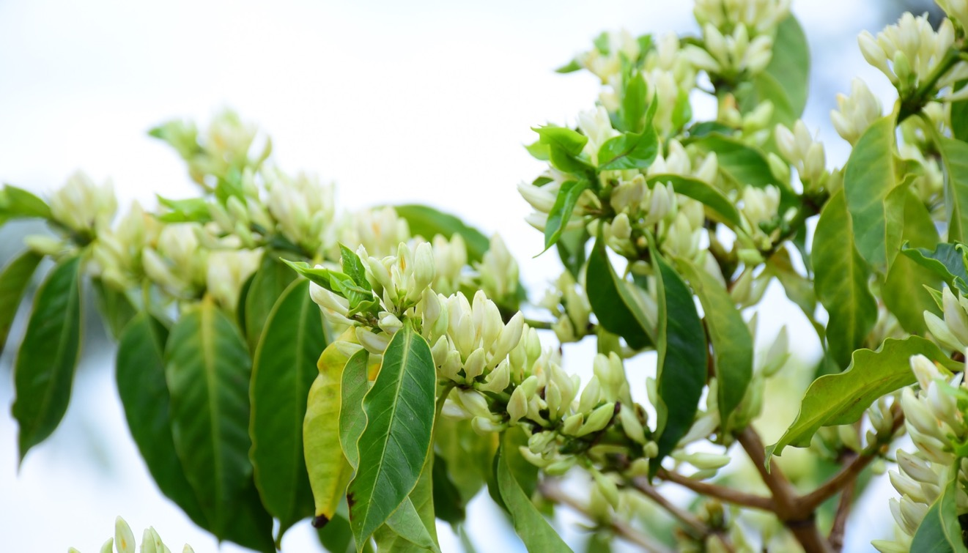
SELECTA
JUNE 2024
CORPORATE SOCIAL RESPONSIBILITY REPORT 2023
CHAPTER THREE
PRODUCT
PAGE 76

Slide 84
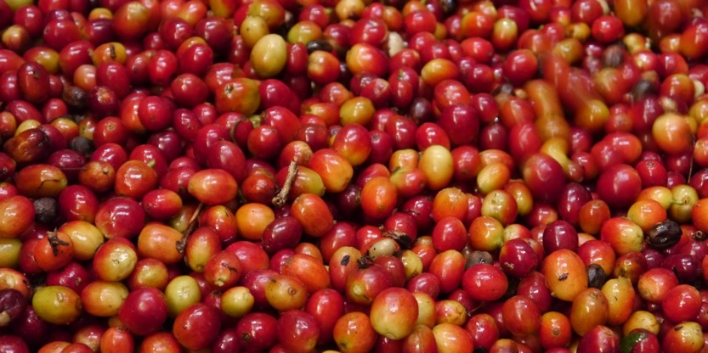
SELECTA
JUNE 2024
CORPORATE SOCIAL RESPONSIBILITY REPORT 2023
CHAPTER THREE
PRODUCT
PAGE 77
Product
PELICAN ROUGE
Pelican Rouge goes beyond delivering great coffee; it’s about sustaining a legacy, crafting exceptional flavours, and committing to a better future for all. Pelican Rouge —a brand that values heritage, champions great taste, and leads in sustainability.
Picture: Selecta Coffee Fund fresh coffee beans

Slide 85

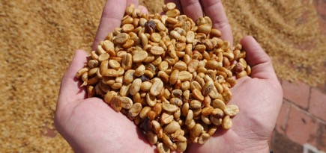
SELECTA
JUNE 2024
CORPORATE SOCIAL RESPONSIBILITY REPORT 2023
CHAPTER THREE
PRODUCT
PAGE 78
Pelican Rouge: Heritage, Great Taste, and Sustainability
Pelican Rouge is not just a coffee brand; it’s a legacy that dates back to the nineteenth century, where the Van Leckwyck family began their journey in Antwerp, Belgium. They traded exotic spices, tea, and green coffee beans, gradually becoming pioneers in coffee roasting. This rich heritage is the bedrock upon which Pelican Rouge is built, embodying a tradition of excellence and innovation that has spanned over 150 years.
Heritage
Founded in 1863, Pelican Rouge has always been about exploring new grounds and finetuning the art of coffee roasting. Joseph van Leckwyck, one of the early visionaries, understood the importance of quality in coffee, which led him to control the roasting process meticulously. This dedication to quality helped establish Pelican Rouge as a trusted name in coffee, known for its consistent and superior taste. The brand's name, "Roode Pelikaan," was carefully chosen to resonate deeply with the local audience, a testament to its roots in Belgian culture.
Great Taste
At Pelican Rouge, the pursuit of the perfect cup of coffee is a passion. The process begins with sourcing the finest coffee beans from around the world, ensuring each batch is roasted to perfection. The blends are crafted to cater to a variety of tastes, from mild to dark roasts, designed specifically for different brewing methods like espresso and filter coffee. This meticulous attention to detail guarantees a consistent and exceptional coffee experience. Our professionals, equipped with deep knowledge and expertise, ensure that every cup meets the highest standards of quality and flavour.
Sustainability
Sustainability is deeply ingrained in Pelican Rouge’s DNA. Pelican Rouge is committed to sourcing its coffee responsibly, ensuring that all its coffee is certified by Fairtrade, Rainforest Alliance, or Organic standards. Through the Selecta Coffee Fund, Pelican Rouge invests in farm-level programs that improve the livelihoods of coffee farmers, foster social equity, and maintain thriving ecosystems. Pelican Rouge packaging is moving towards fully recyclable mono-material by 2025, aligning with Selecta’s goal to minimize environmental impact. We believe in building long-term relationships with our farmers and suppliers, ensuring that every cup of coffee contributes positively to the planet and the communities we work with.
Picture: Top - Pelican Rouge Coffee Roasters coffee serving. Bottom dried coffee beans.

Slide 86
SELECTA
JUNE 2024
CORPORATE SOCIAL RESPONSIBILITY REPORT 2023
CHAPTER THREE
PRODUCT
PAGE 79
Insetting and Offsetting Emissions Programs explained…
In the context of achieving carbon neutrality for coffee production, Pelican Rouge employs both emissions insetting and offsetting programs.
Insetting programs
Insetting programs focus on reducing emissions within the company's own supply chain. This means implementing sustainability initiatives that directly reduce the carbon footprint of the production process, starting from the source. For Pelican Rouge, this involves:
Farm-Level interventions - implementing sustainable farming practices that reduce emissions, such as agroforestry, organic farming, or precision agriculture. These practices can enhance soil health, increase biodiversity, and reduce the need for chemical inputs.
Supply chain improvements - making changes within the coffee supply chain to reduce emissions, such as improving energy efficiency in processing facilities, optimizing transportation routes, or using renewable energy sources at various stages of production.
Partnerships with farmers - working directly with coffee farmers to adopt practices that lower their carbon footprint. This might include training and support for implementing carbon-reducing techniques and technologies.
How carbon capture benefits farmers and companies
When farmers capture carbon on their land, they create carbon removal units. Companies can purchase these units, which means they are investing in sustainable farming practices. This helps reduce the companies' carbon emissions, making their coffee production more eco-friendly. At the same time, it provides extra income for farmers, improving their livelihoods. This creates a more sustainable and equitable coffee production process, benefiting both the environment and farming communities. It's a win-win situation for everyone involved.
Offsetting emissions
Offsetting emissions involves compensating for the carbon dioxide (CO2) emissions produced by certain activities by investing in projects that remove or reduce an equivalent amount of CO2 from the atmosphere. Essentially, it's a way to balance out the emissions that cannot be eliminated. This is achieved through:
Carbon credits - purchasing carbon credits from projects that reduce or capture CO2, such as reforestation projects, renewable energy projects (like wind or solar farms), or methane capture projects.
Verified Carbon Standard (VCS) - ensuring that the offset projects meet certain standards to verify their effectiveness in reducing CO2 emissions.
Combined approach for carbon neutrality
Pelican Rouge's approach to achieving carbon neutrality for its coffee production involves a combination of both insetting and offsetting:
Insetting - making systemic changes within the coffee supply chain to reduce emissions directly at the source, thereby decreasing the overall carbon footprint of their operations.
Offsetting - investing in external projects that balance out the residual, unavoidable CO2 emissions produced during coffee production and roasting.
By utilizing both strategies, Pelican Rouge not only compensates for the emissions it produces but also takes proactive steps to minimize future emissions, creating a more sustainable and environmentally responsible coffee production process.

Slide 87

SELECTA
JUNE 2024
CORPORATE SOCIAL RESPONSIBILITY REPORT 2023
CHAPTER THREE
PRODUCT
PAGE 80
Product
REDUCING EMISSIONS IN OUR OWN SUPPLY CHAIN
SCF FARMERS - INSET SUPPLIER
Farmers involved in the SCF insetting programs employ regenerative practices to grow low-carbon coffee. These farmers are compensated per metric ton of carbon sequestration achieved through their efforts.
PROJECT DEVELOPERS - SCHUTTELAAR & PARTNERS
We work directly with farmers to develop decarbonation projects. Schuttelaar & Partners collaborate with cooperatives within our coffee supply chain to deliver insets, ensuring a reduction in emissions.
Pelican Rouge Coffee Roaster - The Pelican Rouge Coffee Roaster purchases physical coffee from farmers or traders and receives the emissions reduction benefits (insets) generated from these projects.
Selecta AG - Selecta AG purchases the coffee from Pelican Rouge Coffee Roaster to distribute across all markets, counting the emissions reduction benefits towards our Scope 3 net carbon balance.
INDEPENDENT QUALITY ENABLERS - ACORN
Acorn provides measurement, reporting, and verification to confirm the sequestered CO2 emissions from these projects, ensuring transparency and accuracy.
MAINSTREAM STANDARDS & INDEPENDENT THIRD-PARTY VERIFIERS
These verifiers assess the credibility of the entire process and the final claims, maintaining the integrity of our carbon neutrality efforts.
Through these comprehensive programs, Selecta has significantly reduced greenhouse gas emissions and promoted sustainable practices within our supply chain, underscoring our commitment to a greener future.

Slide 88

SELECTA
JUNE 2024
CORPORATE SOCIAL RESPONSIBILITY REPORT 2023
CHAPTER THREE
PRODUCT
PAGE 81
Product
RECYCLABLE PACKAGING
Packaging plays a critical role in our sustainability strategy. We are committed to redesigning our packaging to ensure it is fully recyclable, thereby reducing our environmental footprint.
PROOF OF COMMITMENT
2023 MILESTONES
OUR JOURNEY AHEAD 2024-2026
Our packaging redesign initiatives, like our mono material coffee bags, are aimed at replacing non-recyclable components with sustainable alternatives.
Mono-material refers to packaging made from a single type of material, which simplifies the recycling process and improves the efficiency of waste management. Using mono-materials helps reduce environmental impact as it is easier to recycle compared to multi-material packaging, which often requires separation of different materials before recycling.
At Selecta, we proudly use mono-material packaging for our Pelican Rouge coffee bags. This innovative approach not only ensures that our packaging is more sustainable and easier to recycle but also aligns with our commitment to reducing environmental impact and promoting eco-friendly practices. By choosing mono-material packaging, we make a significant step towards a greener future.
20% Packaging redesign Leading the way in sustainable packaging.
We produced over 815.000 mono material bags in 2023.
By the end of 2025, we are committed to increasing the proportion of mono-material packaging in our assortment from 20% to 50%. These efforts are projected to result in a 24% reduction in CO2 emissions by 2025 compared to 2023 levels, equating to approximately 2,460 tons of CO2 saved.

Slide 89

SELECTA
JUNE 2024
CORPORATE SOCIAL RESPONSIBILITY REPORT 2023
CHAPTER THREE
PRODUCT
PAGE 82
Advanced Circularity
Reducing CO2 emissions through innovative packaging solutions
One of our key initiatives is enhancing circularity by using mono-material packaging, which significantly reduces CO2 emissions within our Scope 3 emissions and across our clients' value chains.
Transition to mono-material packaging
We are transitioning our PR branded products to mono-material packaging, specifically for private labels, ground coffees, and instant products. This packaging is made of low-density polyethylene (LDPE), which is easier to recycle compared to traditional multi-material packaging. LDPE is widely recognized in European sorting and recycling systems, making it an ideal choice for mechanical recycling and non-food applications.
Environmental impact assessment
Our Life Cycle Assessment analysis compared our new mono-material packaging with traditional flexible plastic packaging, typically made of polyethylene (PE) and polyethylene terephthalate (PET). PET, a common food packaging material, is less efficient to recycle. Our analysis shows that increasing the use of mono-material packaging can save up to 4.4 kg of CO2 per kg of packaging.
Implementation and goals
We are actively testing mono-material packaging across various product lines to maximize CO2 reduction. While we have limited influence over our supply chain partners, our goal is to expand the use of this sustainable packaging solution.
Picture: Pelican Rouge Monomaterial packaging

Slide 90
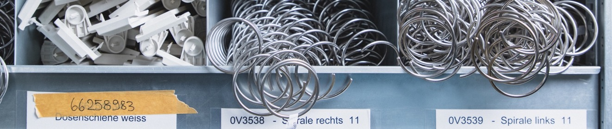
SELECTA
JUNE 2024
CORPORATE SOCIAL RESPONSIBILITY REPORT 2023
CHAPTER THREE
PRODUCT
PAGE 83
Planet
CIRCULAR MACHINES
Refurbishing our machines is a key part of our circular economy strategy. By extending the lifecycle of our machines, we reduce waste and minimize the environmental impact of our operations. We have developed a comprehensive circular program designed to extend the lifecycle of our equipment and minimize environmental waste. Our program offers three distinct options for handling used equipment, each tailored to meet different needs and ensure sustainability.
PROOF OF COMMITMENT
2023 MILESTONES
OUR JOURNEY AHEAD 2024-2026
Our refurbishment initiatives focus on giving a second life to our machines, thus avoiding emissions associated with manufacturing new ones.
22,241 circular machines
In 2023, we proudly implemented 22,241 circular machines. This highlights our commitment to sustainability across various markets, showcasing our global efforts to reduce waste and promote a greener future.
We will continue refurbishing machines at our facilities across Europe, further integrating circularity into our operations.
Picture: Selecta refurbishment items

Slide 91
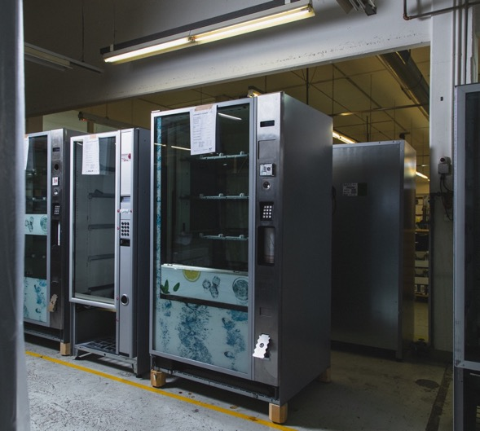
SELECTA
JUNE 2024
CORPORATE SOCIAL RESPONSIBILITY REPORT 2023
CHAPTER THREE
PRODUCT
PAGE 84
Our Circular Program explained…
1. Refurbishment equipment
Our refurbishment option involves taking used equipment and fully repairing, updating, and cleaning it to make it as good as new. This process includes:
Full repairs - fixing any mechanical or electrical issues to ensure optimal performance.
Updates - upgrading components such as the user interface to the latest standards.
Deep cleaning - thoroughly cleaning each machine to ensure it meets our high standards of hygiene and appearance.
2. Occasion equipment
For our occasion equipment option, we offer second-hand, used machines that have been tested and cleaned before installation.
Testing - each machine is thoroughly tested to verify that it works properly.
Cleaning - machines are cleaned to ensure they meet our standards for hygiene and appearance.
3. Scrap Equipment
For equipment that is no longer part of our core portfolio due to reasons such as the end of its lifecycle, damage, non-functionality, or excessive electricity consumption, we have a responsible disposal process:
Sales to third parties - we offer scrap equipment for sale to third parties through Selecta Other Overhead (OOH).
Recycling - equipment that cannot be sold is offered at low prices to raw material recycling companies.
This approach ensures that even at the end of its life, our equipment is handled in an environmentally responsible manner, reducing waste and promoting recycling.
Picture: Selecta Refurbished machines

Slide 92















SELECTA
JUNE 2024
CORPORATE SOCIAL RESPONSIBILITY REPORT 2023
CHAPTER THREE
PRODUCT
PAGE 85
Did you know?
CIRCULAR MACHINES
525
1.029
1.012
Our heroes are in Spain and Italy!
At our refurbishment centres in Spain and Italy, we've given new life to 15,253 vending machines. This incredible effort has helped us avoid emitting 3,050 tonnes of CO2 equivalent!
By refurbishing and extending the life cycle of these machines, we're making a significant environmental impact—reducing waste and promoting sustainability.
5
35
930
1.359
28
319
1.182
57
32
4.389
10.864

Slide 93

SELECTA
JUNE 2024
CORPORATE SOCIAL RESPONSIBILITY REPORT 2023
CHAPTER THREE
PRODUCT
PAGE 86
Planet
CERTIFIED PRODUCTS
Meeting the specific needs of our clients with certified and sustainable products is a priority. We aim to offer products that hold relevant certifications, ensuring they meet high sustainability standards.
PROOF OF COMMITMENT
We are actively developing partnerships with suppliers who are committed to certified and sustainable practices.
OUR JOURNEY AHEAD 2024-2026
We will continue to develop partnerships with suppliers who are committed to providing certified and sustainable products, ensuring our offerings meet the highest standards.

Slide 94





SELECTA
JUNE 2024
CORPORATE SOCIAL RESPONSIBILITY REPORT 2023
CHAPTER THREE
PRODUCT
PAGE 87
RAINFOREST ALLIANCE
FAIRTRADE
ORGANIC
CO2 NEUTRAL
ISO 22000
The Rainforest Alliance certification is dedicated to conserving biodiversity and ensuring sustainable livelihoods. Farms and businesses certified by the Rainforest Alliance adhere to rigorous standards that promote environmental, social, and economic sustainability. These standards include:
Environmental protection - implementing practices that protect ecosystems, waterways, and wildlife.
Social responsibility - ensuring fair treatment and good working conditions for workers, including access to education and healthcare.
Economic viability - helping farmers and producers improve their productivity and profitability through sustainable practices.
Fairtrade certification aims to promote fair trading conditions and support sustainable livelihoods for farmers and workers in developing countries. The key features of Fairtrade include:
Fair prices - ensuring that producers receive a minimum price that covers the cost of sustainable production, plus a Fairtrade Premium for investment in community and business projects.
Safe working conditions - protecting workers' rights and ensuring safe working environments.
Environmental standards - encouraging sustainable agricultural practices that protect the environment, including restrictions on harmful chemicals and promotion of organic farming.
The Organic certification ensures that products are produced according to strict organic farming standards. These standards promote ecological balance and conserve biodiversity. Key sustainability features include:
No synthetic chemicals - prohibiting the use of synthetic pesticides, fertilizers, and genetically modified organisms (GMOs).
Animal welfare - ensuring that animals are raised in natural conditions with access to the outdoors, organic feed, and humane treatment.
Sustainable practices - emphasizing crop rotation, composting, and other practices that maintain soil health and ecosystem balance.
CO2 Neutral certification indicates that a product or business has measured, reduced, and offset its carbon emissions to achieve a net-zero carbon footprint. The main features of this certification include:
Emission reduction - implementing strategies to minimize greenhouse gas emissions through energy efficiency, renewable energy, and sustainable practices.
Carbon offsetting - investing in projects that capture or reduce CO2, such as reforestation, renewable energy, and methane capture projects.
Continuous improvement - regularly measuring and verifying emissions to ensure ongoing compliance and improvement in sustainability practices.
ISO 22000 certification ensures food safety and the health and safety of the final consumer. It integrates Hazard Analysis and Critical Control Points (HACCP) and covers all stages of the food supply chain. Key features include:
Hazard identification - identifying and controlling potential hazards from raw material production to final consumption.
Food safety management - implementing a comprehensive food safety management system.
Consumer health - ensuring the health and safety of the final consumer through rigorous safety standards.

Slide 95

SELECTA
JUNE 2024
CORPORATE SOCIAL RESPONSIBILITY REPORT 2023
CHAPTER THREE
PRODUCT
PAGE 88
Product
ZERO WASTE OFFER
Our zero-waste commitment is central to our sustainability goals. By thoroughly reviewing client waste streams and identifying opportunities for reduction and diversion, we aim to implement zero-waste initiatives across our operations.
PROOF OF COMMITMENT
Our commitment to zero waste involves detailed analysis and the implementation of pilot projects to achieve our goals.
2023 MILESTONES
We are committed to leading the fight against climate change by adopting innovative and sustainable practices. A key component of this effort is establishing strategic partnerships to implement zero waste opportunities within our service. Early in 2023, we began exploring potential collaborations to integrate advanced recycling solutions into our operations. This initiative marks a significant step forward in our sustainability journey, enabling us to further our commitment to environmental responsibility and deliver greater benefits to our clients and their consumers.
OUR JOURNEY AHEAD 2024-2026
We will conduct detailed reviews of client waste streams, identify opportunities for reduction and diversion, and implement pilot zero-waste initiatives to move closer to our zero-waste commitment.
Through these initiatives, Selecta is leading the way in providing sustainable products that meet the needs of today while safeguarding the planet for future generations. Our focus on certified coffee, recyclable packaging, circular machines, certified products, and zero-waste initiatives underscores our dedication to sustainability and innovation. Together, we can create a more sustainable future, one product at a time.

Slide 96

SELECTA
JUNE 2024
CORPORATE SOCIAL RESPONSIBILITY REPORT 2023
CHAPTER THREE
PRODUCT
PAGE 89
Foodies from Selecta
Advanced waste collection bins
All Foodies solutions – Scan & Go Food Market, Grab & Go Smart Fridges and Shop & Go – are equipped with advanced waste collection bins that simplify the process of separating and recycling various types of waste. These bins are strategically placed to encourage proper waste segregation and to make it as convenient as possible for users to dispose of their waste responsibly.
Facilitating proper waste segregation - the bins are divided into clearly labelled compartments for plastic, paper, vegetable waste, and mixed waste, making it easy for users to dispose of items correctly. This reduces contamination and ensures that recyclable materials are effectively processed.
Reducing landfill waste - by encouraging the separation of recyclable and compostable materials, these bins help divert significant amounts of waste from landfills. This not only conserves landfill space but also reduces the environmental impact associated with waste disposal.
Educational impact - the presence of these bins in our Foodies serves as a constant reminder and educational tool for clients and consumers about the importance of waste segregation and recycling. This fosters a culture of sustainability and encourages them to adopt eco-friendly habits in their daily lives.
Regulatory compliance - as regulations around waste management become more stringent, our innovative waste collection solution helps clients comply with local and national environmental laws.
Supporting sustainable practices - by providing a practical solution for waste management, we enable our clients to adopt sustainable practices seamlessly. This aligns with regulatory requirements and enhances their Corporate Social Responsibility (CSR) initiatives.
To ensure the success of our waste collection initiative, we provide comprehensive support to our clients. This includes:
Educational materials - informative brochures and signage to educate users on proper waste segregation and the benefits of recycling.
Regular monitoring and feedback - routine checks and feedback loops to monitor the effectiveness of the waste collection program and make necessary adjustments.

Slide 97

SELECTA
JUNE 2024
CORPORATE SOCIAL RESPONSIBILITY REPORT 2023
CHAPTER THREE
PRODUCT
PAGE 90
Testimonial
CBRE REDUCES WASTE WITH SELECTA’S REUSABLE CUP SERVICE
CBRE, a global leader in commercial real estate services and investment, is introducing its clients to Selecta's hassle-free ‘Geen Gezeur’ (No Fuss) cup washing service. This initiative allows employees to enjoy their drinks from high-quality, reusable coffee cups that Selecta collects and cleans. Thanks to this service, CBRE’s clients are significantly reducing their waste and are better equipped to meet increasingly strict recycling regulations.
With the ‘Geen Gezeur’ service, Selecta is helping organizations reduce their ecological footprint. As a European leader in FoodTech, Selecta supports companies looking to switch to reusable coffee cups, which last for at least two hundred washes. Selecta provides these durable cups and manages all logistics, including collection and cleaning in their own dedicated facilities.
“By making it easy for companies to participate and lowering the barriers, we encourage reuse and promote a circular economy in the corporate world,” explains Sjoerd Homminga, Procurement Leader Benelux at Selecta. “This also helps organizations more easily achieve their sustainability goals and comply with legal standards by reducing their use of disposable cups.”
Sustainability meets efficiency
As a facility management advisor, CBRE often partners with Selecta to install coffee machines and supply coffee beans to its clients. Now, it is adding the ‘Geen Gezeur’ service to its offerings. Rob Mommersteeg, Manager of Soft Services at CBRE, has already introduced the service to several clients.
“We are always looking for solutions that combine sustainability with efficiency. By opting for reusable coffee cups, we not only minimize ecological impact but also actively contribute to raising environmental awareness among our clients” says Mommersteeg.
Optimization process
In the initial weeks of the ‘Geen Gezeur’ service, the collection of cups is continually refined to match the actual usage by employees. “Initially, we collected used cups too frequently, which meant the collection bins weren’t being filled efficiently. We can often reduce the number of collections by better organizing onsite collection and scheduling fewer pickup times. This reduces transportation needs, further enhancing the sustainability of this service” explains Mommersteeg.
Maintaining the habit
CBRE and Selecta are mindful of the recycling challenges and work closely to ensure that used cups are properly sorted and processed. CBRE is responsible for sorting and collecting the cups in designated bins.
“It took a little time for our clients' employees to get used to keeping their cup throughout the day, but it has quickly become a habit” observes Mommersteeg. “We are excited to continue this partnership with Selecta and introduce it to more companies” he concludes.
Images: Selecta reusable cup collection stand

Slide 98

SELECTA
JUNE 2024
CORPORATE SOCIAL RESPONSIBILITY REPORT 2023
CHAPTER FOUR
PEOPLE
PAGE 91
04
PEOPLE

Slide 99

SELECTA
JUNE 2024
CORPORATE SOCIAL RESPONSIBILITY REPORT 2023
CHAPTER FOUR
PEOPLE
PAGE 92

Slide 100

SELECTA
JUNE 2024
CORPORATE SOCIAL RESPONSIBILITY REPORT 2023
CHAPTER FOUR
PEOPLE
PAGE 93
People at the heart of everything we do
CHAMPIONING WELL-BEING AND ETHICAL PARTNERSHIPS
We prioritize the health & safety of our associates, nurture fair partnerships, and ensure a positive social impact in our communities.
At Selecta, we place people at the heart of everything we do. Our commitment extends beyond our associates to our partners and the communities in which we operate. Through various initiatives, we strive to create a safe, inclusive, and supportive environment for all, while driving positive social change.

Slide 101
SELECTA
JUNE 2024
CORPORATE SOCIAL RESPONSIBILITY REPORT 2023
CHAPTER FOUR
PEOPLE
PAGE 94
People
SOCIAL IMPACT COFFEE
Change Please is our flagship social initiative aimed at creating positive social change. By supporting individuals experiencing homelessness, we are committed to transforming lives and fostering a sense of community.
PROOF OF COMMITMENT
2023 MILESTONES
OUR JOURNEY AHEAD 2024-2026
Our efforts are focused on ensuring that 100% of profits from Change Please are directed towards supporting homeless individuals.
In 2023, we established the foundation for our partnership with Change Please. This collaboration will extend the reach of Change Please across all Selecta markets. We anticipate significant growth in 2024, working together to expand the Change Please programs into numerous European markets.
Every bag count
We aim to support individuals experiencing homelessness by ensuring that every bag and every cup of Change Please coffee contributes to providing them with opportunities for a better future.

Slide 102

SELECTA
JUNE 2024
CORPORATE SOCIAL RESPONSIBILITY REPORT 2023
CHAPTER FOUR
PEOPLE
PAGE 95
Product
CHANGE PLEASE
Transforming lives through coffee. By partnering with Change Please and Pelican Rouge Coffee Roasters, you are not just serving coffee; you are serving hope, dignity, and a chance for a better life. This initiative is more than just corporate social responsibility; it's about creating a ripple effect of positive change in our communities. Every cup of Change Please coffee you serve helps to support someone in need, making your everyday coffee purchase a powerful act of compassion and solidarity

Slide 103


SELECTA
JUNE 2024
CORPORATE SOCIAL RESPONSIBILITY REPORT 2023
CHAPTER FOUR
PEOPLE
PAGE 96
Change Please is a social enterprise that harnesses the power of coffee to tackle homelessness. Founded in 2015, Change Please offers more than just high-quality coffee; it provides a pathway to a better life for people experiencing homelessness. By training individuals to become skilled baristas and supporting them with essential services like housing, therapy, and financial advice, Change Please creates opportunities for sustainable employment and personal development.
Impact and achievements
Since its inception, Change Please has significantly impacted the lives of over 5’000 individuals, providing them with the skills and support needed to rebuild their lives. The organization operates multiple retail sites across London and partners with more than 1’000 entities globally, allowing it to scale its impact and reach more people in need. All profits from the sale of Change Please coffee are reinvested into programs that help end homelessness, making every cup a step towards positive change.
The partnership with Pelican Rouge Coffee Roasters
The collaboration between Change Please and Pelican Rouge Coffee Roasters is a testament to how businesses can combine efforts to drive social impact. Pelican Rouge, with its extensive experience in sourcing and roasting high-quality coffee, provides the perfect partner to help Change Please scale its operations and enhance its impact across Europe. This partnership allows Change Please to expand its distribution, manage major client accounts effectively, and ensure that all their coffee is climate compensated and sustainably sourced.
How It works
Training and employment - Change Please trains individuals experiencing homelessness to become baristas, providing them with a living wage job, housing support, therapy, and financial advice.
Sustainable coffee - the coffee is roasted by Pelican Rouge Coffee Roasters, ensuring each blend is crafted to perfection while being 100% climate compensated and transparently sourced.
Community impact - by choosing Change Please coffee, businesses and consumers contribute to a broader social movement, helping to provide jobs, support services, and a pathway out of homelessness.

Slide 104

SELECTA
JUNE 2024
CORPORATE SOCIAL RESPONSIBILITY REPORT 2023
CHAPTER FOUR
PEOPLE
PAGE 97
People
SELECTA COFFEE FUND
The Selecta Coffee Fund is dedicated to investing in farm-level programs that enhance sustainable, long-term partnerships within the coffee supply chain. This initiative focuses on improving the livelihoods of coffee farmers and their communities.
Our commitment to local farmers: more than just donations
At Selecta, our approach to supporting local farmers goes far beyond financial donations. We have established a comprehensive, hands-on program to work directly with farmers, ensuring sustainable development and long-term success. Our dedicated team in Rwanda for example exemplifies this commitment through the Selecta Coffee Fund.
Our Team
20 Presidents of saving groups - these leaders help manage local saving initiatives, empowering farmers to save and invest in their future.
8 Members of the program beneficiaries' general committee - this committee represents the interests of the program's beneficiaries, ensuring their voices are heard and their needs are met.
3 Members of the executive committee of advisors - these advisors provide strategic guidance and support to ensure the program's objectives are achieved effectively.
3 Full-time associates for the Selecta Coffee Fund in Rwanda. Site operational manager - oversees the day-to-day operations, ensuring the smooth running of all activities and programs. 2 Veterinarians - provide essential veterinary services, improving the health and productivity of livestock, which is crucial for the farmers' livelihoods.
Selecta's extensive on-the-ground involvement demonstrates our deep commitment to the well-being and prosperity of local farmers. By working together with them, we ensure that our support is impactful, sustainable, and transformative.
Image: Rwanda team Selecta Coffee Fund

Slide 105

SELECTA
JUNE 2024
CORPORATE SOCIAL RESPONSIBILITY REPORT 2023
CHAPTER FOUR
PEOPLE
PAGE 98
A message from ...
Hello, my name is Benjamin Nkurunziza, and I am the Site Operational Manager for the Selecta Coffee Fund projects in Rwanda. I am 37 years old and the third of four children. While my siblings live abroad, my mother and I care for each other here in Rwanda since my father passed away when I was just 13.
I have dedicated the last nine years of my life to the Rwandan coffee sector. Before joining the Selecta Coffee Fund, I worked for various coffee-producing and exporting companies, holding various roles.
My journey in the coffee industry began in 2010 during my academic internship at a coffee exporting company in Rwanda. After completing my undergraduate studies in Agricultural Economics and Agribusiness in 2012, the same company that hosted my internship offered me a position. Eager to advance my education, I pursued a master’s degree in Agricultural Economics at Stellenbosch University in South Africa, graduating in 2015. I returned to the Rwandan coffee sector in 2016 and have been deeply involved ever since.
Coffee is more than a crop; it brings joy, happiness, and prosperity. I've seen first hand how it connects people—from producers to supply chain actors to end consumers in both domestic and international markets. Coffee has the power to lift thousands, if not millions, out of poverty. My passion lies in ensuring the sustainability of coffee production to preserve these benefits.
Selecta stands out among the companies I’ve worked for. Here, my ideas are genuinely valued and supported, and the working conditions are excellent. Selecta is committed to addressing global coffee production issues, and they provide the necessary resources for sustainability initiatives. I see a bright future for myself, the people involved, and the entire industry with Selecta.
Thank you for being part of this journey. Together, we can ensure that coffee continues to bring joy and prosperity to communities around the world.
“COFFEE IS MORE THAN A CROP; IT BRINGS JOY, HAPPINESS, AND PROSPERITY. I'VE SEEN FIRSTHAND HOW IT CONNECTS PEOPLE—FROM PRODUCERS TO SUPPLY CHAIN ACTORS TO END CONSUMERS IN BOTH DOMESTIC AND INTERNATIONAL MARKETS. IT HAS THE POWER TO LIFT THOUSANDS, IF NOT MILLIONS, OUT OF POVERTY.” – Benjamin Nkurunziza

Slide 106

SELECTA
JUNE 2024
CORPORATE SOCIAL RESPONSIBILITY REPORT 2023
CHAPTER FOUR
PEOPLE
PAGE 99
The Selecta Coffee Fund explained…
Nurturing sustainability and fairness
The Selecta Coffee Fund is an embodiment of our commitment to sustainability and equity within the coffee supply chain. Established to address the pressing environmental and social issues in coffee production, the fund supports farm-level programs that aim to improve the livelihoods of coffee farmers, foster social equity, and maintain thriving ecosystems.
Our mission and goals
The Selecta Coffee Fund is dedicated to building long-term, sustainable partnerships with coffee farmers. Our goals include supporting at least 2,500 farmer families directly and over 15,000 indirectly by 2025. Through our initiatives, we aim to increase coffee yield and quality, boost farmer income, enhance biodiversity, and contribute to climate adaptation and mitigation efforts.
Key programs and impact areas
Farmer prosperity - we invest in training farmers in climate-resilient farming practices, improved farm management, and income diversification strategies. This helps to ensure better working conditions, increased yields, and greater profitability for coffee growers.
Social equity - our programs focus on safeguarding human rights, promoting gender equality, and preventing child labour in coffee farming communities. We are committed to empowering women and fostering social equity in all our sourcing areas.
Ecosystem protection - we embrace regenerative agriculture and agroforestry to protect natural resources such as soil, water, and biodiversity. Healthy soils lead to healthy coffee trees, which in turn sustain high yields and quality.
Carbon reduction and climate resilience - our farm-level programs focus on reducing carbon emissions and enhancing climate resilience. We align our efforts with global sustainability goals, including the COP26 deforestation pledge.
Geographical focus and partnerships
The Selecta Coffee Fund operates in key coffee-producing regions, including Burundi, Rwanda, Honduras, and Colombia:
Burundi - we partner with local organizations to improve coffee yield, enhance women's social and economic positions, and rehabilitate community water sources. Our efforts include plant rejuvenation, Good Agricultural Practices (GAP) training, and income diversification through heifer distribution programs.
Rwanda - in the Southern province, we focus on improving coffee productivity and household income by training farmers on Good Agricultural Practices and providing cows to diversify income and reduce fertilizer costs.
Honduras - through our collaboration with Mercon, we support regenerative agriculture practices, establishing model farms that lead farmers towards sustainable farming methods.
Colombia - in the Huila region, we work with Solidaridad to foster a community-focused approach to coffee farming, promoting agroforestry and sustainability.
Image: Selecta Coffee Fund

Slide 107

SELECTA
JUNE 2024
CORPORATE SOCIAL RESPONSIBILITY REPORT 2023
CHAPTER FOUR
PEOPLE
PAGE 100
A message from ...
Hello, I’m Ulf Gustafsson, a 57-year-old Swede living in Stockholm. For the past 26 years, I have had the privilege of working at Selecta in various roles. I started as a Team Leader in Service, moved on to become a Regional Manager for Service and Solutions, and for the last 12 years, I’ve been focused on HR and Sustainability in the Nordic region.
Selecta has provided me with numerous opportunities to learn and grow, and I’m proud to have been a part of the company’s transformation over the years. It’s been an incredible journey, and I’m grateful to be part of it.
Currently, my main responsibilities include overseeing sustainability, training, and acting as a People Partner, primarily in Denmark, Finland, Norway, and Sweden. Additionally, I contribute to several projects for the Selecta Group.
In my role in Sustainability, I engage in various activities:
Contributing to sustainability reporting
Managing the Selecta Coffee Fund in Rwanda
Presenting our sustainability initiatives and the Selecta Coffee Fund to clients
Training new associates in sustainability practices
Leading and participating in diverse sustainability projects
I take immense pride in being part of the Selecta Coffee Fund Rwanda team. It brings me great joy to see the positive changes we’ve made for more than 550 families in Rwanda. The impact of our work there is truly significant and life-changing for our beneficiaries.
To further enhance my knowledge, I am currently enrolled in a training program called “Advancing Diversity and Inclusion” at INSEAD Business School. This course is providing me with new insights on how we can advance our sustainability efforts both in Europe and in the regions where we operate Selecta Coffee Fund programs.
Thank you for supporting our mission. Together, we can continue to make a meaningful difference in the lives of many and drive sustainable change.
Image: Ulf Gustafsson (right) visiting coffee farmers in Rwanda
“IT BRINGS ME GREAT JOY TO SEE THE POSITIVE CHANGES WE’VE MADE FOR MORE THAN 550 FAMILIES IN RWANDA. THE IMPACT OF OUR WORK THERE IS TRULY SIGNIFICANT AND LIFE-CHANGING FOR OUR BENEFICIARIES.”
– Ulf Gustafsson

Slide 108

SELECTA
JUNE 2024
CORPORATE SOCIAL RESPONSIBILITY REPORT 2023
CHAPTER FOUR
PEOPLE
PAGE 101
Cecily’s story
A JOURNEY OF GROWTH
Image: Selecta Coffee Fund
“My children enjoy fresh milk daily, strengthening them from within. Rather than sell our surplus, we choose to nourish our neighbours’ children, contributing to the health of our community.”

Slide 109


SELECTA
JUNE 2024
CORPORATE SOCIAL RESPONSIBILITY REPORT 2023
CHAPTER FOUR
PEOPLE
PAGE 102
My life blossomed with a single cow given by the Selecta Coffee Fund in 2018. I'm Cecile Kanakuze, a 41-year-old mother and coffee farmer from Rwanda, living with my four children, spouse, and grandchild. This cow wasn't just an animal; it was a catalyst for change.
Training from Selecta transformed my approach to farming—imparting wisdom on animal care, hygiene, and disease prevention. The result? My children enjoy fresh milk daily, strengthening them from within. Rather than sell our surplus, we choose to nourish our neighbours’ children, contributing to the health of our community.
The cow's pregnancy led to four calves, marking the beginning of an incredible transformation. The first calf I passed on to a neighbour, broadening the circle of the Selecta Coffee Fund's impact. From selling the next two calves, I purchased land, expanding my coffee farm significantly.
Each year, the Selecta-invited training sessions refine my coffee farming skills and financial management, enhancing the yield from my coffee trees. The tools provided have been indispensable, but it's the manure—the "gold"—that has turned my farm around, boosting both coffee and kitchen garden crops.
From once scraping by on about Rwf 400,000 (approx. € 285) annually, our income has soared above Rwf 2,000,000 (approx. € 1,425). This dramatic increase springs from:
Improved coffee yields through enhanced cultivation techniques.
Expanding our coffee tree count from 400 to 4,200.
Biennial calf sales and augmented crop production thanks to organic manure.
Our village retail shop started in 2021.
Working as a coffee collector, facilitating connections between local farmers and washing stations.
My heartfelt thanks to Selecta, its associates, and the dedicated Selecta Coffee Fund team in Rwanda for their consistent training and veterinary support. Your belief in us has nurtured a thriving future for my family and community.
Images: Selecta Coffee Fund

Slide 110


SELECTA COFFEE FUND
SELECTA
JUNE 2024
CORPORATE SOCIAL RESPONSIBILITY REPORT 2023
CHAPTER FOUR
PEOPLE
PAGE 103
People
PROOF OF COMMITMENT
Our investments aim to support farmers, improve biodiversity, and contribute to climate adaptation and mitigation.
2023 MILESTONES
2.000+ Farmers supported
More than 2000 farmers benefited from our programs.
3.000 tCO2 Carbon removal potential
Significant carbon removal potential reached.
11.000 Shade trees planted
We planted over 11.000 shade trees to enhance biodiversity and support sustainable farming practices.
OUR JOURNEY AHEAD 2024-2026
Comprehensive impact measurement
We will measure the comprehensive impact on farmer families, biodiversity, climate adaptation, and mitigation, ensuring our programs deliver meaningful benefits. We will also extend our carbon insetting programs, allowing more Selecta clients to embark on this opportunity.
Watch Marie’s inspiring story
Discover the heart-warming journey of Marie Mukeshimana, a widowed mother of five, who transformed her life with a cow donation from the Selecta Coffee Fund Program.

Slide 111

SELECTA
JUNE 2024
CORPORATE SOCIAL RESPONSIBILITY REPORT 2023
CHAPTER FOUR
PEOPLE
PAGE 104
Felicien’s story
A JOURNEY OF RESILIENCE
In the lush hills of Rwanda, where the aroma of coffee blossoms fills the air, Felicien Munyandinda’s story unfolds—a tale of resilience, legacy, and the transformative power of the Selecta Coffee Fund. Felicien was born in 1960, into a family of coffee farmers. When he was just nine years old, a pivotal event etched itself into his memory and set the course of his life. One fateful day, coffee parchment was stolen from his father’s farm. As the thieves fled, some of the parchment spilled into the bushes. Over time, these discarded seeds sprouted into small coffee trees, unnoticed by most but not by young Felicien.
With a dream to follow in his father’s footsteps, Felicien saw potential where others saw waste. He carefully uprooted the small coffee trees from the bushes, replanting them with the guidance and support of his father. That first effort yielded 25 coffee trees, marking the beginning of his journey as a coffee farmer. The following year, his father expanded Felicien’s plantation with 25 new trees, nurturing his son’s budding passion.
Decades later, Felicien’s modest beginning has flourished into a thriving farm of 2,750 coffee trees. His dedication and hard work have borne fruit—quite literally—enabling him to purchase additional land, cultivate various crops, build a home for his family, keep livestock, and acquire a grain miller. His success is not just measured in yields but in the stability and prosperity it has brought to his family.
Felicien’s legacy of coffee farming extends to his children. Two of his three children have embraced this family tradition, each tending to their own coffee trees—130 and 120 respectively. This continuation underscores the profound impact of a single act of perseverance and the enduring power of a family’s dedication to their land and craft.
The Selecta Coffee Fund has played a crucial role in Felicien’s journey. As one of the three farmers selected to develop model coffee farms, Felicien has received invaluable support and education in good agricultural practices. This opportunity has not only enhanced his own farming techniques but also positioned him as a beacon of knowledge and inspiration within his community. Other farmers now look to Felicien’s farm as a model, learning effective practices that can transform their own farms and lives.
Felicien expresses deep gratitude for the Selecta Coffee Fund’s commitment to improving his agricultural knowledge and supporting him in becoming a model farmer. The Fund’s impact is evident in the thriving coffee trees, the prosperity of his family, and the ripple effect of improved practices spreading through his community.
“WITH A DREAM TO FOLLOW IN MY FATHER’S FOOTSTEPS, I SAW POTENTIAL WHERE OTHERS SAW WASTE.”
- Felicien Munyandinda

Slide 112
SELECTA
JUNE 2024
CORPORATE SOCIAL RESPONSIBILITY REPORT 2023
CHAPTER FOUR
PEOPLE
PAGE 105
People
ETHICS IN THE SUPPLY CHAIN
Upholding ethical standards across our supply chain is a core principle at Selecta. We are committed to ensuring that our suppliers adhere to high standards of environmental, social, and governance (ESG) practices
PROOF OF COMMITMENT
2023 MILESTONES
OUR JOURNEY AHEAD 2024-2026
We conduct systematic ESG risk evaluations to ensure compliance and ethical behaviour throughout our supply chain.
509 Critical Suppliers Assessed
We covered 509 critical suppliers, representing 80% of Group spend, with an ESG risk evaluation. This 80% is based on supplier spend greater than 200K €. We are committed to maintaining the highest ethical standards across our supply chain. Our supplier selection process, which includes a rigorous onboarding protocol and a detailed supplier traffic light risk assessment system, is designed to ensure that all our suppliers adhere to these standards. Additionally, we employ Ignite Procurement, a comprehensive tool for identifying Human Rights risks, ensuring compliance with our commitment to social responsibility.
Our Supplier Code of Conduct sets clear expectations for how our suppliers should behave. It reflects our commitment to ethical business practices, covering important areas like labour standards, health and safety, environmental impact, and business integrity. This document is part of our contracts with suppliers, ensuring they follow these ethical principles. Before a supplier can join Selecta's list, they must agree to our Code of Conduct and complete a self-assessment questionnaire. We also use an in-house tool to check the supplier’s reputation and identify any potential red flags in their business history.
We continuously monitor social risks through a special evaluation process. This process helps us identify risks related to human rights and working conditions, known as social risks. We assess these risks based on factors like geography and industry, using this data to ensure our suppliers maintain high ethical standards.
Systematic ESG Risk Assessment
We will implement systematic ESG risk assessments for all new suppliers, ensuring ongoing compliance and ethical practices.

Slide 113





SELECTA
JUNE 2024
CORPORATE SOCIAL RESPONSIBILITY REPORT 2023
CHAPTER FOUR
PEOPLE
PAGE 106
Our Supplier Selection Process explained ...
Our ethical supply chain approach is a comprehensive system designed to ensure that our suppliers adhere to the highest standards of ethics and responsibility. Through our detailed selection process, risk assessment system, and the use of advanced tools like Ignite, we are committed to maintaining a supply chain that is not only efficient and reliable but also ethical and socially responsible.
Supplier traffic light risk assessment system
Our supplier traffic light risk assessment system categorizes suppliers based on their risk levels.
Green - low risk, compliant with all standards.
Yellow - medium risk, with some areas requiring improvement.
Red - high risk, non-compliant, requiring immediate action or reconsideration of partnership.
This system helps us prioritize and manage our supplier relationships effectively, ensuring continuous improvement and compliance.
Ignite - human rights risk identification
Ignite is a crucial component of our supply chain management, required by our clients to ensure comprehensive Human Rights risk identification. This tool utilizes advanced methodologies to:
Identify risks - Ignite helps pinpoint potential Human Rights risks within the supply chain, ensuring proactive management and mitigation.
Compliance assurance - it ensures that all suppliers comply with international Human Rights standards, maintaining the integrity of our supply chain.
Continuous monitoring - Ignite provides ongoing monitoring and reporting, allowing us to address any issues promptly and maintain high ethical standards.
By integrating Ignite into our supply chain management, we enhance our ability to protect Human Rights and ensure ethical practices throughout our operations.
SUPPLIER CODE OF CONDUCT (COC)
SUPPLIER SELF-ASSESSMENT QUESTIONNAIRE (SSAQ)
SUPPLIER SOCIAL RESPONSIBILITY ASSESSMENT (SSRA)
SOCIAL RISK EVALUATION
SUPPLIER SELECTION
Our Supplier Code of Conduct serves as the foundation of our engagement with suppliers. It sets out the ethical, environmental, and social standards we expect all our suppliers to adhere to, ensuring alignment with our values and business practices.
Process identification - the SSAQ is used to identify and evaluate the processes that suppliers have in place to meet our standards. This self-assessment helps us understand their current practices and areas that may need improvement.
Reputational risk assessment - the SSRA involves a thorough assessment of the supplier’s social responsibility practices, evaluating their commitment to ethical operations and potential reputational risks. This ensures that our suppliers are aligned with our ethical
Human rights risks assessment - this step focuses on assessing risks associated with Human Rights violations within the supply chain. It is crucial for identifying areas where intervention may be needed to uphold Human Rights and prevent violations.
Based on the evaluations from the SSAQ, SSRA, and Social Risk Evaluation, we make informed decisions on supplier selection. This ensures that we partner with suppliers who meet our stringent ethical standards and contribute positively to our supply chain integrity.

Slide 114

SELECTA
JUNE 2024
CORPORATE SOCIAL RESPONSIBILITY REPORT 2023
CHAPTER FOUR
PEOPLE
PAGE 107
People
EMPLOYER OF CHOICE
Being an employer of choice means creating a safe, inclusive, and supportive workplace for all our associates. We are committed to preventing accidents and promoting diversity and inclusion across the Group.
PROOF OF COMMITMENT
2023 MILESTONES
OUR JOURNEY AHEAD 2024-2026
Our policies and programs aim to ensure zero preventable accidents and foster a diverse and inclusive workplace.
We've made significant progress in increasing the representation of women in our leadership roles. In our country leadership positions, the representation of women has grown to 23%. Moreover, we're proud to have achieved gender parity in our Group OpCo.
On average, each enrolled associate spent 10 hours in training. These changes reflect our ongoing commitment to fostering diversity and inclusivity at all levels of our organization.
Selecta D&I program
We will continue to expand our Diversity & Inclusion program.
Fairness in recruiting, promotion, and compensation
We will implement and enhance policies around fairness in recruiting, promotion, and compensation to ensure an equitable workplace.
Through these initiatives, Selecta is committed to fostering a positive social impact, ensuring the well-being of our associates, and maintaining fair relationships with our partners. Together, we can create a healthier, safer, and more inclusive community for all.

Slide 115
SELECTA
JUNE 2024
CORPORATE SOCIAL RESPONSIBILITY REPORT 2023
CHAPTER FOUR
PEOPLE
PAGE 108
Our diversity & inclusion program explained ...
Selecta - A journey of inclusion and growth
At Selecta, we believe that our people are the heart of our success. We are dedicated to creating a dynamic, inclusive, and supportive work environment where everyone can thrive. Our commitment to equity, diversity, and inclusion is reflected in every aspect of our operations, from recruitment to career development.
Selecta’s diversity and inclusion program - fostering equality and empowerment
At Selecta, we are deeply committed to creating an inclusive, equitable, and diverse workplace where every employee feels valued and respected. Launched in 2022, our Diversity and Inclusion Program is designed to ensure that all our associates thrive, regardless of their background or identity. This program is a cornerstone of our corporate culture, reflecting our dedication to equality and fairness across all aspects of our operations.
We believe that diversity and inclusion are essential to a positive work environment and lead to better outcomes for our people and our business. We are committed to:
Encouraging diversity and inclusion - we promote a diverse and inclusive culture at Selecta, where all individual’s contributions are recognized and valued. We ensure a workplace free from bullying, harassment, and unlawful discrimination.
Creating a supportive environment - we provide training for leaders and associates about their rights and responsibilities under our diversity and inclusion policy. We foster a respectful environment where differences are celebrated.
Fair recruitment and promotion practices - our recruitment and promotion processes are designed to be fair and inclusive. We ensure gender-balanced candidate slates and interview panels, and we prioritize diverse candidates when they are equally qualified.
Equal compensation - we adhere to the principle of Equal Pay for Equal Work, ensuring that all associates are compensated fairly based on their role and performance, without discrimination.
Specific actions for recruitment and promotion
To foster diversity in recruitment, we
Include equal opportunity statements in job postings.
Ensure job descriptions are neutral and inclusive.
Require head-hunters to present a gender-balanced slate for leadership positions.
Target a balanced representation of candidates in interviews.
Use diverse interview panels to provide various perspectives.
For internal promotions, we
Maintain gender-balanced candidate slates for leadership roles.
Encourage applications and nominations from diverse candidates.
Implement succession planning with a focus on developing diverse talent.
Fairness in Compensation
We are committed to fair compensation practices, ensuring that pay is based solely on performance and role requirements, without influence from non-merit factors such as gender, ethnicity, or sexual orientation.
Enforcement and monitoring
Our Group Diversity & Inclusion Working Group regularly tracks and monitors adherence to this policy, ensuring that our commitments translate into tangible actions.
Consequences of policy breach
We take all complaints seriously and handle them under our disciplinary procedures.
At Selecta, we believe that a diverse and inclusive workplace is fundamental to our success. By fostering an environment where everyone can thrive, we not only enhance our organizational performance but also contribute to a more equitable society. We invite you to be part of this journey and help us build a better, more inclusive future.

Slide 116

SELECTA
JUNE 2024
CORPORATE SOCIAL RESPONSIBILITY REPORT 2023
CHAPTER FOUR
PEOPLE
PAGE 109
People
EMPOWERING ASSOCIATES THROUGH CONTINUOUS LEARNING
We believe that being an employer of choice means investing in the continuous growth and development of our most valuable asset—our people. To support this vision, we provide regular training to all 6,500 of our employees through the innovative EdApp platform. This ensures that every team member has access to high-quality educational resources, tailored to a variety of topics essential for personal and professional growth.
In 2023, our dedication to employee development was evident as each enrolled employee spent, on average, 10 hours engaged in training. These sessions cover a wide range of subjects, from enhancing technical skills and leadership capabilities to fostering diversity, inclusion, and sustainability practices.
By offering these regular training opportunities, we aim to empower our associates with the knowledge and skills they need to excel in their roles and advance their careers. This not only helps us achieve our SDG commitments but also reinforces our status as a top employer, dedicated to nurturing a culture of continuous improvement and lifelong learning.

Slide 117



SELECTA
JUNE 2024
CORPORATE SOCIAL RESPONSIBILITY REPORT 2023
CHAPTER FOUR
PEOPLE
PAGE 110
Your onboarding passport
EMPOWERING EVERY NEW JOINER
At Selecta, we are dedicated to ensuring that every new joiner receives the best possible start. To achieve this, we have developed a comprehensive 'Onboarding Passport' that equips every new joiner with all the resources and support they need to succeed from day one. This initiative is a testament to our commitment to being an employer of choice.
The Onboarding Passport is a structured guide designed to support every new joiner’s integration into Selecta. It includes a detailed four-week program that outlines essential milestones, key principles, training resources, and ongoing support mechanisms.
By providing this structured and supportive onboarding experience, we ensure that every new joiner feels welcomed, informed, and prepared to thrive in their role. The Onboarding Passport reflects our dedication to fostering a culture of continuous improvement, professional growth, and personal satisfaction.

Slide 118

SELECTA
JUNE 2024
CORPORATE SOCIAL RESPONSIBILITY REPORT 2023
CHAPTER FIVE
QUALITY & INNOVATION
PAGE 111
05
QUALITY & INNOVATION

Slide 119

SELECTA
JUNE 2024
CORPORATE SOCIAL RESPONSIBILITY REPORT 2023
CHAPTER FIVE
QUALITY & INNOVATION
PAGE 112
Image: Selecta Coffee Fund

Slide 120

QUALITY & INNOVATION
SELECTA
JUNE 2024
CORPORATE SOCIAL RESPONSIBILITY REPORT 2023
CHAPTER FIVE
QUALITY & INNOVATION
PAGE 113
Our commitment
We are dedicated to investing in the quality and innovative capacity of our products and services. While we do not hold a Group certificate, our integrated management system certifications are defined per market. These include ISO 9001, ISO 14001, ISO 45001, and ISO 22000, along with local certifications.
We strive to deliver the highest achievable process and product quality for all our offerings, in compliance with legal and sustainability requirements. Our processes and procedures are meticulously designed to meet these standards.
Quality products and services
At Selecta, we take pride in our premium coffee offerings. Through our Pelican Rouge brand, we source coffee beans from different regions in the world, ensuring high-quality green beans that we roast in our own roastery. In addition to Pelican Rouge, we offer a wide range of other renowned coffee brands, including Starbucks, Nescafé, Lavazza, Segafredo, and various local coffee brands. For these brands, we rely on their product certificates to maintain our high standards of quality and sustainability.
Coffee Machines
Our coffee machines boast a minimum availability rate of 99.5%. This means that 99.5% of the time, our machines are operational and not undergoing maintenance or repairs. Causes for downtime include both scheduled and unscheduled issues such as product shortages, technical malfunctions, software issues, or periodic cleaning requirements.
Quality and innovation policy
At the heart of our company lies a commitment to quality and innovation, directed by our executive team. They ensure the policy is effectively implemented across all levels. Our dedicated managers and leaders play a crucial role in executing this policy. The Product & Innovation Team spearheads the introduction and phase-out of products and services, ensuring they align with our high standards of quality and innovation.
To maintain excellence, we adhere to a comprehensive internal quality and process manual based on ISO 9001 standards. This manual also incorporates local regulations, including fire safety and electrical certifications, ensuring that our processes are safe and compliant.
Our commitment to continuous client satisfaction
At Selecta, our ultimate goal is to enhance client satisfaction continuously. We achieve this through a strategic, data-driven approach that integrates client feedback at every stage of our service journey.

Slide 121
SELECTA
JUNE 2024
CORPORATE SOCIAL RESPONSIBILITY REPORT 2023
CHAPTER FIVE
QUALITY & INNOVATION
PAGE 114
Quality & innovation
THE SELECTA JOY SCORE
Measuring success
The Selecta Joy Score is designed to be a lever for the continuous improvement of our service with clients and serves as a vital communication channel to better identify and address their needs. By regularly collecting and analysing Joy Score data, we can gain insights into client satisfaction and areas where we can enhance our services.
The results of the Joy Score speak for themselves. From the start of 2022 to the end of 2023, our Joy Score grew from 36% to an impressive 75%, a remarkable increase of 39 percentage points. This growth highlights our commitment to improving client experiences.
Comparison with NPS (Net Promoter Score)
The Joy Score can be compared to the Net Promoter Score (NPS), a widely recognized metric used to measure clients and consumers loyalty and satisfaction. NPS works by asking clients and consumers a simple question: "On a scale of 0 to 10, how likely are you to recommend our company/product/service to a friend or colleague?" Based on their responses, clients and consumers are categorized into three groups:
Promoters (score 9-10) - loyal enthusiasts who will keep buying and refer others, fuelling growth.
Passives (score 7-8) - satisfied but unenthusiastic clients and consumers who are vulnerable to competitive offerings.
Detractors (score 0-6) - unhappy clients and consumers who can damage our brand and impede growth through negative word-of-mouth.
The NPS is then calculated by subtracting the percentage of Detractors from the percentage of Promoters. The score ranges from -100 to +100, with a higher score indicating better client and consumer loyalty and satisfaction.
The unique value of the Joy Score
While the NPS provides a general measure of clients and consumers loyalty, the Joy Score is a Selecta-owned service tailored specifically to our operations and client interactions. It offers more nuanced insights into client and consumer satisfaction, focusing on specific aspects of our service that matter most to our clients and consumers. This allows us to:
Tailor improvements - by understanding detailed client and consumer feedback, we can make targeted improvements to our services and products.
Enhance communication - the Joy Score serves as a direct communication channel, enabling us to promptly address client and consumer concerns and needs.
Drive innovation - regular feedback from the Joy Score helps us identify trends and areas for innovation, ensuring we stay ahead of client and consumer expectations.
The Joy Score is a powerful tool that not only measures client and consumer satisfaction but also drives continuous improvement and fosters closer relationships with our clients and consumers, ensuring that we consistently meet and exceed their expectations.
FROM THE START OF 2022 TO THE END OF 2023, OUR JOY SCORE GREW FROM 36% TO AN IMPRESSIVE 75%, A REMARKABLE INCREASE OF 39 PERCENTAGE POINTS

Slide 122
SELECTA
JUNE 2024
CORPORATE SOCIAL RESPONSIBILITY REPORT 2023
CHAPTER FIVE
QUALITY & INNOVATION
PAGE 115
Key initiatives for improvement
ADVANCED DIGITAL COMMUNICATION
We have implemented 24/7 digital communication via machine-specific QR codes, allowing clients to report issues or request services anytime. When clients scan the QR code, they are directed to a customized landing page where they can easily report issues using a two-stage drop-down menu. This system provides immediate feedback on the status of their request, ensuring transparency and quick resolutions.
EFFICIENT ISSUE REPORTING
Clients can report technical issues or request refunds using the QR codes attached to our machines. Once reported, a confirmation of receipt is automatically sent, and an Enterprise Resource Planning (ERP) case is created if necessary. This streamlined process ensures that no issue goes unnoticed and that each is addressed promptly.
CONTINUOUS FEEDBACK LOOP
Our closed-loop feedback process involves several key steps:
Collecting feedback: We gather feedback through surveys, client forums, and direct communication channels.
Analyzing feedback: The feedback is analyzed to identify common issues, areas for improvement, and trends. This analysis is crucial for strategic planning.
Implementing changes: Based on the analysis, we implement targeted measures to address specific concerns and improve overall service quality.
Monitoring results: We continuously monitor the effectiveness of the implemented changes through key performance indicators (KPIs) such as the Joy Score, Client Effort Score, and Client Satisfaction metrics.
ENHANCED CLIENT SUPPORT
Our client forum provides answers to frequently asked questions, ensuring that clients can find the information they need quickly. The forum is promoted on our website and linked directly from inbound queries.
The webshop enhances the reordering process by displaying previous orders and suggesting suitable products, making it easy for clients to restock efficiently.
COMPREHENSIVE CASE MANAGEMENT
We ensure that all client inquiries are handled promptly through an integrated system. Incoming calls are routed via the Interactive Voice Response (IVR) system, and specific inquiries are directed to the appropriate resource, such as the client forum or webshop.
Emails are forwarded to the relevant department based on the selection in the form or defined keywords.
Our case management system allows for seamless transfer of cases from Enterprise Resource Planning (ERP) to Customer Relationship Management (CRM), ensuring that clients receive updates at each stage. For example, after a service visit, technicians document the status with a photo in Televent, which is then transferred to the Customer Relationship Management system and automatically closes the case.
PRACTICAL EXECUTION & MEASUREMENT
Vital signs monitoring: We continuously monitor key metrics such as webshop contribution, the number of visitors to the client forum, the total amount of callback requests, and the number of issues reported via QR codes.
Service level metrics: We track average waiting time, handling time, abandonment rate, and resolution times to ensure high service standards.
Client satisfaction surveys: Regular surveys are conducted to gather feedback, and the results are used to refine our services. The Joy Score, Client Effort Score, and Client Satisfaction are key indicators of our success.
Ongoing communication: We maintain regular communication with clients through newsletters, updates on innovations, and referral campaigns to keep them engaged and informed.

Slide 123

SELECTA
JUNE 2024
CORPORATE SOCIAL RESPONSIBILITY REPORT 2023
CHAPTER FIVE
QUALITY & INNOVATION
PAGE 116
Introducing our industry-leading innovations
INNOVATIONS
In our ongoing commitment to sustainability, we are proud to introduce five key, industry-leading innovations in this sustainability report. These innovations—Panama Coffee Machine, Aquablu, EcoJoy, Zero Waste Concept, and MadeBlue—are set to make a significant impact and drive meaningful change across our operations and the wider industry.
Each of these innovations represents a step forward in our efforts to reduce environmental impact, enhance operational efficiency, and promote sustainable practices. By integrating cutting-edge technology and sustainable principles, we aim to lead the industry toward a more sustainable future. It underscores our dedication to leading the industry in sustainability. They highlight our proactive approach to environmental stewardship, social responsibility, and operational excellence. We believe that through innovations like this, we can inspire change and drive progress towards a more sustainable future for all.

Slide 124

SELECTA
JUNE 2024
CORPORATE SOCIAL RESPONSIBILITY REPORT 2023
CHAPTER FIVE
QUALITY & INNOVATION
PAGE 117
Innovation
THE PANAMA
The Panama Coffee Machine is set to transform the way people enjoy coffee. It’s a state-of-the-art solution that not only elevates your coffee game but also supports a greener, more sustainable future.
Image: Selecta Panama Coffee Machine

Slide 125


SELECTA
JUNE 2024
CORPORATE SOCIAL RESPONSIBILITY REPORT 2023
CHAPTER FIVE
QUALITY & INNOVATION
PAGE 118
The Panama coffee machine is one of our latest and most exciting innovations launched in 2023. Designed to redefine the coffee experience, the Panama Coffee Machine combines cutting-edge technology with unparalleled efficiency, superior performance, and a strong commitment to sustainability.
Key benefits
Unmatched efficiency: Save 25 minutes of operating time daily with no need for a cleaning cycle
Energy savings: Reduce the ecological footprint with 30% less energy consumption
Superior performance: Boasting a 99.5% technical uptime and a modular design with five easily replaceable modules
High capacity and flexibility: Capable of handling over 400 servings per day
Revolutionary milk technology: Enjoy perfect milk froth without daily cleaning and stay informed with smart notifications
Sustainable and practical: Utilize long-lasting milk packs that can be stored for up to 3 months at room temperature, with no milk waste. Benefit from 100% green electricity in production, 50% less packaging material, and no cooling requirements, leading to 30% less energy consumption and no use of cleaning agents or rinse water.
Image: Selecta Panama Coffee Machine , Lattiz milk pack

Slide 126

AQUABLU
SELECTA
JUNE 2024
CORPORATE SOCIAL RESPONSIBILITY REPORT 2023
CHAPTER FIVE
QUALITY & INNOVATION
PAGE 119
Revolutionizing hydration for a sustainable future
The Aquablu is one of our latest innovations launched in 2023. Aquablu is designed to transform the hydration experience with state-of-the-art technology and a strong commitment to sustainability. This innovative water dispenser system not only ensures the highest quality of water but also supports a plastic-free lifestyle.
Key benefits
Advanced purification: Aquablu uses cutting-edge purification technology to remove up to 99% of impurities, including microplastics, heavy metals, pesticides, and pharmaceutical residues. This ensures people always have access to the cleanest, healthiest water straight from the tap.
Sustainability: By eliminating the need for plastic bottles, Aquablu significantly reduces plastic waste. The system is designed to be environmentally friendly, using 100% green electricity and minimal packaging.
Smart connectivity: The Aquablu water tap features smart, connected functionality that provides real-time insights into usage trends and syrup levels. This allows for efficient maintenance scheduling and helps reduce CO2 emissions by optimizing service routes.
Personalized hydration: With 39 drink options available, users can customize their hydration experience by combining still, sparkling, or chilled water with various natural flavours, each enriched with essential vitamins and minerals like Vitamin B, Vitamin C, and Zinc.
Practical and cost-effective: The Aquablu system connects directly to the water tap, eliminating the need for water storage and reducing logistics costs associated with bottled water delivery. This not only saves money but also enhances sustainability by reducing transport emissions.
Aquablu, the ultimate water solution that offers convenience, superior quality, and a commitment to a greener future. We make every sip count towards a more sustainable world.

Slide 127

SELECTA ECO JOY
SELECTA
JUNE 2024
CORPORATE SOCIAL RESPONSIBILITY REPORT 2023
CHAPTER FIVE
QUALITY & INNOVATION
PAGE 120
Pioneering sustainability in Food Tech and vending solutions
We are proud to introduce Eco Joy, our latest innovation launched in 2024. This ground-breaking service sets the foundation for achieving climate neutrality, aligning with Europe’s ambitious goal of reducing greenhouse gas emissions by 2050. Developed in 2023 and launched in 2024, Eco Joy represents a significant leap forward in our commitment to sustainability and environmental responsibility.
Why Eco Joy?
In response to the increasing urgency to combat climate change, Eco Joy was created to provide our clients with an advanced, reliable tool for measuring and managing their carbon footprints. Recognizing the impending regulatory requirements for CO2 reporting and the growing consumer demand for sustainable practices, we have introduced Eco Joy as a comprehensive service that not only helps businesses comply with these regulations but also enhances their brand reputation and competitive edge.
Key benefits
Accurate CO2 measurement: Eco Joy offers precise calculations of CO2 emissions across all aspects of our operations, including product distribution, logistics, and hardware energy consumption. This ensures that every footprint is accurately measured and integrable into sustainability strategies.
Certified by Climate Partner: Our tool is certified by Climate Partner, a global authority in climate action solutions, providing our clients with credible and impactful sustainability assessments.
Minimizing emissions: We strive to minimize emissions at every operational step, with a goal of maximum sustainability. This includes innovative waste reduction practices and the use of energy-efficient technologies.
CO2 Compensation: For any remaining emissions, Eco Joy offers full CO2 compensation through sustainable projects, each holding a gold rating. Clients have the flexibility to choose their preferred compensation project, ensuring a tailored approach to achieving climate neutrality or even climate-positive outcomes.
Detailed reporting and transparency: Clients can opt for a detailed, certified overview and data report on their CO2 footprint, providing actionable insights and transparency. This enables businesses to effectively communicate their sustainability efforts to stakeholders and consumers.
Flexible service options: Eco Joy offers two service options: a comprehensive analysis and data report, or full CO2 compensation managed by Selecta. Both options are designed to seamlessly integrate into our clients' operations, ensuring their sustainability goals are met efficiently.
By choosing Eco Joy, businesses not only comply with upcoming regulations but also position themselves as leaders in sustainability, driving cost savings, improved brand reputation, and a competitive advantage in an increasingly eco-conscious market. With Eco Joy we take a proactive step towards a greener future today.
SELECTA ECO JOY PIONEERING SUSTAINABILITY IN FOODTECH & VENDING SOLUTIONS

Slide 128

SELECTA ZERO WASTE SOLUTION
SELECTA
JUNE 2024
CORPORATE SOCIAL RESPONSIBILITY REPORT 2023
CHAPTER FIVE
QUALITY & INNOVATION
PAGE 121
Leading the way in sustainable coffee solutions
The Zero Waste Concept, a transformative initiative, was meticulously developed in 2023. This pioneering program underscores our unwavering commitment to sustainability, aiming to drastically reduce waste associated with coffee consumption and promote a circular economy.
Why Zero Waste concept?
The introduction of the Zero Waste Concept is driven by the urgent need to combat climate change and support Europe’s ambitious goal of achieving climate neutrality by 2050. In 2023, the Zero Waste concept emerged as a material topic for Selecta. We conducted extensive pilot programs to understand our clients' needs and refine our approach, ensuring that our solution meets the highest standards of effectiveness and sustainability.
Key benefits
Comprehensive waste management: The Zero Waste concept encompasses three primary waste streams: cups, coffee grounds, and packaging. Our program ensures that each of these components is effectively collected, recycled, and repurposed to maximize sustainability.
Innovative recycling solutions:
  Cups: We offer both reusable cups and efficient recycling of paper cups into hygienic paper products. Our Brickbin collector bins, made from recycled materials, facilitate easy and effective collection.
  Coffee grounds: Partnering with CaffeInc, we recycle spent coffee grounds into valuable products such as biogas, soil enhancers, and even cosmetics ingredients. This high-value recycling process ensures that no coffee ground goes to waste.
  Packaging: Our Pelican Rouge coffee bags are made from mono-material, a recyclable plastic that simplifies the recycling process and improves the quality of the recycled product.
Sustainability reporting and certification: Clients who join the Zero Waste program receive quarterly reports detailing the amount of waste recycled. This transparency helps businesses track their sustainability progress and demonstrate their commitment to environmental responsibility.
Operational efficiency: The Zero Waste concept is designed to integrate seamlessly into our clients’ operations. Our Joy Ambassadors manage the collection of waste streams, ensuring that recycling efforts are efficient and effective.
Supporting climate goals: By adopting the Zero Waste Concept, clients not only comply with regulatory requirements but also contribute to broader environmental goals. This proactive approach positions them as leaders in sustainability, enhancing their brand reputation and competitive edge.
Image: Selecta reusable cups

Slide 129

SELECTA
JUNE 2024
CORPORATE SOCIAL RESPONSIBILITY REPORT 2023
CHAPTER FIVE
QUALITY & INNOVATION
PAGE 122
Brickbin: a sustainable solution for coffee waste
Brickbin is an innovative solution designed to tackle coffee-related waste sustainably. This eco-friendly collector bin is crafted from recycled materials, reflecting our commitment to environmental stewardship. The Brickbin system streamlines the recycling process for coffee cups, ensuring they are efficiently collected and repurposed into hygienic paper products. By integrating Brickbin into our operations, we significantly reduce waste and promote a circular economy, making it easier for our clients and their customers to participate in sustainability efforts. Brickbin exemplifies our dedication to creating practical, sustainable solutions that benefit both the environment and our communities.
CaffeInc: Transforming coffee waste into valuable resources
CaffeInc is at the forefront of sustainable innovation, offering a 100% circular solution for coffee waste. The company transforms spent coffee grounds into high-value products such as upcycled coffee oil, coffee blocks, and natural coffee colorants. These products cater to various industries, including personal care, bio-based materials, and textiles, ensuring that coffee waste is repurposed effectively and sustainably.
CaffeInc's mission is to create a world without coffee waste. By recovering valuable ingredients from coffee by-products, they contribute to a greener future, significantly reducing CO2 emissions and keeping essential resources within the economy. Every ton of coffee waste processed by CaffeInc saves 400 kg of CO2, showcasing their commitment to environmental stewardship.
By identifying client needs through pilot programs in 2023, we have tailored the Zero Waste concept to ensure it effectively addresses the challenges faced by businesses in managing coffee-related waste.
Innovative product development
Upcycled coffee oil: This eco-friendly oil, derived from spent coffee grounds, has nourishing properties beneficial for skin and hair, making it a sought-after ingredient in the personal care industry.
Coffee blocks: Used in the bio-based materials industry, these blocks offer a sustainable alternative to traditional materials, reducing environmental impact and promoting circular economy principles.
Natural coffee colorants: Ideal for the textile industry, these natural colorants provide a non-toxic, environmentally friendly alternative to synthetic dyes, which are among the most polluting aspects of textile production.
Collaborative efforts
CaffeInc collaborates with various partners to collect and process coffee waste, ensuring a local supply chain and production. Their partnership with the Amsterdam Climate and Energy Fund (ACEF) is pivotal in advancing circular innovations and building a dedicated recycling plant for coffee waste in Amsterdam. This plant aligns with the city's ambition to become a leading circular hub in Europe, making significant strides in energy savings and sustainable practices.
Image: CaffeInc products made of coffee ground
WE CONDUCTED EXTENSIVE PILOT PROGRAMS TO UNDERSTAND OUR CLIENTS' NEEDS AND REFINE OUR APPROACH, ENSURING THAT OUR SOLUTION MEETS THE HIGHEST STANDARDS OF EFFECTIVENESS & SUSTAINABILITY

Slide 130
MADE BLUE
SELECTA
JUNE 2024
CORPORATE SOCIAL RESPONSIBILITY REPORT 2023
CHAPTER FIVE
QUALITY & INNOVATION
PAGE 123
Pioneering sustainable water solutions
MadeBlue is one of our latest innovations launched in 2023. Designed to revolutionize water sustainability, MadeBlue combines advanced technology with a strong commitment to providing clean water while supporting environmental conservation efforts. This system ensures high-quality water while promoting sustainable practices and global water access.
Key Benefits
Water for Water: For every litre of water dispensed by MadeBlue, an equivalent amount is made available in developing countries, ensuring access to clean drinking water where it’s needed most. Since its launch, MadeBlue has provided over 10 million litres of clean water to communities in need.
Advanced filtration: MadeBlue uses state-of-the-art filtration technology to deliver pure, great-tasting water, removing contaminants and ensuring the highest standards of water quality.
Environmental impact: By reducing the need for bottled water, MadeBlue significantly cuts down on plastic waste. To date, MadeBlue has helped eliminate over 5 million plastic bottles from circulation, reducing plastic pollution and conserving resources.
Smart and connected: The system features smart connectivity, providing real-time data on water usage and system performance. This allows for efficient maintenance and service scheduling, reducing operational costs and environmental impact.
User-Friendly: MadeBlue is easy to use and maintain, with intuitive controls and a sleek design that fits seamlessly into any environment, from offices to hospitality settings.
Sustainability and Social responsibility
Supporting communities: MadeBlue's unique "water for water" concept directly supports clean water projects in developing countries, improving health and quality of life for communities in need. So far, the initiative has benefited over 50,000 people by providing access to safe drinking water.
Reducing plastic waste: By providing a reliable alternative to bottled water, MadeBlue helps decrease the amount of plastic waste generated. This initiative has led to a reduction of approximately 150 tons of plastic waste annually.
Energy efficiency: The system is designed to be energy-efficient, using the latest technology to minimize energy consumption while delivering exceptional performance. This contributes to a reduction of over 500 tons of CO2 emissions per year.
Impactful projects supported by MadeBlue
Clean water for schools in Ethiopia: MadeBlue funds the construction of wells and water purification systems in Ethiopian schools, providing students with safe drinking water and improving their overall health and attendance rates.
Community water systems in Bangladesh: In Bangladesh, MadeBlue supports the installation of community water systems that offer safe and clean drinking water to thousands of families. These systems are maintained by local communities, ensuring long-term sustainability.
Water infrastructure in Kenya: MadeBlue partners with local organizations in Kenya to build and maintain water infrastructure in rural areas, reducing the time and effort required for water collection and allowing communities to focus on education and economic activities.
Rainwater harvesting in Nepal: By supporting rainwater harvesting projects in Nepal, MadeBlue helps communities capture and store rainwater, providing a reliable water source during dry seasons and reducing dependence on distant water sources.
The MadeBlue system is a game-changer in sustainable water solutions, offering a practical and impactful way to enjoy clean water while contributing to global water access initiatives.

Slide 131

SELECTA
JUNE 2024
CORPORATE SOCIAL RESPONSIBILITY REPORT 2023
CHAPTER FIVE
QUALITY & INNOVATION
PAGE 124

Slide 132

SELECTA
JUNE 2024
CORPORATE SOCIAL RESPONSIBILITY REPORT 2023
CHAPTER SIX
ACHIEVEMENTS, AWARDS & CERTIFICATIONS
PAGE 125
06
ACHIEVEMENTS, AWARDS & CERTIFICATIONS

Slide 133

SELECTA
JUNE 2024
CORPORATE SOCIAL RESPONSIBILITY REPORT 2023
CHAPTER SIX
ACHIEVEMENTS, AWARDS & CERTIFICATIONS
PAGE 126
Award
ECOVADIS
At Selecta, we are committed to sustainability and ethical business practices, and our efforts have been recognized by EcoVadis, one of the world's most trusted providers of business sustainability ratings. In 2023, we are proud to announce that Selecta Group AG (GROUP) achieved a Silver rating with an overall score of 61 out of 100, placing us in the 79th percentile. This means we are among the top 21% of companies rated by EcoVadis across all industries.
Pelican Rouge Coffee Roasters: Gold Rating
In addition to Selecta Group AG's Silver rating, Pelican Rouge Coffee Roasters achieved a Gold rating from EcoVadis. This prestigious rating places Pelican Rouge Coffee Roasters among the top-performing companies in terms of sustainability and ethical practices, further emphasizing our group's overall commitment to these values.
Our achievements in the EcoVadis ratings are a clear indication of our ongoing efforts to operate sustainably and ethically. We are proud of the progress we have made and remain dedicated to continuous improvement in all areas of our business.
What is EcoVadis?
EcoVadis is a leading sustainability ratings platform that evaluates companies on their corporate social responsibility (CSR) and sustainability performance. The assessment covers four key areas: Environment, Labor & Human Rights, Ethics, and Sustainable Procurement. Companies are scored on a scale from 0 to 100, and the results provide a comprehensive overview of their sustainability practices. Achieving a high rating from EcoVadis is a significant indicator of a company's commitment to sustainable and ethical operations.

Slide 134








SELECTA
JUNE 2024
CORPORATE SOCIAL RESPONSIBILITY REPORT 2023
CHAPTER SIX
ACHIEVEMENTS, AWARDS & CERTIFICATIONS
PAGE 127
Making a real impact with the right certifications
CERTIFICATIONS
We believe that certifications should be more than just a badge to showcase. They should be a testament to meaningful change and positive impact in the communities where we operate. Our focus is on obtaining certifications that truly matter—those that address the most pressing local needs and have the highest impact.
We understand that every region we work in has unique challenges and requirements. That's why we prioritize certifications that are most relevant and beneficial to the specific countries and communities we serve. Whether it’s promoting sustainable farming practices, ensuring fair labour conditions, or protecting local ecosystems, our certifications are chosen to support and uplift the areas where they are most needed.
For us, it’s not about collecting certificates for commercial gain. It’s about making a tangible difference. We carefully select certifications that align with our values and commitment to social and environmental responsibility. This approach ensures that our efforts contribute to genuine progress and improvements in the lives of the people and communities we touch.
By focusing on impactful certifications, we aim to create a legacy of positive change, fostering a sustainable and equitable future for all. At Selecta, our dedication to meaningful certification is a core part of our mission to make a real, lasting difference in the world.
35

Slide 135

SELECTA
JUNE 2024
CORPORATE SOCIAL RESPONSIBILITY REPORT 2023
CHAPTER SIX
ACHIEVEMENTS, AWARDS & CERTIFICATIONS
PAGE 128

Slide 136

SELECTA
JUNE 2024
CORPORATE SOCIAL RESPONSIBILITY REPORT 2023
CHAPTER SEVEN
ABOUT THIS REPORT
PAGE 129
07
ABOUT THIS REPORT

Slide 137

SELECTA
JUNE 2024
CORPORATE SOCIAL RESPONSIBILITY REPORT 2023
CHAPTER SEVEN
ABOUT THIS REPORT
PAGE 130
Report scope
This report covers only the activities and assets covered by Selecta Group AG. Varying by topic, business activities of entities outside Selecta Group AG but in the Selecta Group AG value chain may be covered.
Standards we work with
Global Reporting Initiative (GRI)
The Global Reporting Initiative (GRI) is an international independent organization that helps businesses, governments, and other organizations understand and communicate their impacts on issues such as climate change, human rights, and corruption. The GRI Standards are designed to be a common global language for organizations to report on these impacts, providing a standardized framework for sustainability reporting.
Key points:
Universal standards: Include general disclosures and management approach disclosures applicable to all organizations.
Topic-specific standards: Cover specific economic, environmental, and social topics.
Transparency and accountability: Enhance the credibility and comparability of sustainability reports.
European Sustainability Reporting Standards (ESRS)
The European Sustainability Reporting Standards (ESRS) are part of the European Union’s Corporate Sustainability Reporting Directive (CSRD), which requires companies to report on their sustainability impacts comprehensively. The ESRS aim to improve and standardize the quality of sustainability information disclosed by companies, ensuring that stakeholders have access to relevant, comparable, and reliable data.
Key Points:
Mandatory Reporting: Applicable to large and listed companies within the EU.
Focus Areas: Include climate change, environmental impacts, social matters, and governance issues.
Alignment with Global Standards: Ensures coherence with other international frameworks like the GRI.
Sustainable Development Goals (SDGs)
The Sustainable Development Goals (SDGs) are a collection of 17 global goals set by the United Nations General Assembly in 2015 for the year 2030. They are part of the UN's 2030 Agenda for Sustainable Development, which aims to address a wide range of global challenges,
including poverty, inequality, climate change, environmental degradation, peace, and justice.
Key Points:
17 Goals: Include specific targets for each goal, with a total of 169 targets and 232 indicators.
Global Blueprint: Provide a shared blueprint for peace and prosperity for people and the planet.
Integrated and indivisible: Recognize that action in one area will affect outcomes in others, and that development must balance social, economic, and environmental sustainability.
By adhering to these standards, we ensure that our sustainability practices are transparent, comprehensive, and aligned with global efforts to create a more sustainable and equitable world.
Period
This report covers the period from January 1 2023, to December 31, 2023. Reference years may go back to 2018, varying by subject and depending on available data. The reporting cycle is on an annual basis. This report is the sixth edition.
Publication
This report was published June 24, 2024.
Contact
For questions or comments on the content of this report, please contact Adrian Mourarach, Environmental Specialist or Andreas Fetscher, Commercial Value Director. Please see the contact details in the colophon.
This report is compiled by:
Sustainability Team Selecta Group AG
Andreas Fetscher
Group Commercial Value Director
M: +46 709 85 80 71
E: andreas.fetscher@selecta.com
Adrian Mourarach
Group Environmental Specialist
M: +49 173 31 89 052
E: adrian.mourarach@selecta.com
Tanya Joustra
Group Marketing Director
M: +31 620 84 12 29
E: tanya.joustra@selecta.com
Colophon
This report is a publication of
Selecta AG
Alte Steinhauserstrasse 14
6330 Cham

Slide 138

SELECTA
JUNE 2024
CORPORATE SOCIAL RESPONSIBILITY REPORT 2023
CHAPTER EIGHT
APPENDIX
PAGE 131
08
APPENDIX

Slide 139
SELECTA
JUNE 2024
CORPORATE SOCIAL RESPONSIBILITY REPORT 2023
CHAPTER EIGHT
APPENDIX – GRI TABLE PLANET
PAGE 132
PLANET
Pioneering the fight against climate change: Achieving CO₂ neutrality for our service
Carbon neutrality, renewable energy, enhancing efficiency
MATERIAL TOPIC | DISCLOSURE | INDICATORS | UNIT |  | MATERIAL TOPIC | DISCLOSURE | INDICATORS | UNIT
ENERGY | GRI 302-1, GRI 302-4 | Total energy consumption | MWh |  | CLIMATE | GRI 305-1, GRI 305-2 | Total scopes 1 and 2 GHG emissions (market-based) | tCO2e
 | GRI 302-1, GRI 302-4 | Total energy consumption from renewable sources | MWh |  |  | GRI 305-4 | Total scopes 1 and 2 per euro turnover | tCO2e/million €
 | GRI 302-1, GRI 302-4 | Total energy consumption from non-renewable sources | MWh |  |  | GRI 305-1 | Direct (Scope 1) GHG emissions | tCO2e
 | GRI 302-1, GRI 302-4 | Total percentage of renewable energy | % |  |  | GRI 305-1 | fuel oil | tCO2e
 | GRI 302-1, GRI 302-4 | Consumed energy by source | MWh |  |  | GRI 305-1 | gas | tCO2e
 | GRI 302-1, GRI 302-4 | grid electricity | MWh |  |  | GRI 305-1 | vehicle fleet | tCO2e
 | GRI 302-1, GRI 302-4 | purchased renewable electricity (4) | MWh |  |  | GRI 305-2 | Energy indirect (Scope 2) GHG emissions | tCO2e
 | GRI 302-1, GRI 302-4 | self-generated renewable electricity | MWh |  |  | GRI 305-2 | grid electricity (market-based) | tCO2e
 | GRI 302-1, GRI 302-4 | district heating | MWh |  |  | GRI 305-2 | renewable electricity (market-based) | tCO2e
 | GRI 302-1, GRI 302-4 | fuel oil | MWh |  |  | GRI 305-2 | which district heating | tCO2e
 | GRI 302-1, GRI 302-4 | gas | MWh |  |  | GRI 305-3 | Other relevant indirect (Scope 3 upstream) GHG emissions | tCO2e
 | GRI 302-4 | Est. total improvement in energy effciency through IOT implementation | MWh |  |  | GRI 305-3 | 1. Purchased goods and services | tCO2e
 | GRI 302-1, GRI 302-5 | Renewable electricity generated on site and sold back to the grid | MWh |  |  | GRI 305-3 | 2. Capital Goods | tCO2e
WASTE | GRI 306-3 | Total waste generated | Metric tons |  |  | GRI 305-3 | 3. Fuel- and energy-related activities (not included in Scope 1 or Scope 2) | tCO2e
 | GRI 306-3 | Non-hazardous waste generated | Metric tons |  |  | GRI 305-3 | 4. Transportation of good paid by Selecta | tCO2e
 | GRI 306-3 | Non-hazardous waste reused or recycled | Metric tons |  |  | GRI 305-3 | 5. Waste generated in operations | tCO2e
 | GRI 306-3 | Non-hazardous waste diverted from landfill | % |  |  | GRI 305-3 | 6. Business travel | tCO2e
 | GRI 306-3 | Hazardous waste generated | Metric tons |  |  | GRI 305-3 | 7. Employee commuting | tCO2e
WATER | GRI 305-5 | Total water consumption | m3 |  |  | GRI 305-3 | 8. Other relevant indirect (Scope 3 downstream) GHG emissions | tCO2e
 |  |  |  |  |  | GRI 305-3 | 9. Transportation of goods not paid by the Group | tCO2e
 |  |  |  |  |  | GRI 305-3 | 11. Use of sold products | tCO2e
 |  |  |  |  |  | GRI 305-3 | 12. End-of-life treatment of sold products | tCO2e
 |  |  |  |  |  | GRI 305-3 | Avoided GHG emissions thanks to sold products and services | tCO2e
 |  |  |  |  |  | GRI 305-3 | Saved emissions due to sold products and services | tCO2e
 |  |  |  |  | BIODIVERSITY | GRI 304-1 | Number of sites owned, leased or managed in or adjacent to protected areas and/or key biodiversity areas | Units
Important note: All data and metrics are pending third-party verification. The GRI tables will be updated in Fall 2024.

Slide 140
SELECTA
JUNE 2024
CORPORATE SOCIAL RESPONSIBILITY REPORT 2023
CHAPTER EIGHT
APPENDIX – GRI TABLE PEOPLE & PRODUCT
PAGE 133
PEOPLE
We are committed to the health & safety of our associates and a fair relationships with our partners and ensuring a positive social impact on the community
MATERIAL TOPIC | SUBSTANTIATION | DISCLOSURE | INDICATORS |  | UNIT
ETHICS IN THE SUPPLY CHAIN | Uphold ethical standards across Selecta's supply chain. | GRI 414-1 | New suppliers that were screened using ESG criteria |  | %
BUSINESS ETHICS | Ensure that Selecta's ethics standards are maintained in all our business partnerships. | GRI 205-2 | Total number and percentage of associates that have received training on anticorruption, broken down by employee category and region. |  | %
 | Ensure that Selecta's ethics standards are maintained in all our business partnerships. | GRI 205-3 | Total number and nature of confirmed incidents of corruption. |  | Units
 | Ensure that Selecta's ethics standards are maintained in all our business partnerships. | GRI 206-1 | Number of legal actions pending or completed during the reporting period regarding anti-competitive behavior and violations of anti-trust and monopoly legislation in which the organization has been identified as a participant. |  | Units
DIVERSITY & INCLUSION | Cultivating a safe, inclusive, and equitable workplace | GRI 405-1 | Diversity of governance bodies and associates |  | % TBD by HR
 | Cultivating a safe, inclusive, and equitable workplace | GRI 405-2 | Ratio of basic salary and remuneration of women to men |  | % TBD by HR
 | Cultivating a safe, inclusive, and equitable workplace | GRI 406-1 | Incidents of discrimination and corrective actions taken |  | % TBD by HR
 | Ensure the health and safety of our associates | GRI 403-9 | The number and rate of fatalities as a result of work-related injury |  | Units
 | Ensure the health and safety of our associates | GRI 403-9 | The number and rate of high-consequence work-related injuries (excluding fatalities) |  | Units
 | Ensure the health and safety of our associates | GRI 403-9 | The number of hours worked |  | Units
 | Ensure the health and safety of our associates | GRI 403-10 | The number and rate of recordable work-related injuries |  | Units
PRODUCT
Through a sustainable assortment and innovative circularity projects we cover the needs of today considering the impact on tomorrow
MATERIAL TOPIC | SUBSTANTIATION | DISCLOSURE | INDICATORS |  | UNIT
CIRCULARITY | Rethinking design for the environment | GRI 301-2 | Recycled input materials used |  | %
 | Revolutionizing sustainability with every refurbishment | GRI 301-3 | Reclaimed products and their packaging materials (refurbished machines) |  | %
Important note: All data and metrics are pending third-party verification. The GRI tables will be updated in Fall 2024.

Slide 141
SELECTA
JUNE 2024
CORPORATE SOCIAL RESPONSIBILITY REPORT 2023
CHAPTER EIGHT
APPENDIX – SUSTAINABILITY INITIATIVES TIMELINE PLANET
PAGE 134
PLANET
2018 | In 2018, we launched our group-wide sustainability approach. Developed in collaboration and consultation with our associates, clients, and other key stakeholders, we identified topics that are material to our business.
 | Selecta made a commitment to the environment with every single cup we used was not only recyclable but also PEFC certified, ensuring that they were sourced responsibly.
 | We creatively transformed 873 tons of biowaste into a source of electricity, lighting up homes and warming hearts
 | Innovation was at the forefront with the introduction of telemetry and pre-kitting. We also kick-started a green mobility project, a testament to our commitment to sustainable transportation
 | Energy efficiency was a key focus, with 60% of our machines equipped with energy-saving options
 | A significant milestone was the shift of 135,000 machines to LED lighting. This simple yet effective change led to substantial energy savings and reduced carbon emissions by 47 tons, based on the average EU grid intensity in 2018.
 | Selecta’s fleet was 6000 vehicles strong.
2019 | The year saw a major push towards refurbishment, with 23,000 refurbished vending machines installed, making up 43% of all newly installed vending machines. This initiative not only reduced waste but also breathed new life into existing resources.
 | A cup reuse pilot was launched in Switzerland, marking a significant step towards reducing single-use waste.
 | The company also expanded its smart vending machine network to 94,000, with 52,000 new installations or upgrades. This smart technology helped us to optimize energy use and reduce carbon footprint.
 | Selecta’s fleet also counted over 6,900 vehicles, further extending its reach. In Sweden, the Netherlands, and Spain, we started implementing green mobility projects. These projects aimed to replace part of Selecta’s existing fleet with more environmentally friendly hybrid and fully electric cars, starting our path towards Green Mobility.
 | In 2019, we launched the Selecta AlertLine, where violations could be reported confidentially or anonymously, as well as established our Company’s core values and Code of Conduct.
2020 | In 2020, Selecta reduced the share of plastic cups from 49% to 33%, transitioning to paper cups, and initiated the CIRCUP project in the Netherlands to improve the recyclability of paper cups. We turned coffee waste into valuable resources, collaborating with Kwekersgilde and Cirkellab in the Netherlands to use used coffee grounds as soil for cultivating oyster mushrooms. 100% of our paper cups were either PEFC- or FSC-certified. We also focused on sustainable packaging, reducing the amount and weight of packaging materials and planning to further explore re-usability and recyclability, focusing the technical feasibility of implementing 100% mono-material packaging, reducing our product’s carbon footprint.
 | In 2020, we installed 9,300 additional smart vending machines. Thus, the share of smart vending machines increased to 23%, compared to 20% in 2019. Of the 5,050 routes we operate daily across Europe, about 20% already make use of telemetry.
 | In 2020, 23% of the nearly 450,000 vending machines we operated were smart vending machines, compared to 20% in 2019.
 | In 2020, Selecta increased the rate of refurbished vending machines to 47%, up from 43% in 2019. Italy led the group with nearly 4,800 refurbished machines installed
 | We renewed our policy for benefit cars, aiming for a fully electric fleet by 2030 and have reduced our fleet to 5000 cars as a result of efficient result from telemetry roll-out. By the end of the year 23% of machines were equipped with telemetry.
PLANET
2021 | We have set our very first carbon impact reduction targets and started measuring the impact.
 | Scope 1 & 2 emissions: we has been successful in reducing its direct and indirect emissions and have decreased from 49,142 metric tons of CO₂-eq in 2019 to 37,270 metric tons of CO₂-eq in 2021. The majority of these emissions (86%) come from our fleet.
 | Route optimization: Selecta’s route optimization program supported by telemetry and pre-kitting prevented the release of approximately 206 metric tons of CO₂ into the atmosphere in 2021.
 | Transition to electric fleet: by the end of 2021, only about 1.5% of our fleet was either fully electric or hybrid. However, we have committed that all new orders for replacements of end-of-lease vehicles and orders for new vehicles will have to be for fully electric vehicles by the end of 2030.
 | Awards and recognition: Selecta Switzerland received a Swisscom IoT Climate Award in early 2022.
 | In the Netherlands, we started collecting spent coffee grounds and use them as soil for cultivating oyster mushrooms. We also launched a pilot to manufacture coffee trays and bins from bioplastics made from coffee waste and recycled PET bottle caps.
 | Selecta Italy started collaborating with partners to produce biogas from spent coffee grounds (will provide estimate).
 | In Switzerland, for example, refurbished machines accounted for 51% of our machines in the field, up from 33% in 2019.
2022 | In 2022, Selecta made significant steps in reducing their Scope 1 and 2 CO2 emissions. We achieved a reduction to 75% of their 2019 baseline levels, despite a lower-than-target result due to the inclusion of business travel in private vehicles and a 13% growth in net sales.
 | The company’s fleet, which represented 86% of their scope 1 and 2 CO2 emissions, was the main focus of their initiatives. We further implemented telemetry to optimize kilometres driven, continued to transition to electric vehicles, and worked on improving driving behaviour to optimize fuel usage
 | We had had 89 full electric vehicles) within our fleet and reduced our vehicles from 5071 to 4785 due to successful gains in efficiency after telemetry rollout.
 | We actively transitioned to energy-efficient LED lighting in our long-term lease facilities, with an investment of approximately €150,000 in 2022 across multiple countries.
 | We also focused on insulation and heating reduction as part of their energy-saving program.
 | We have optimized operating hours and heating across their locations, setting office temperatures to 19°C to reduce energy consumption while maintaining employee wellbeing, reducing our impact of infrastructure in our Scopes 1 and 2.
 | Introduced waste reduction initiatives at their Pelican Rouge Coffee Roasters, reusing beans that are unable to be used through their partnership with Caffe Inc. or by converting them to green energy. In 2022, they delivered 2,200kg of off-spec coffee and 1,700kg of spent coffee grounds to Caffe Inc. for recycling and reuse in high-end coffee-based products.
 | In 2022, we refurbished 13,961 machines throughout the United Kingdom, Spain, Italy, Belgium and the Netherlands

Slide 142
SELECTA
JUNE 2024
CORPORATE SOCIAL RESPONSIBILITY REPORT 2023
CHAPTER EIGHT
APPENDIX – SUSTAINABILITY INITIATIVES TIMELINE PEOPLE
PAGE 135
PEOPLE
2018 | Selecta supported the Juegaterapia Foundation and the Jack O’Donnell Foundation, making a difference in countless lives of children. We launched the ‘Vägen In’ program in Sweden, opening doors of opportunity and collaborated with service companies in Dordrecht, Netherlands, and worked with L‘Atelier de la Villette in France, fostering strong partnerships and employment opportunities.
 | 30% of our Group work force was women and 90% of associates held a permanent contract.
2019 | We have conducted our first Group level survey, which covered over 10000 associates and were proud of a group-wide response rate of 73%, indicating and confirming the commitment and passion of our associates to contribute towards a better place to work.
 | The share of women in our workforce was about 30%. Finland was the leader with 71% of its workforce being women. Most of our associates (89%) benefited from a fixed contract and worked on a full-time basis (91%).
 | In 2019, we launched the Selecta AlertLine, where violations could be reported confidentially or anonymously, as well as established our Company’s core values and Code of Conduct.
 | We continued making an impact on our communities. Selecta Denmark supported ‘Knæk Cancer’, a national cancer research initiative. In the Netherlands, they sponsored ‘Villa Pardoes’, providing vacations for families with critically ill children, and ‘Stichting Jarige Job’, offering birthday boxes for underprivileged children. They also supported ‘Voedselbank’, a food distribution initiative for those in need.
2020 | We had 8000+ associates, of which 30% were women and 97% of which held a permanent contract.
 | In the UK, we partnered with OLIO to combat food waste, sharing surplus food with the community. Globally, they continued their collaboration with AUARA, providing clean water access to those in need, and supported the Point Foundation in empowering vulnerable children in Rwanda and South Africa.
 | Selecta also became a donor to Close the Gap, a social enterprise aiming to bridge the digital divide in low- and middle-income countries. Locally, we supported initiatives like Juegaterapia Foundation in Spain and Stichting Jarige Job in the Netherlands, creating play areas for hospitalized children and providing birthday boxes for underprivileged children respectively.
2021 | We had 7000+ associates, of which 29% were women and 97% of which held a permanent contract.
 | Refresh of our Speak-Up Program which encourages associates to report any misconduct that violates our Code of Conduct.
 | We have deployed a ‘Needs-Based Solutions’ (NBS) training program for our commercial and solutions associates across all markets.
 | Selecta UK prepared the roll-out of a Wellness Initiative. This initiative provided free fruit each week at every depot and office, a Spotify mindfulness playlist for associates, a ‘cycle to work’ scheme, stress awareness and mental health first-aid training, as well as initiatives to raise awareness around alcohol, drugs, social media, and gambling abuse.
 | Selecta actively supported local communities through various projects and initiatives, ranging from charity projects to social inclusion programs. They partner with organizations like DENS’ Foodbank to tackle food waste and donate resources, exemplifying their commitment to community welfare.
2022 | In early 2022, at Selecta we recognized the importance of integrating a Belief System more deeply into our daily operations. To achieve this, we established a daily ritual where a spoken commitment to their clients and consumers is made at the start of every meeting. This practice serves as a constant reminder of their commitments and keeps them central to our daily work.
PEOPLE
 | Roll-out the Selecta Diversity & Inclusion Program and meetings across the group. By the end of 2022, we saw an increase of women in First Level Leadership roles (26%, +3% vs. 2021) and Country Leadership roles (19%, +3% vs. 2021).
 | We launched a new Group-wide health and safety policy and escalation path last year; the new policy means that we have enhanced transparency on health and safety matters across the entire business and a minimum standard which all local entities must achieve on Health & Safety topics.
 | In 2022, we launched our training modules with tailor-made content for our associates on EdApp ―a digital tool enhancing learning through interactive videos, quizzes, games, and assessments. Using this system has increased the internal knowledge of our associates and helped amplify our ONE Selecta approach by making the same content and learning available to our Associates across our 16 markets. In 2022, our Associates completed 8,524 hours of Ed App training across 6,400 associates. We currently have 15 courses ranging from our Selecta Belief System, sustainability, and cyber security to essential knowledge about coffee.
 | Selecta actively supported local communities through various projects and initiatives, including charity projects and social inclusion programs. We have donated to organizations like Villa Pardoes, Jarige Job, and Ronald McDonald House Charities, and have provided significant aid during crises, such as shipping almost 2,000kg of ground coffee to Ukraine during the humanitarian crisis. They also partner with organizations like CAW in Belgium to donate fresh food nearing its expiration date.

Slide 143
SELECTA
JUNE 2024
CORPORATE SOCIAL RESPONSIBILITY REPORT 2023
CHAPTER EIGHT
APPENDIX – SUSTAINABILITY INITIATIVES TIMELINE PRODUCT
PAGE 136
PRODUCT
2018 | Ethical sourcing was paramount for Selecta. 45% of sourced coffee was certified.
 | We started purchasing 40% of Miofino Rwanda beans from Bufcoffee, directly supporting Rwandan coffee growers.
 | Selecta started to lead the way with refurbishment of its machines, with 44% of our 450,000 installed machines being refurbished, giving them a new breath of life.
2019 | Selecta made significant steps forward in sustainable sourcing and responsible procurement. We produced a wide range of certified sustainable products, including high-quality coffees from their own brands, Pelican Rouge and Miofino, at our roasting facility in Dordrecht, in the Netherlands.
 | We roasted approximately 15,000 tonnes of coffee, 52% of which was certified by Fairtrade, UTZ, or Rainforest Alliance.
 | We also supported a water project in the coffee-growing region of Bamenda in Cameroon and conducted our very first human rights impact assessment.
2020 | We shifted our focus towards sourcing impact coffee from Burundi and Rwanda and increased the share of sustainably certified green coffee to 57%.
 | We also focused on sustainable packaging and started operating our first hundreds of Foodies Micro Markets across Europe, offering a wide range of certified sustainable products, including healthier food choices like vegan and plant-based options.
 | We have renewed our Supplier Code of Conduct, ensuring ethical business operations and respect of Human Rights within our organization and within our supply chain.
2021 | We started working to eliminate unnecessary packaging and designed their packaging to be reused, recycled, or composted and aimed to use 100% mono-material coffee bags for our Pelican Rouge brand and planned to ensure that 50% of their packaging is recyclable by 2025.
 | Selecta also committed to phasing out plastic cups and transitioning to recyclable paper cups. We launched the ‘Use me again’ campaign to encourage consumers to reuse their paper cups.
 | In collaboration with the Dutch government, we tested a circular client solution, the ‘Cup it Simple’ concept, which resulted in approximately 477,500 cups being deposited for recycling in the Netherlands alone and also joined forces with McDonald’s, NS Stations, and the Knowledge Institute for Sustainable Packaging (KIDV) in the Netherlands to launch the CIRCUP platform for the circular collection and recycling of paper cups and other paper laminate packaging
 | In 2021, the share of paper cups across the group further increased to 75%, compared to 67% in 2020.
 | In Sweden, we have implemented a Supplier assessment tool to assess risks and monitor compliance and started working closely with our suppliers to develop improvement plans when potential sustainability risks are identified.
 | In terms of coffee sourcing in 2021, 58% of our coffee roasted by Pelican Rouge was certified by the Fairtrade or UTZ/Rainforest Alliance sustainability schemes. Their goal for 2022 was to source only certified coffee for Pelican Rouge-branded coffee. At Group level, the share of certified sustainable coffee was 49%.
2022 | In 2022, Selecta made a giant step towards sustainability by relaunching our Pelican Rouge brand. This brand, with over 150 years of history and over 585 million cups of coffee consumed annually, was transformed into a sustainable coffee solution now based on three key pillars: heritage, great taste, and sustainability.
 | 53% of coffee sold by Pelican Rouge and Selecta was certified.
PRODUCT
 | In 2022, we expanded our cold-water machines across all markets, reducing plastic waste and carbon footprint of our service. Our automated water solutions eliminate the need for detergents and water to clean plastic bottles. Providing fresh, filtered water 24/7, these machines help reduce water waste. By focusing on automated solutions, we enhance the sustainability of our services
 | We started offering a range of plant-based products, including our PLNT toppings in chocolate, oat, and coconut flavours. These products cater to health-conscious and lactose-intolerant consumers and contribute to sustainability with their lower CO2 and water footprints. In 2022, we partnered with
 | ClimatePartner to confirm that our vegan products emit significantly less CO2 per kg than our milk-based products. We also collaborate with Alpro to provide tasty plant-based products, with Alpro’s Oat Barista milk having 3.5 times less CO2 impact than regular milk.
 | We started prioritizing fresh, regional products, supporting local producers and reducing CO2 footprint. 70% of our Swiss assortment was regionally sourced.

Slide 144


2023

